Slide 1
Financial Mathematics
Clicker review session, Final

Slide 2
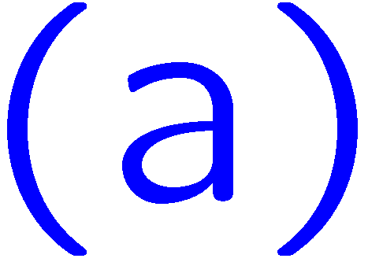
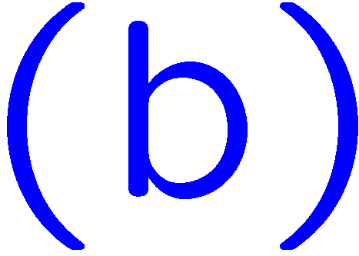
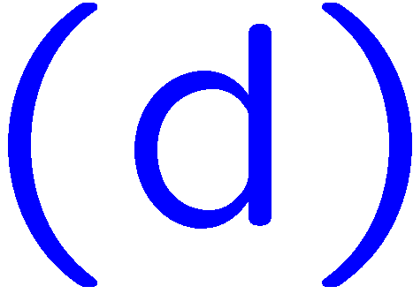
1+1=
1
2
3
4
1 | 2 | 3 | 4 | 5 | 6 | 7 | 8 | 9 | 10 | 11 | 12 | 13 | 14 | 15 | 16 | 17 | 18 | 19 | 20
21 | 22 | 23 | 24 | 25 | 26 | 27 | 28 | 29 | 30 | 31 | 32 | 33 | 34 | 35 | 36 | 37 | 38 | 39 | 40
0 of 5

Slide 3
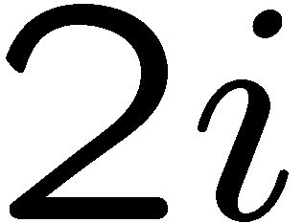
1+1=
1
2
3
4
1 | 2 | 3 | 4 | 5 | 6 | 7 | 8 | 9 | 10 | 11 | 12 | 13 | 14 | 15 | 16 | 17 | 18 | 19 | 20
21 | 22 | 23 | 24 | 25 | 26 | 27 | 28 | 29 | 30 | 31 | 32 | 33 | 34 | 35 | 36 | 37 | 38 | 39 | 40
0 of 5

Slide 4
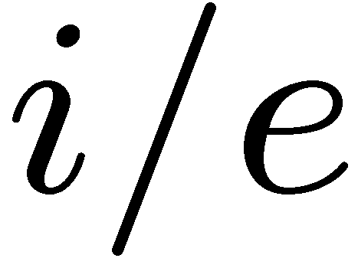
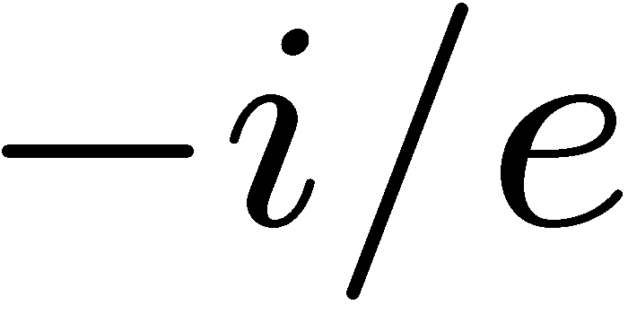
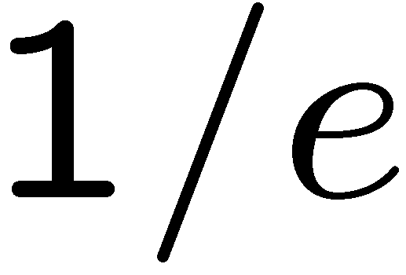
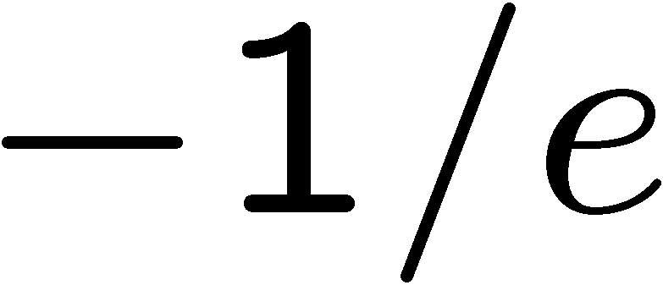
1+1=
1
2
3
4
1 | 2 | 3 | 4 | 5 | 6 | 7 | 8 | 9 | 10 | 11 | 12 | 13 | 14 | 15 | 16 | 17 | 18 | 19 | 20
21 | 22 | 23 | 24 | 25 | 26 | 27 | 28 | 29 | 30 | 31 | 32 | 33 | 34 | 35 | 36 | 37 | 38 | 39 | 40
0 of 5

Slide 5
1+1=
1
2
3
4
1 | 2 | 3 | 4 | 5 | 6 | 7 | 8 | 9 | 10 | 11 | 12 | 13 | 14 | 15 | 16 | 17 | 18 | 19 | 20
21 | 22 | 23 | 24 | 25 | 26 | 27 | 28 | 29 | 30 | 31 | 32 | 33 | 34 | 35 | 36 | 37 | 38 | 39 | 40
0 of 5

Slide 6
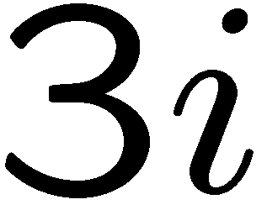
1+1=
1
2
3
4
1 | 2 | 3 | 4 | 5 | 6 | 7 | 8 | 9 | 10 | 11 | 12 | 13 | 14 | 15 | 16 | 17 | 18 | 19 | 20
21 | 22 | 23 | 24 | 25 | 26 | 27 | 28 | 29 | 30 | 31 | 32 | 33 | 34 | 35 | 36 | 37 | 38 | 39 | 40
0 of 5

Slide 7
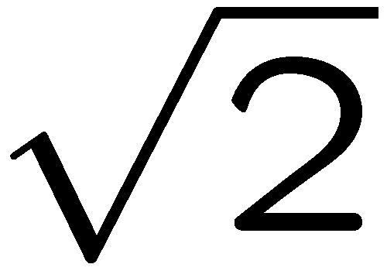
1+1=
1
2
3
4
1 | 2 | 3 | 4 | 5 | 6 | 7 | 8 | 9 | 10 | 11 | 12 | 13 | 14 | 15 | 16 | 17 | 18 | 19 | 20
21 | 22 | 23 | 24 | 25 | 26 | 27 | 28 | 29 | 30 | 31 | 32 | 33 | 34 | 35 | 36 | 37 | 38 | 39 | 40
0 of 5

Slide 8
1+1=
1
2
3
4
1 | 2 | 3 | 4 | 5 | 6 | 7 | 8 | 9 | 10 | 11 | 12 | 13 | 14 | 15 | 16 | 17 | 18 | 19 | 20
21 | 22 | 23 | 24 | 25 | 26 | 27 | 28 | 29 | 30 | 31 | 32 | 33 | 34 | 35 | 36 | 37 | 38 | 39 | 40
0 of 5

Slide 9
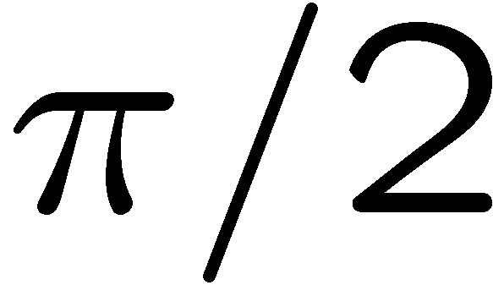
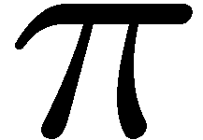
1+1=
1
2
3
4
1 | 2 | 3 | 4 | 5 | 6 | 7 | 8 | 9 | 10 | 11 | 12 | 13 | 14 | 15 | 16 | 17 | 18 | 19 | 20
21 | 22 | 23 | 24 | 25 | 26 | 27 | 28 | 29 | 30 | 31 | 32 | 33 | 34 | 35 | 36 | 37 | 38 | 39 | 40
0 of 5

Slide 10
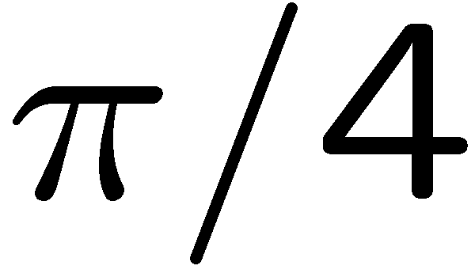
1+1=
1
2
3
4
1 | 2 | 3 | 4 | 5 | 6 | 7 | 8 | 9 | 10 | 11 | 12 | 13 | 14 | 15 | 16 | 17 | 18 | 19 | 20
21 | 22 | 23 | 24 | 25 | 26 | 27 | 28 | 29 | 30 | 31 | 32 | 33 | 34 | 35 | 36 | 37 | 38 | 39 | 40
0 of 5

Slide 11
1+1=
1
2
3
4
0 of 5

Slide 12
1+1=
1
2
3
4
0 of 5

Slide 13
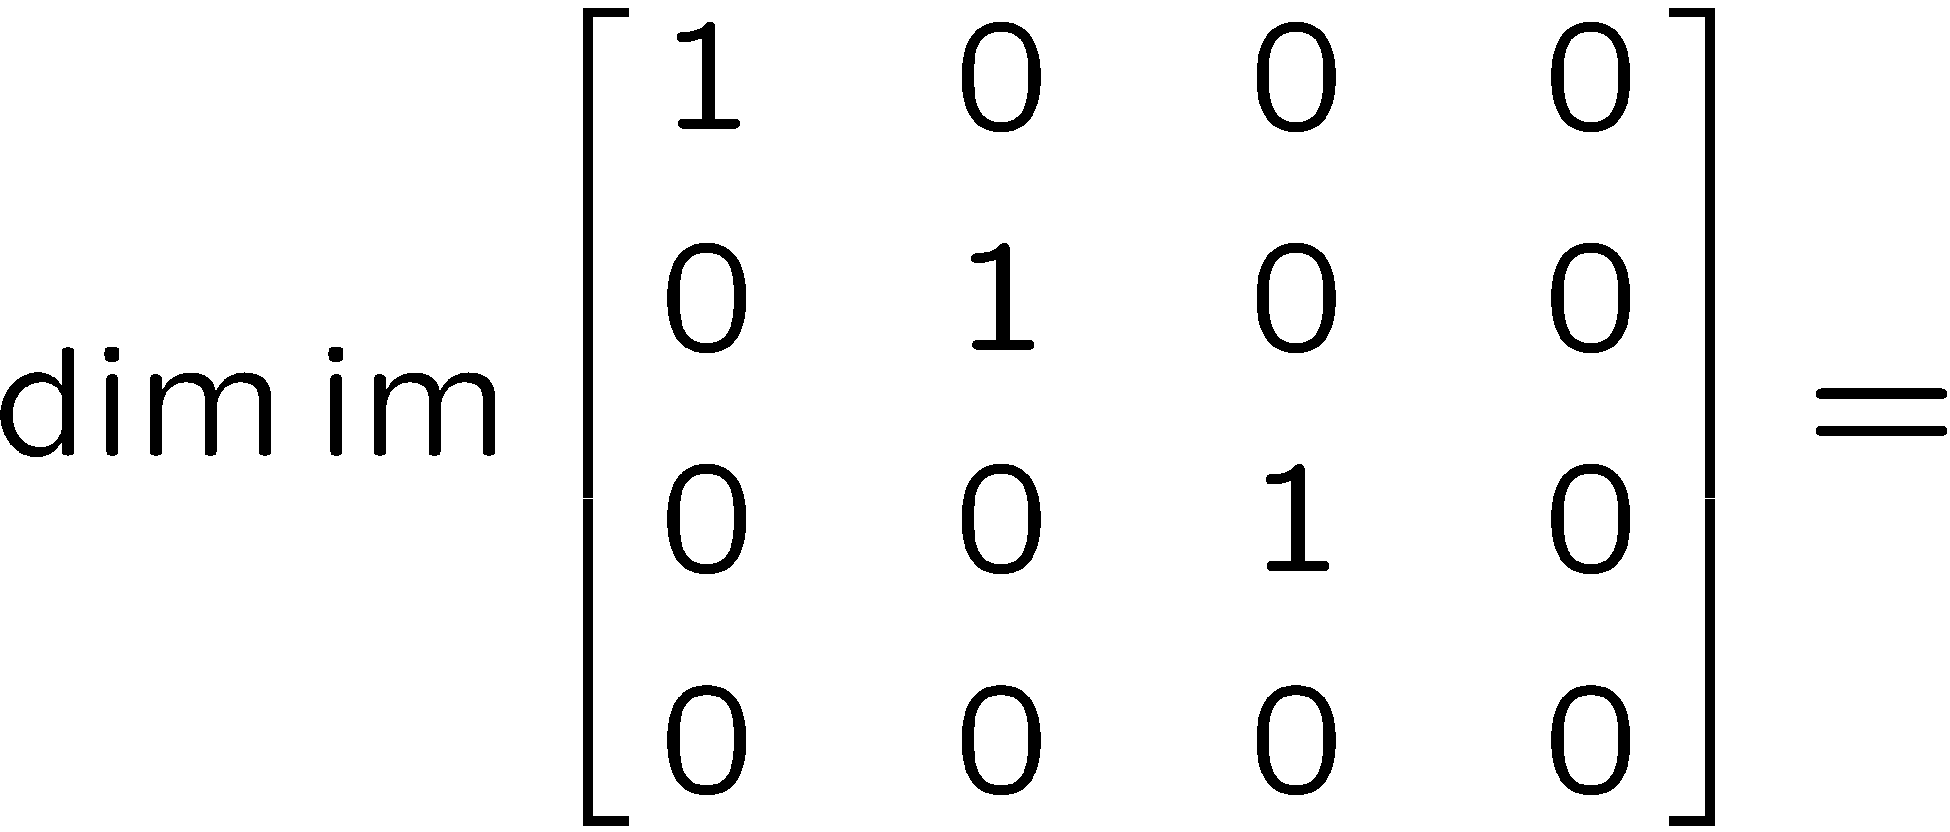
1+1=
1
2
3
4
0 of 5

Slide 14
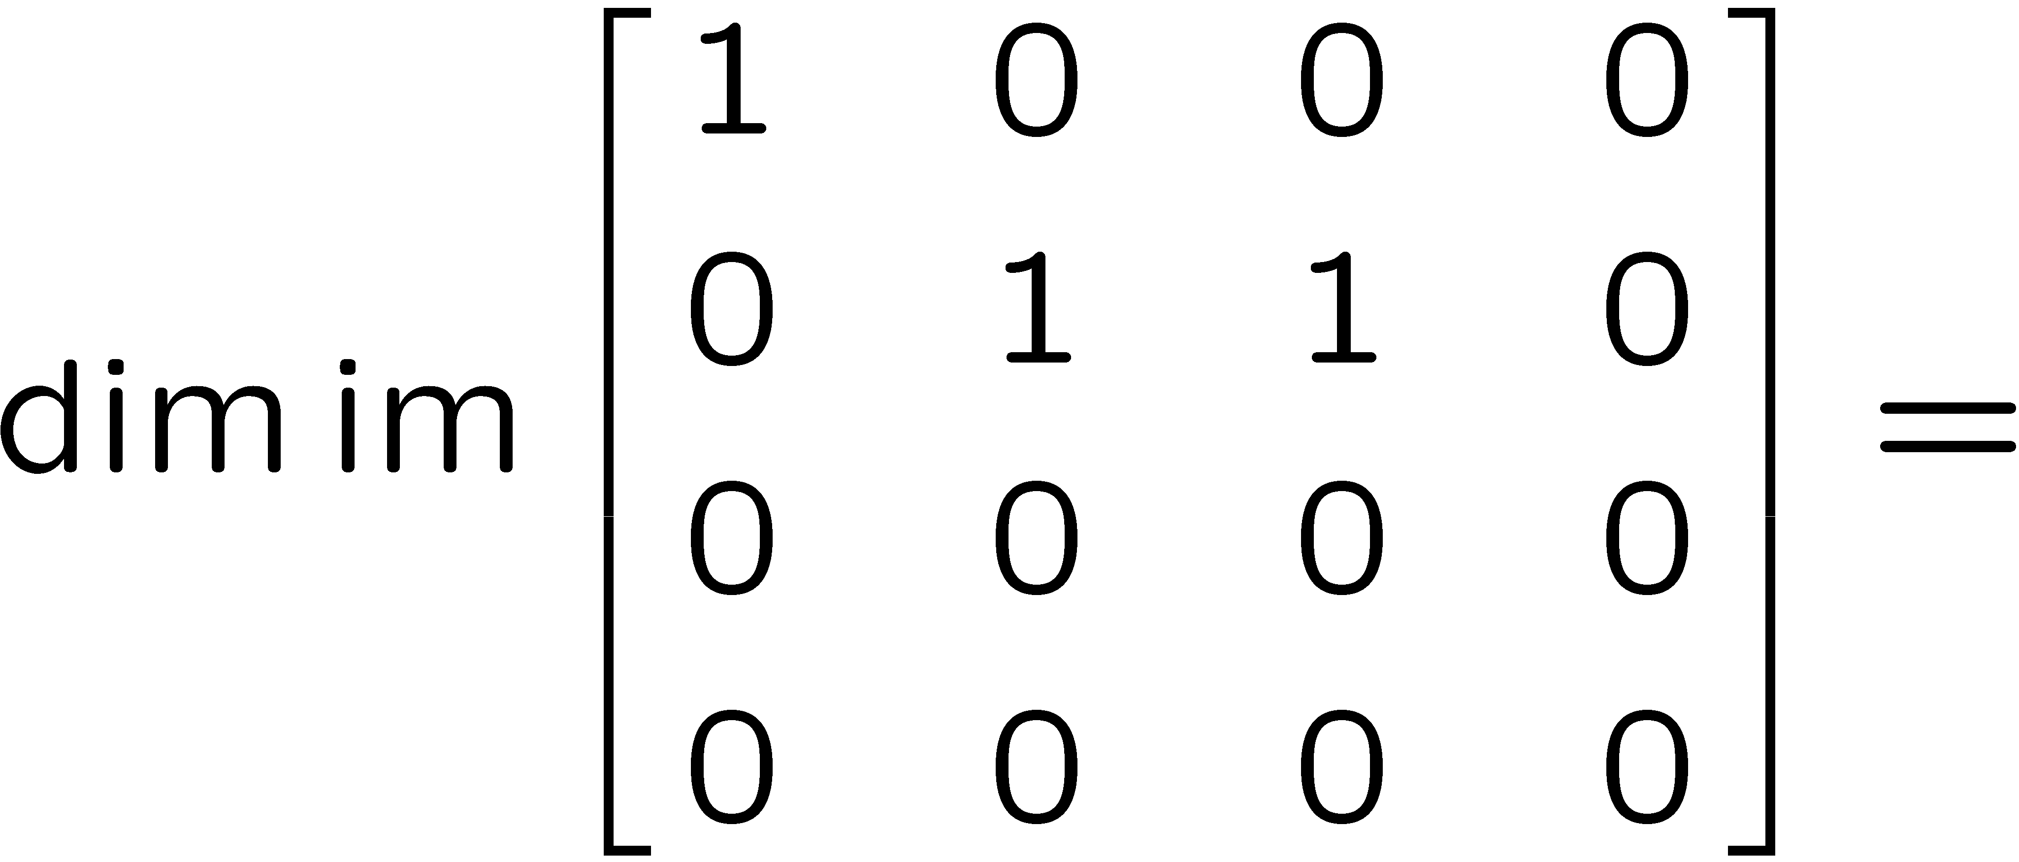
1+1=
1
2
3
4
0 of 5

Slide 15
1+1=
1
2
3
4
0 of 5

Slide 16
1+1=
1
2
3
4
0 of 5

Slide 17
1+1=
1
2
3
4
0 of 5

Slide 18
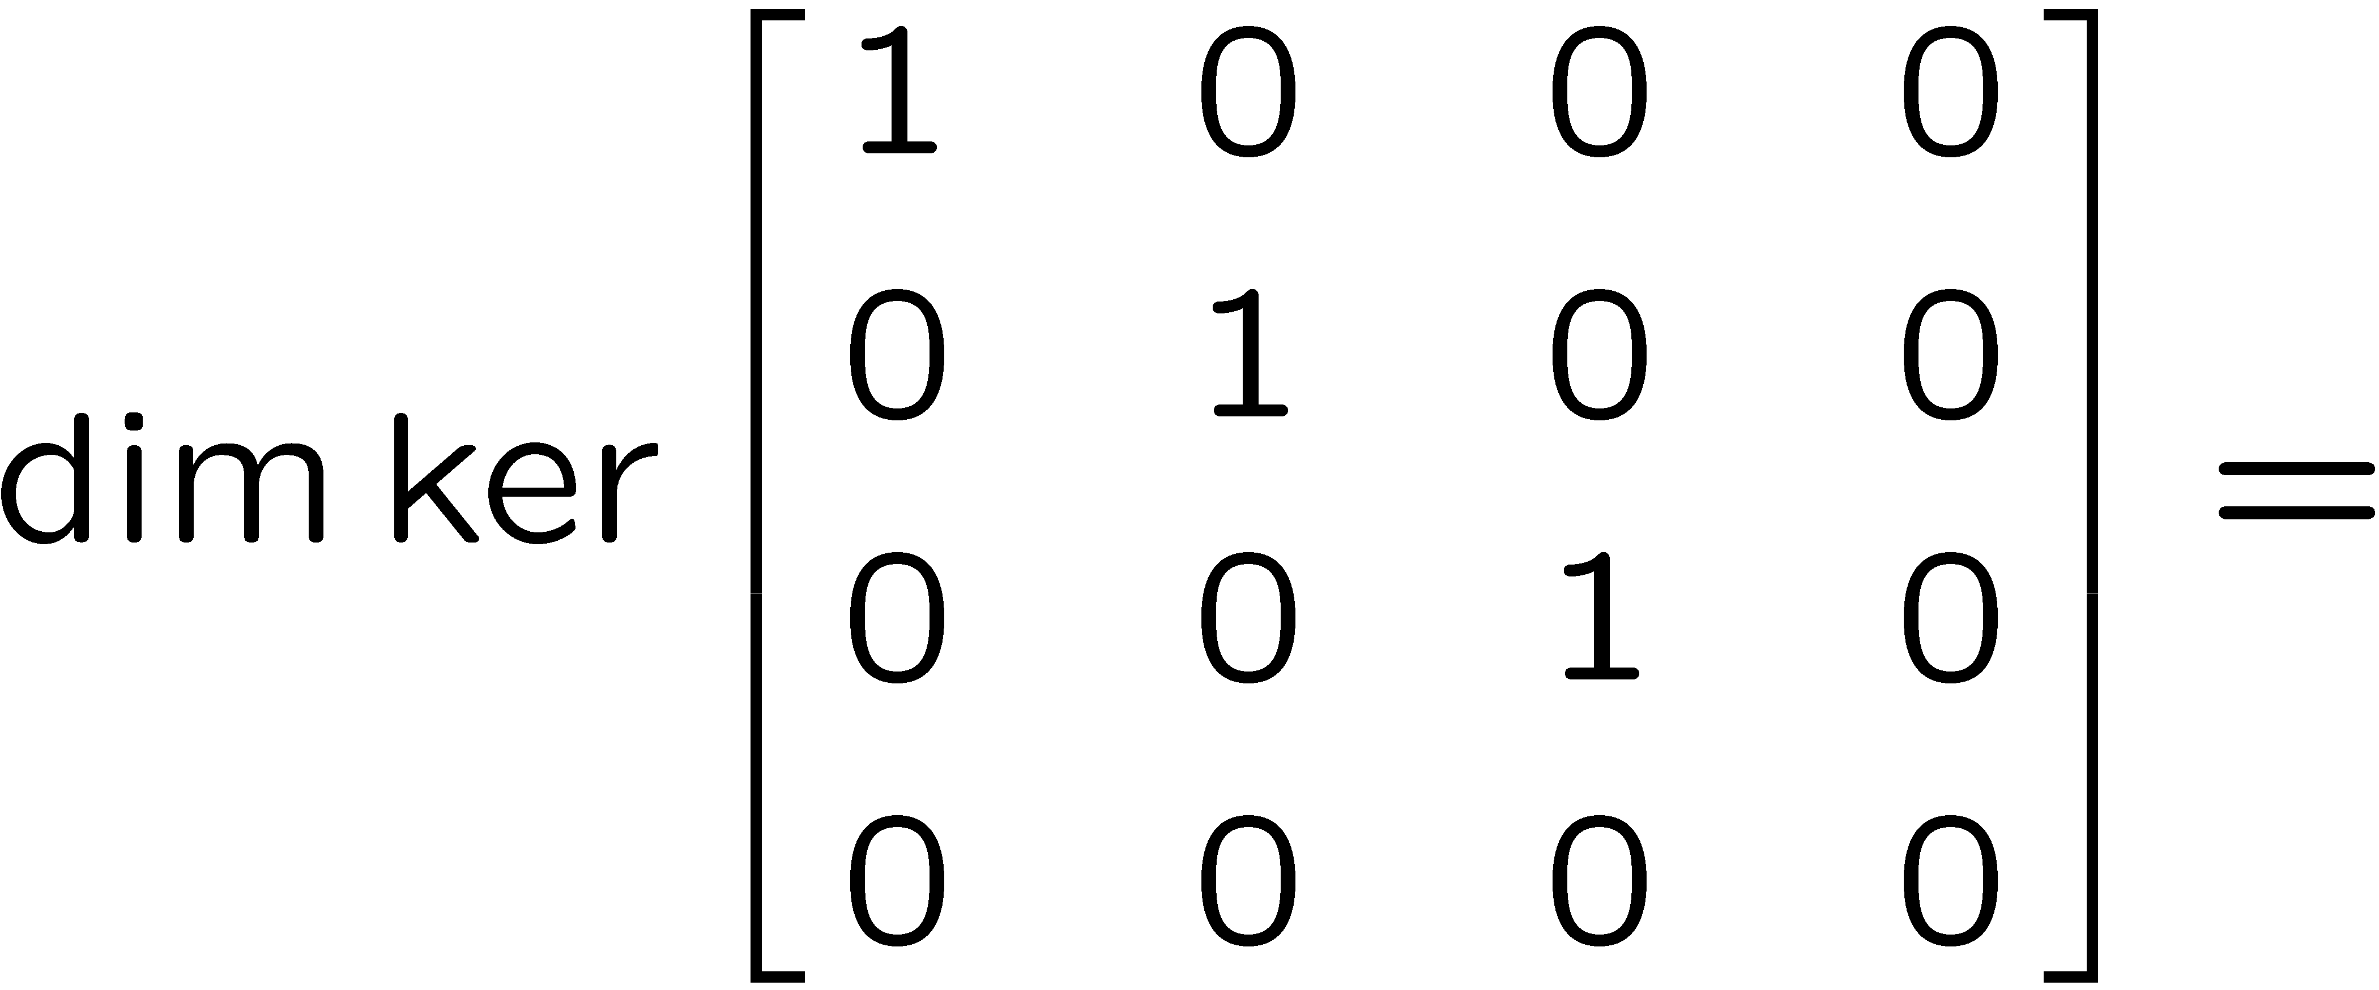
1+1=
1
2
3
4
0 of 5

Slide 19
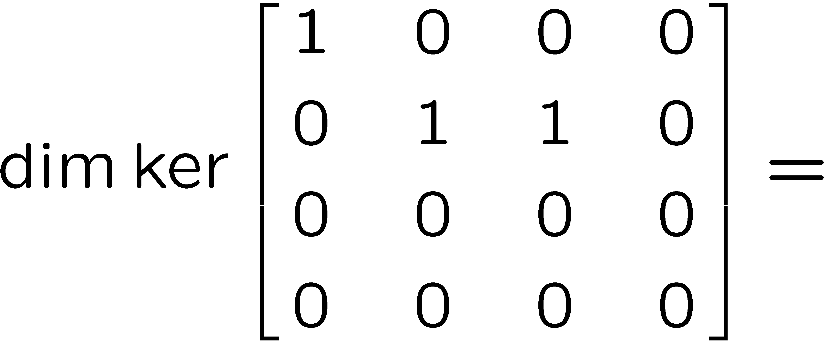
1+1=
1
2
3
4
0 of 5

Slide 20
1+1=
1
2
3
4
0 of 5

Slide 21
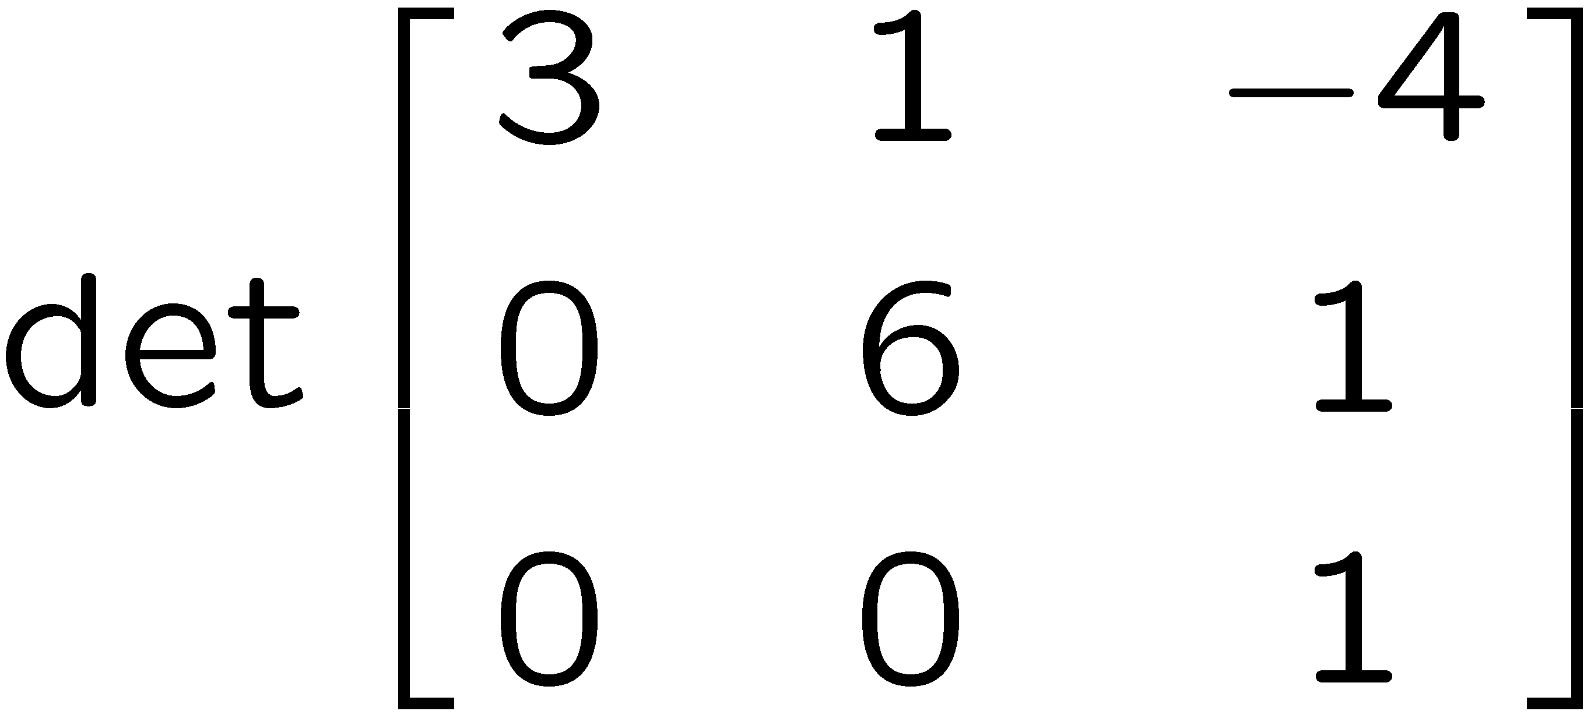
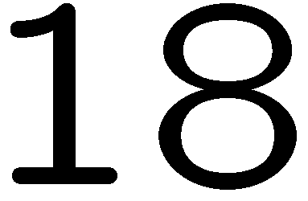
1+1=
1
2
3
4
0 of 5

Slide 22
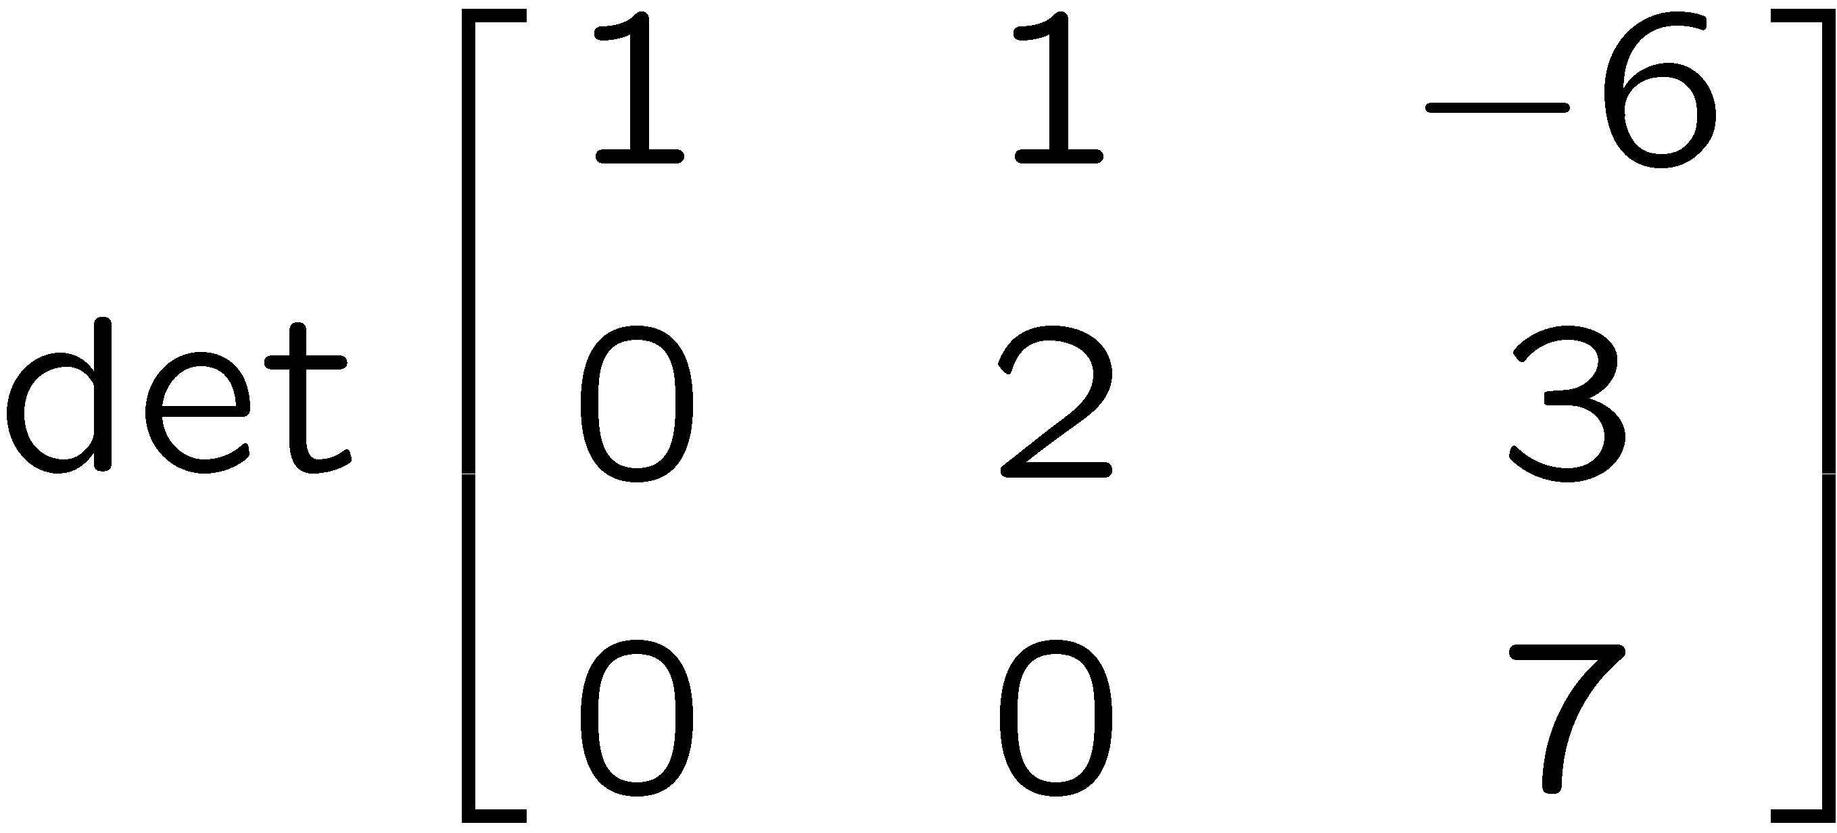
1+1=
1
2
3
4
0 of 5

Slide 23
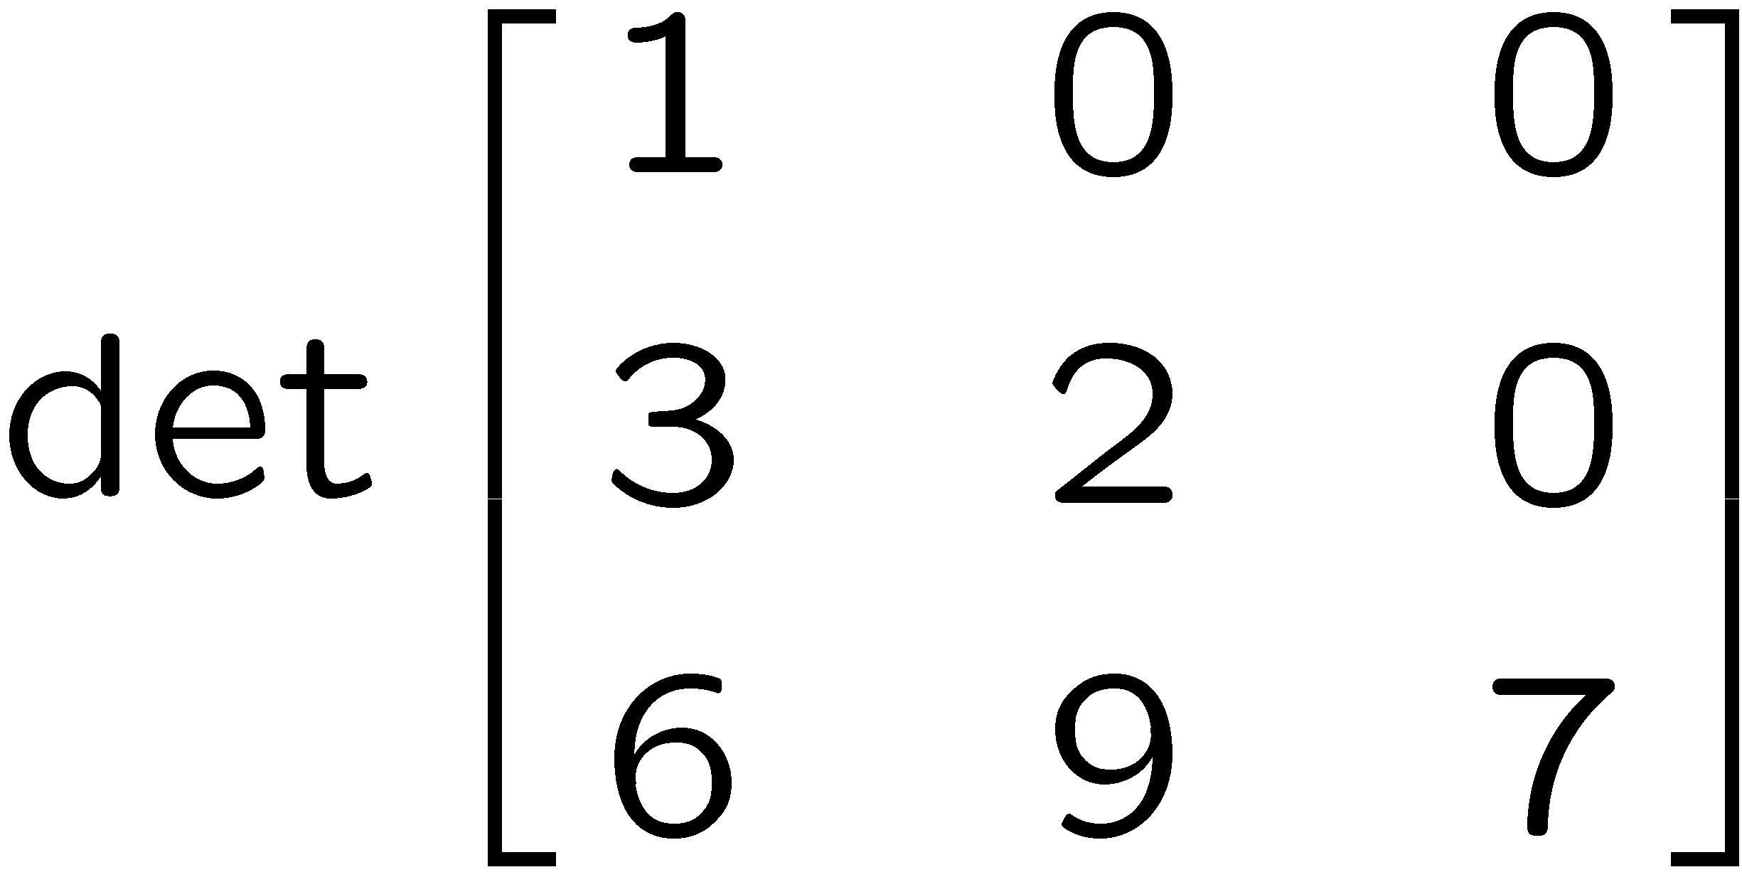
1+1=
1
2
3
4
0 of 5

Slide 24
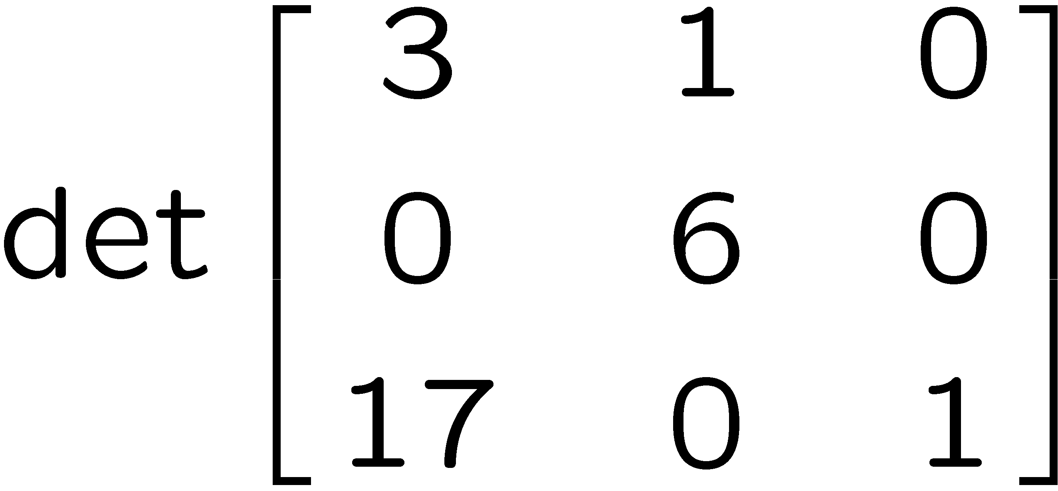
1+1=
1
2
3
4
0 of 5

Slide 25
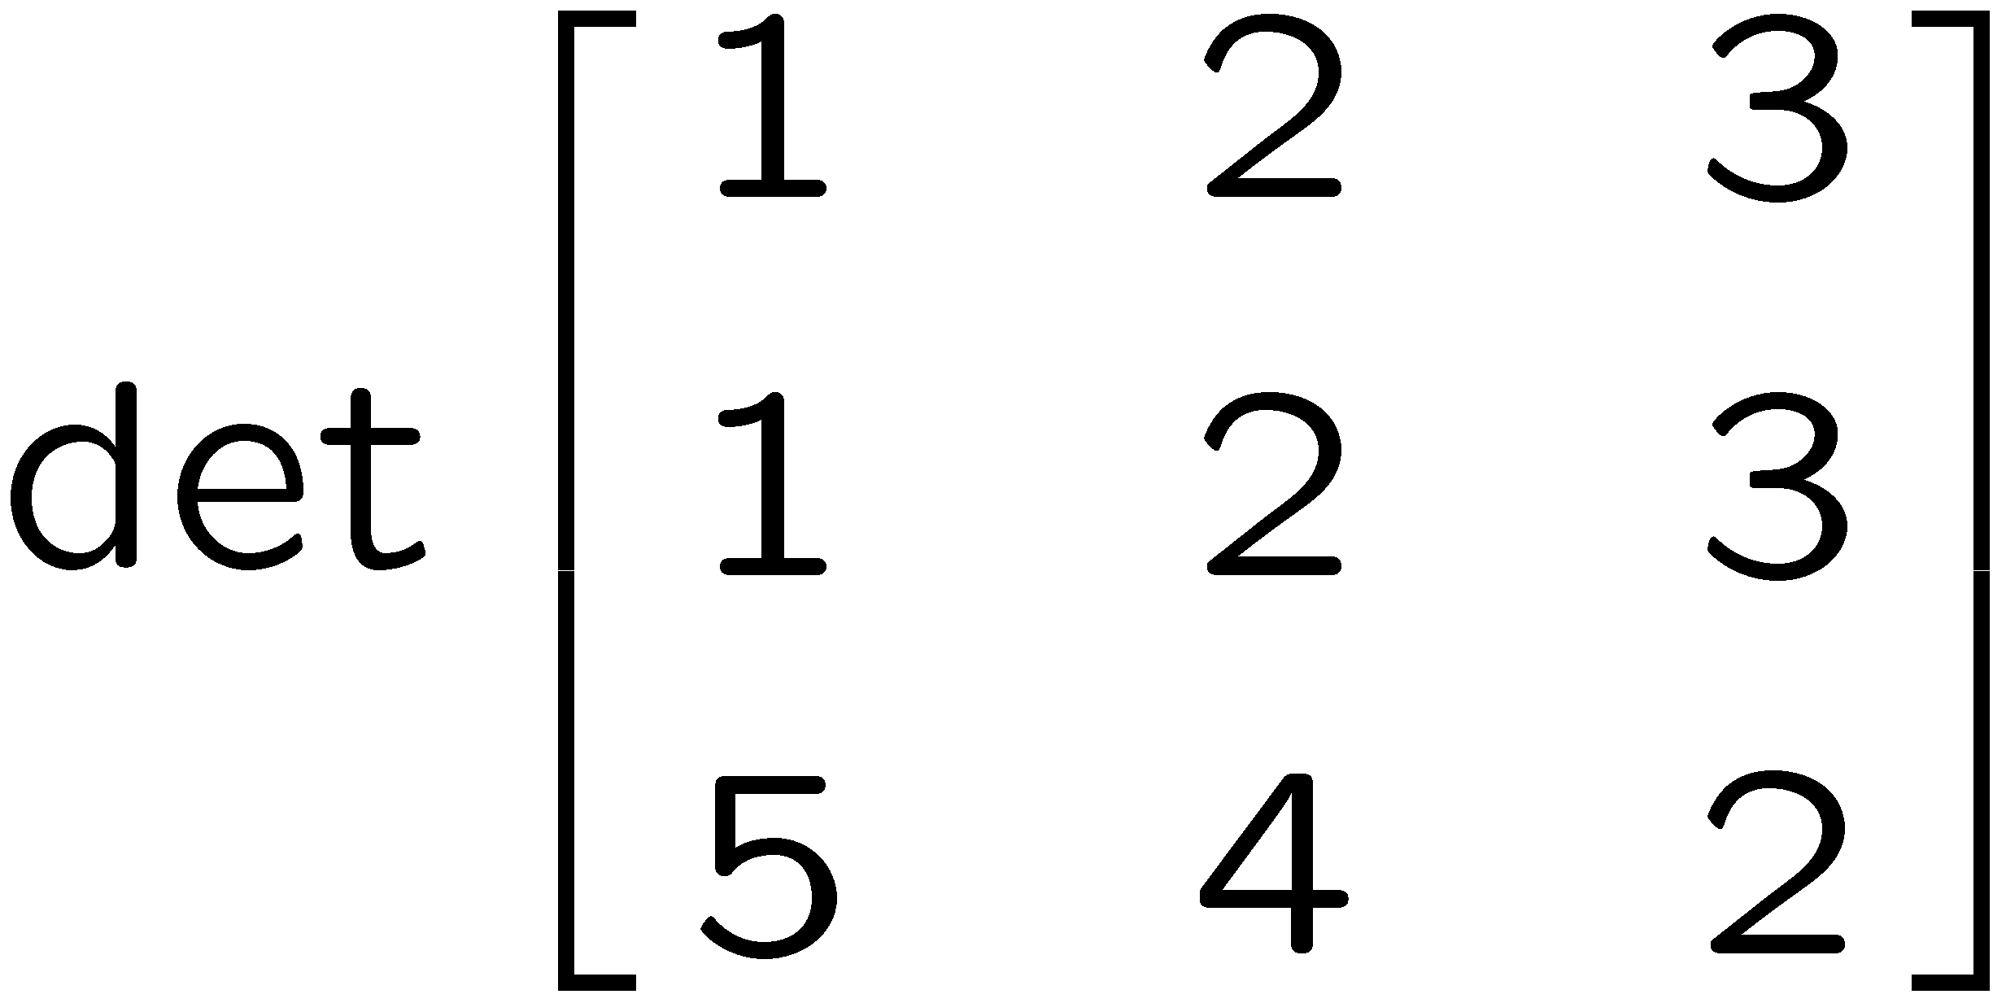
1+1=
1
2
3
4
0 of 5

Slide 26
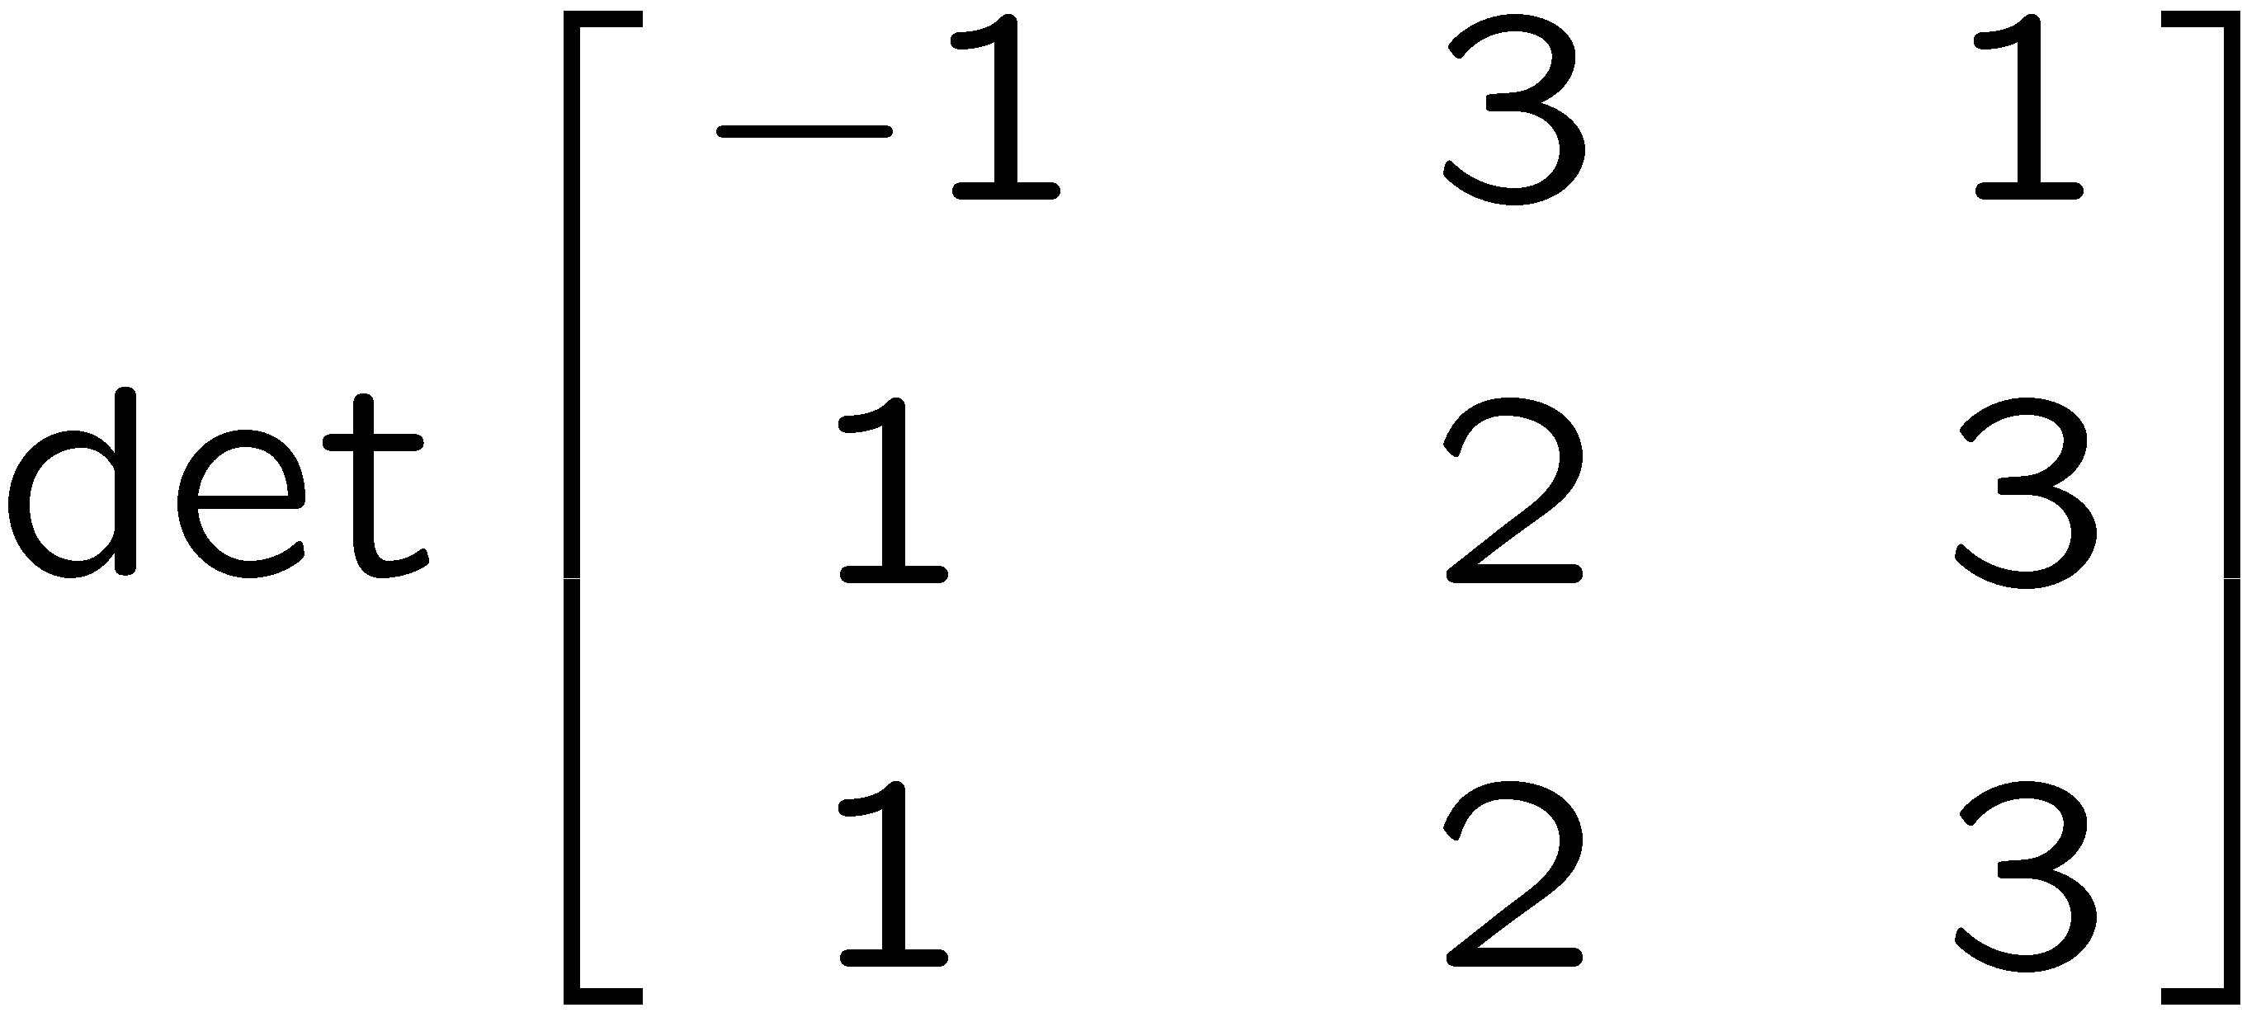
1+1=
1
2
3
4
0 of 5

Slide 27
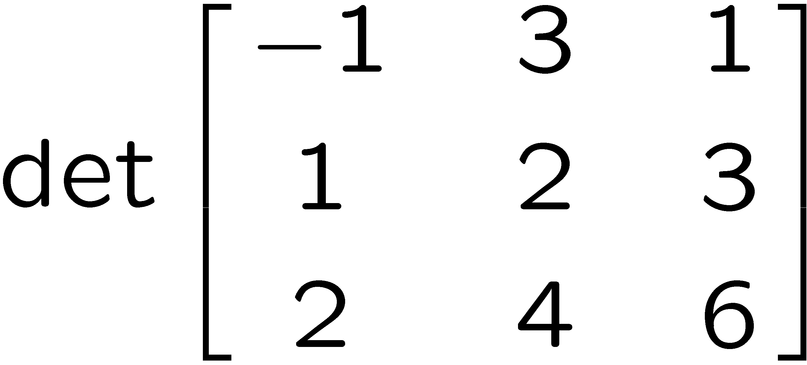
1+1=
1
2
3
4
0 of 5

Slide 28
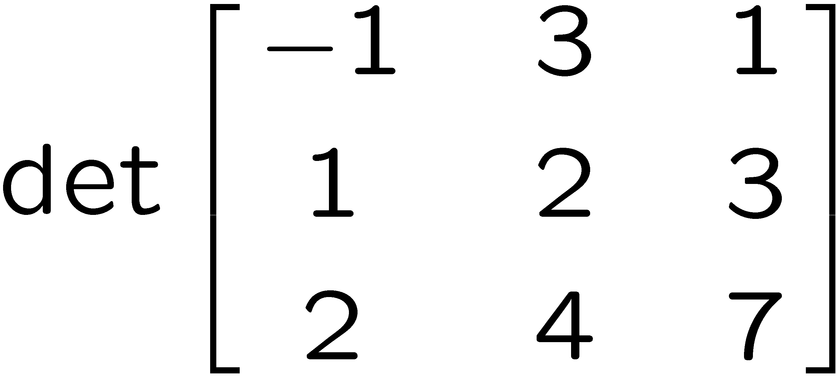
1+1=
1
2
3
4
0 of 5

Slide 29
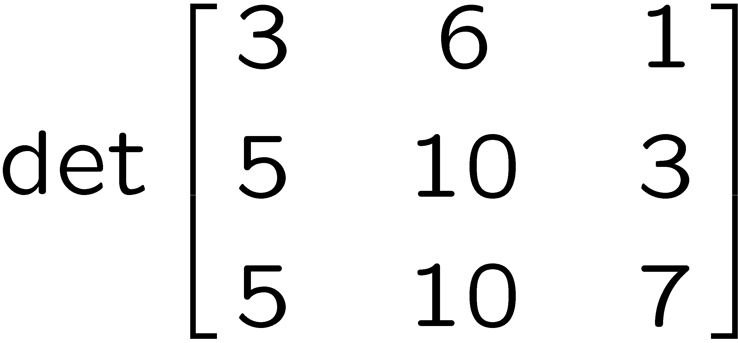
1+1=
1
2
3
4
0 of 5

Slide 30
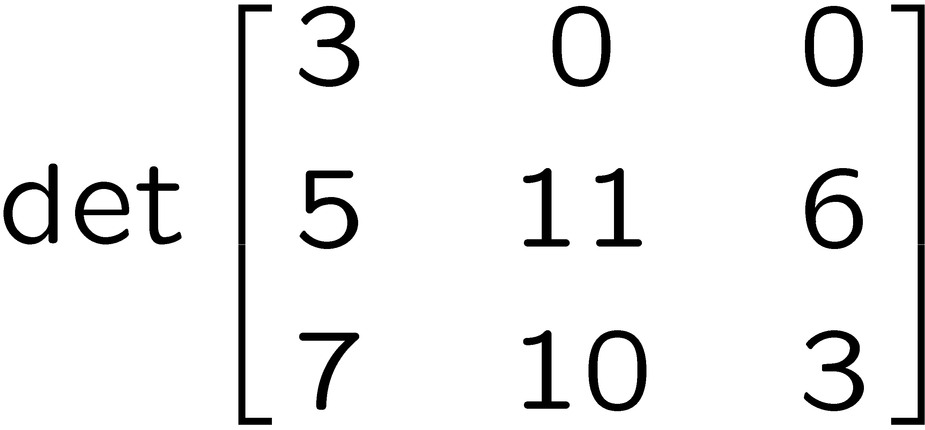
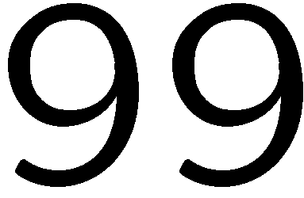
1+1=
1
2
3
4
0 of 5

Slide 31
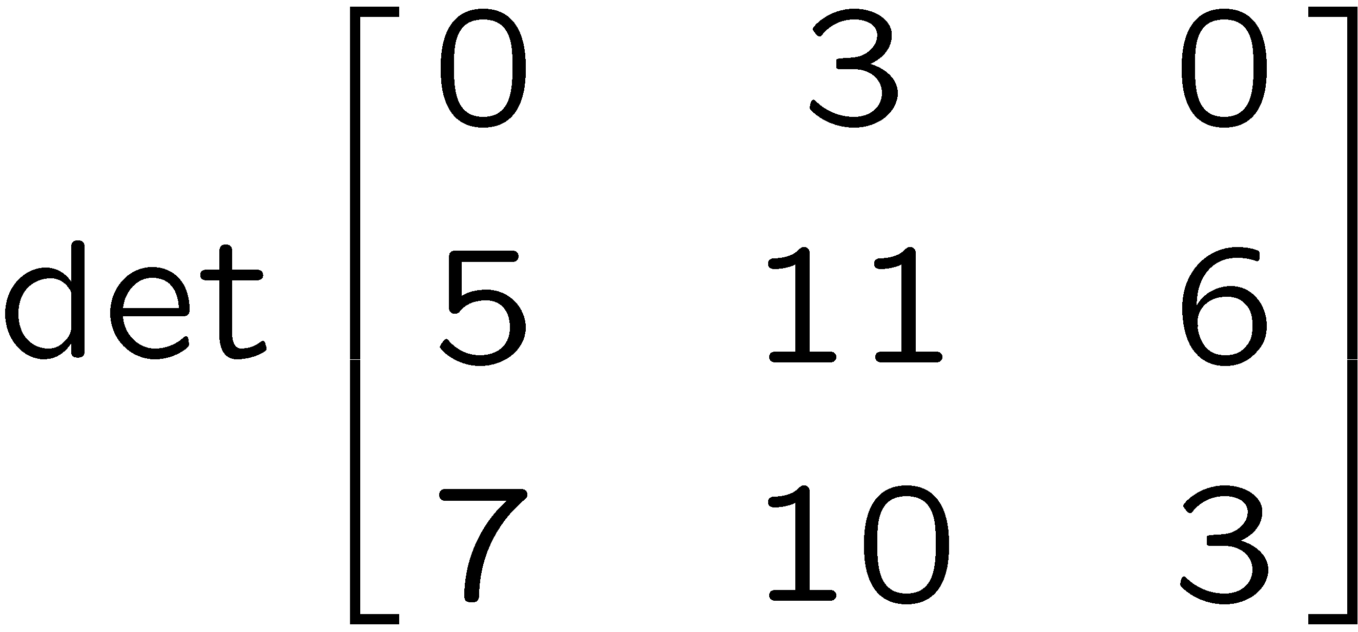
1+1=
1
2
3
4
0 of 5

Slide 32
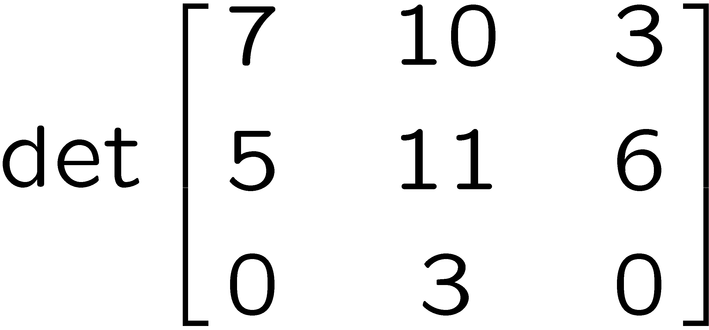
1+1=
1
2
3
4
0 of 5

Slide 33
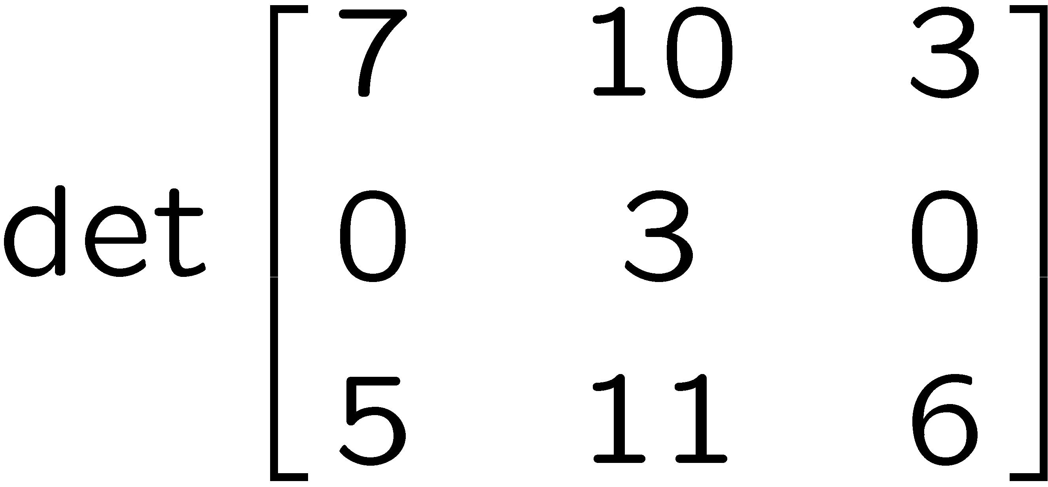
1+1=
1
2
3
4
0 of 5

Slide 34
1+1=
1
2
3
4
0 of 5

Slide 35
1+1=
1
2
3
4
0 of 5

Slide 36
1+1=
1
2
3
4
0 of 5

Slide 37
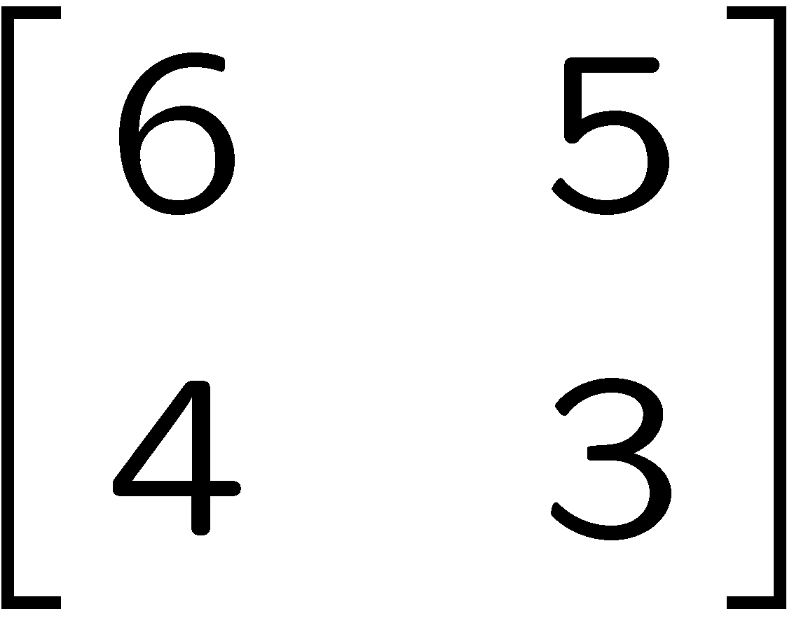
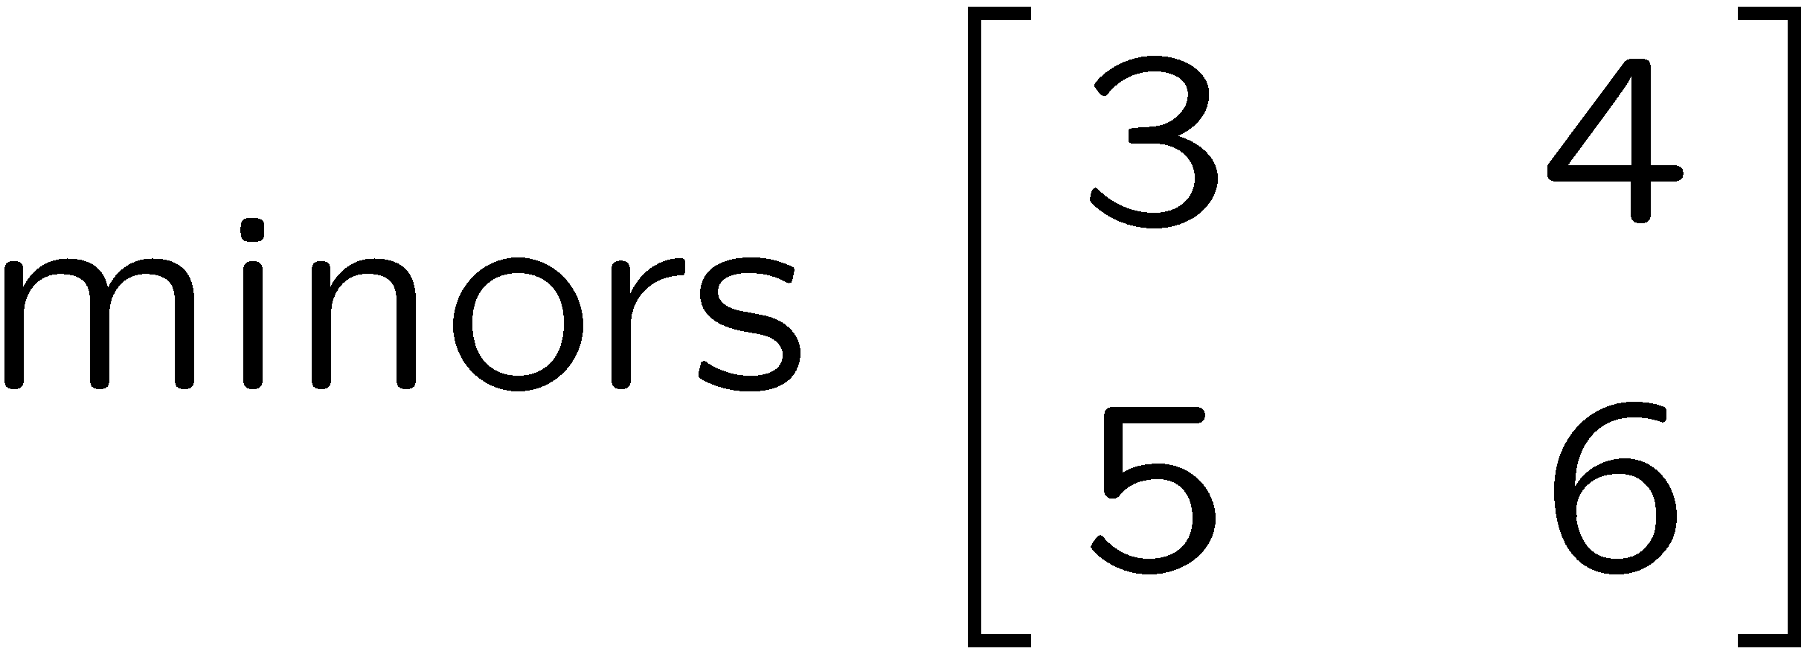
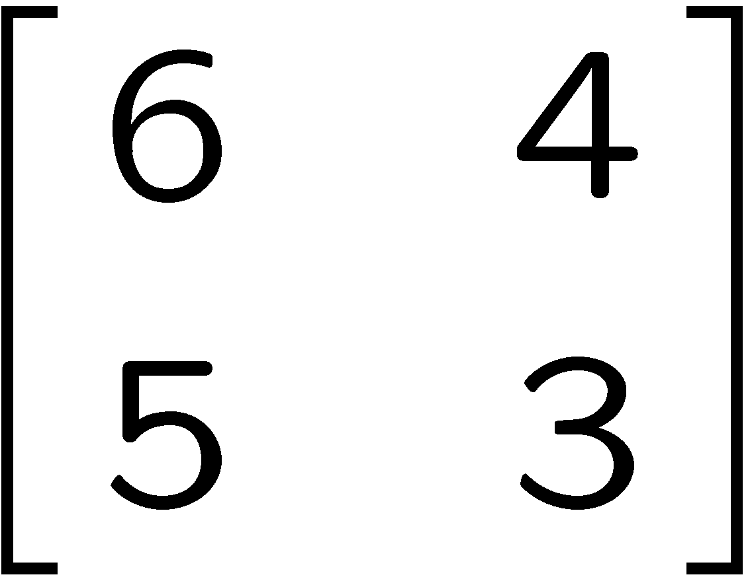
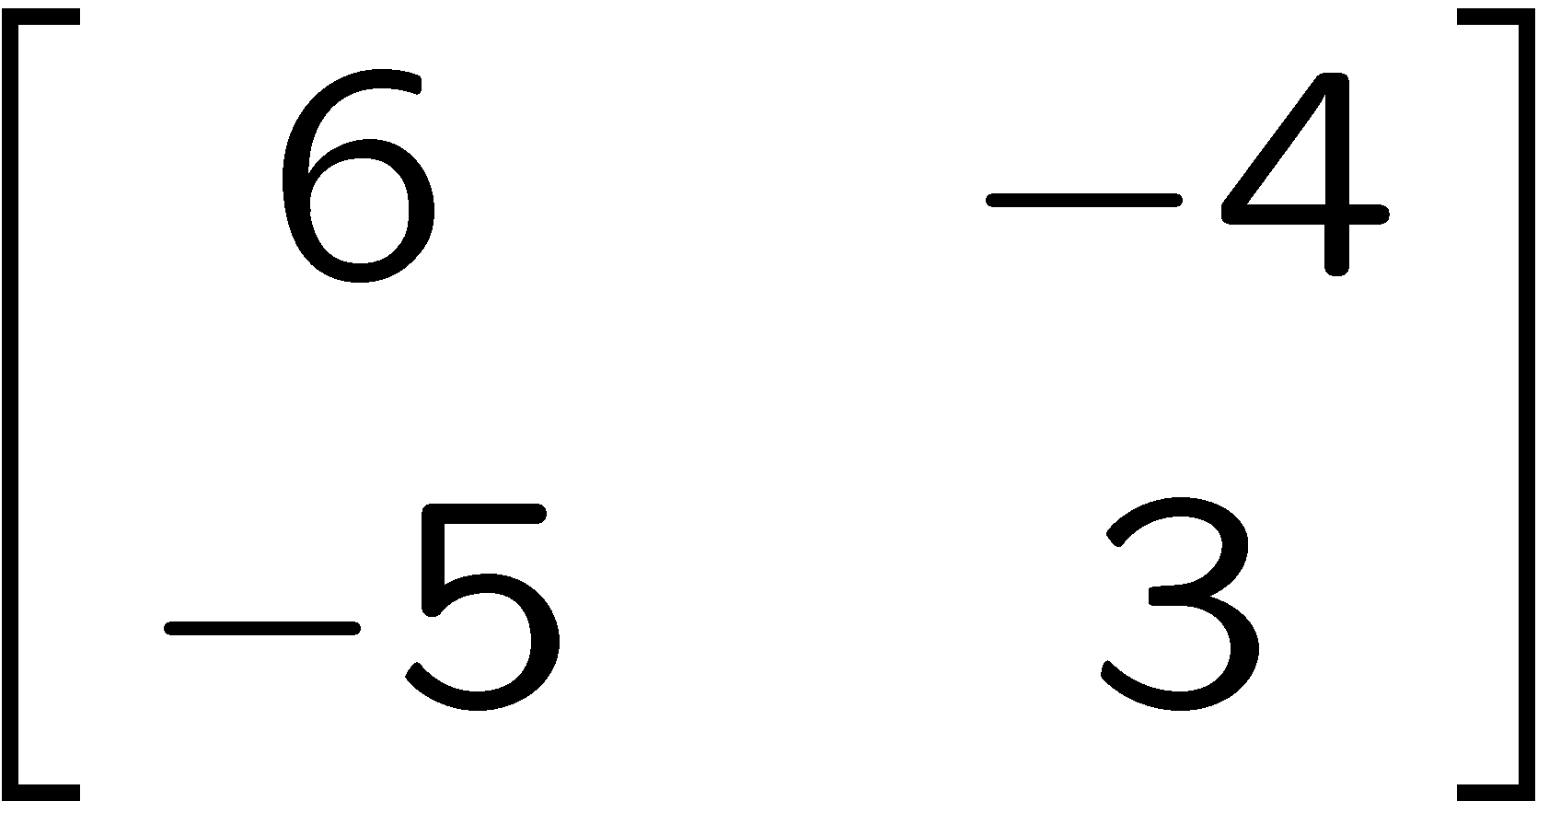
1+1=
1
2
3
4
0 of 5

Slide 38
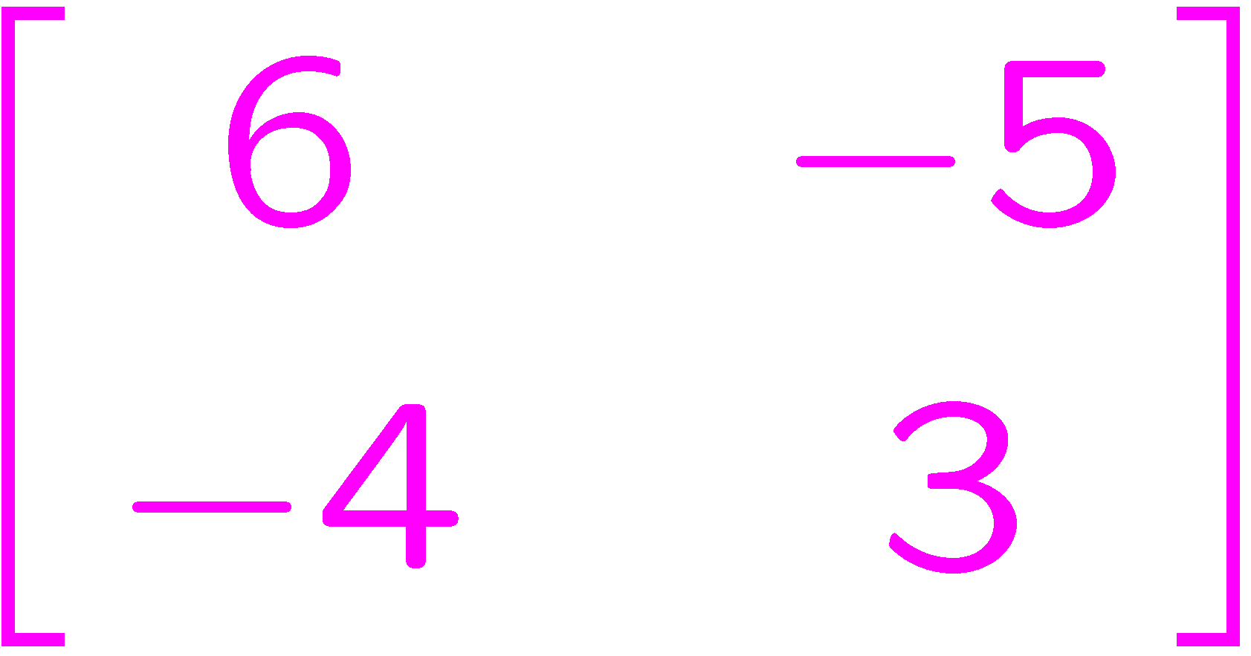
1+1=
1
2
3
4
0 of 5

Slide 39
1+1=
1
2
3
4
0 of 5

Slide 40
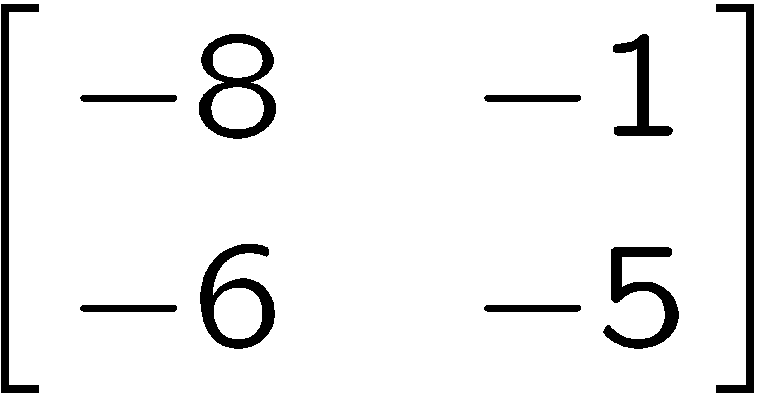
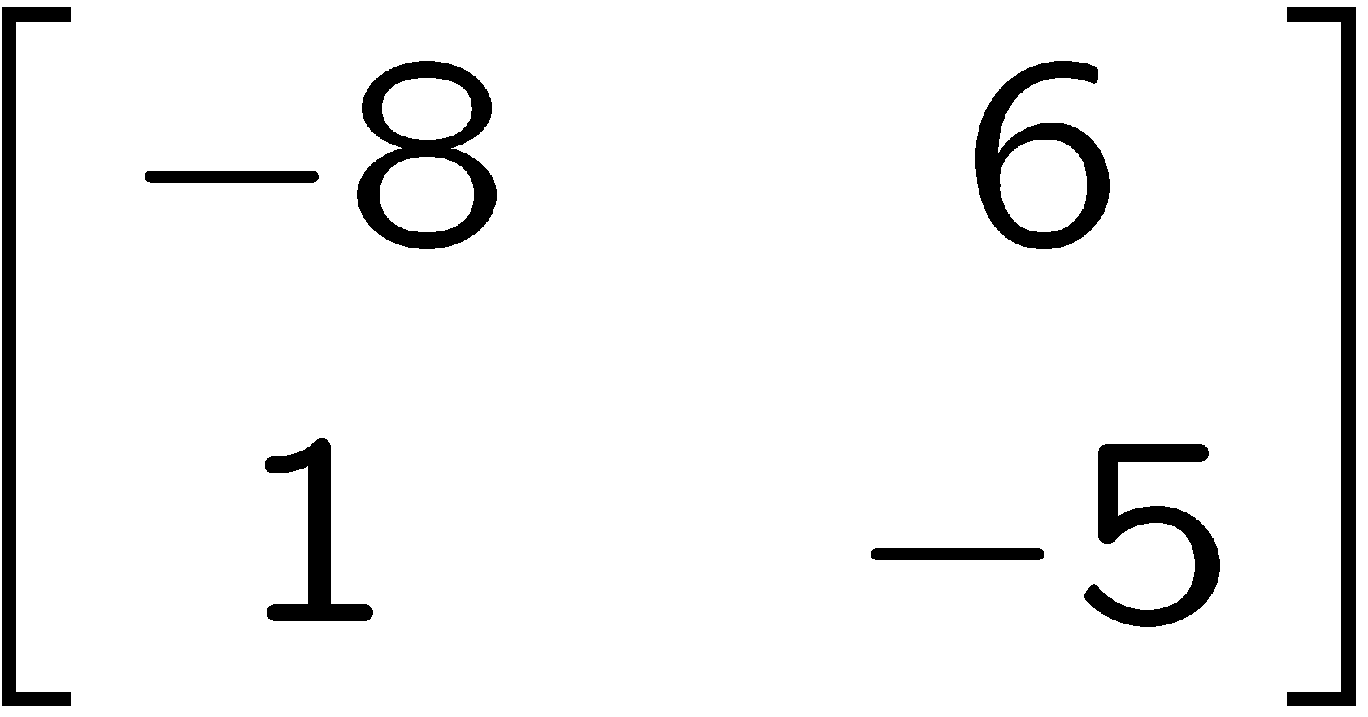
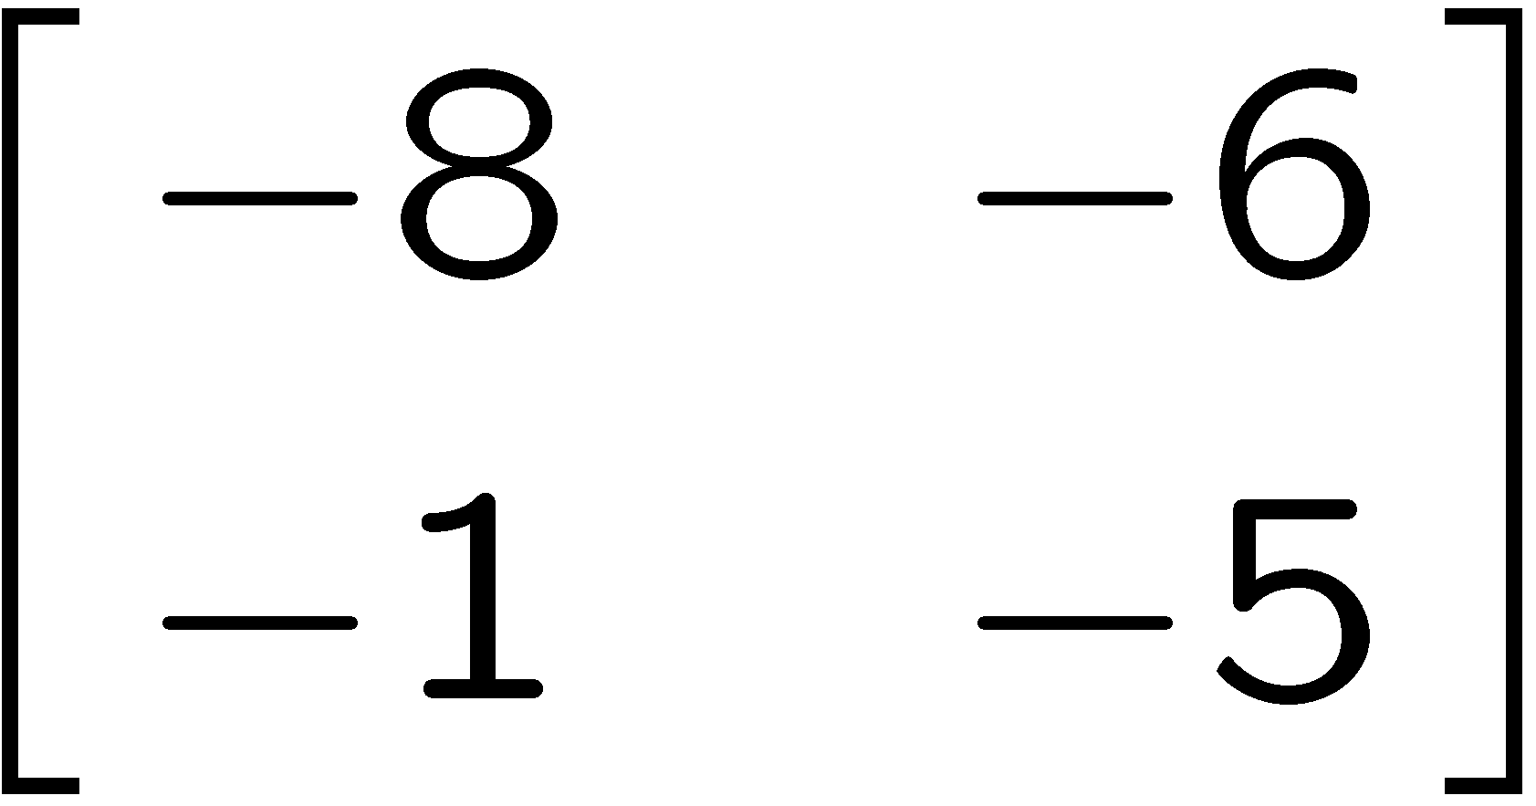
1+1=
1
2
3
4
0 of 5

Slide 41
1+1=
1
2
3
4
0 of 5

Slide 42
1+1=
1
2
3
4
0 of 5

Slide 43
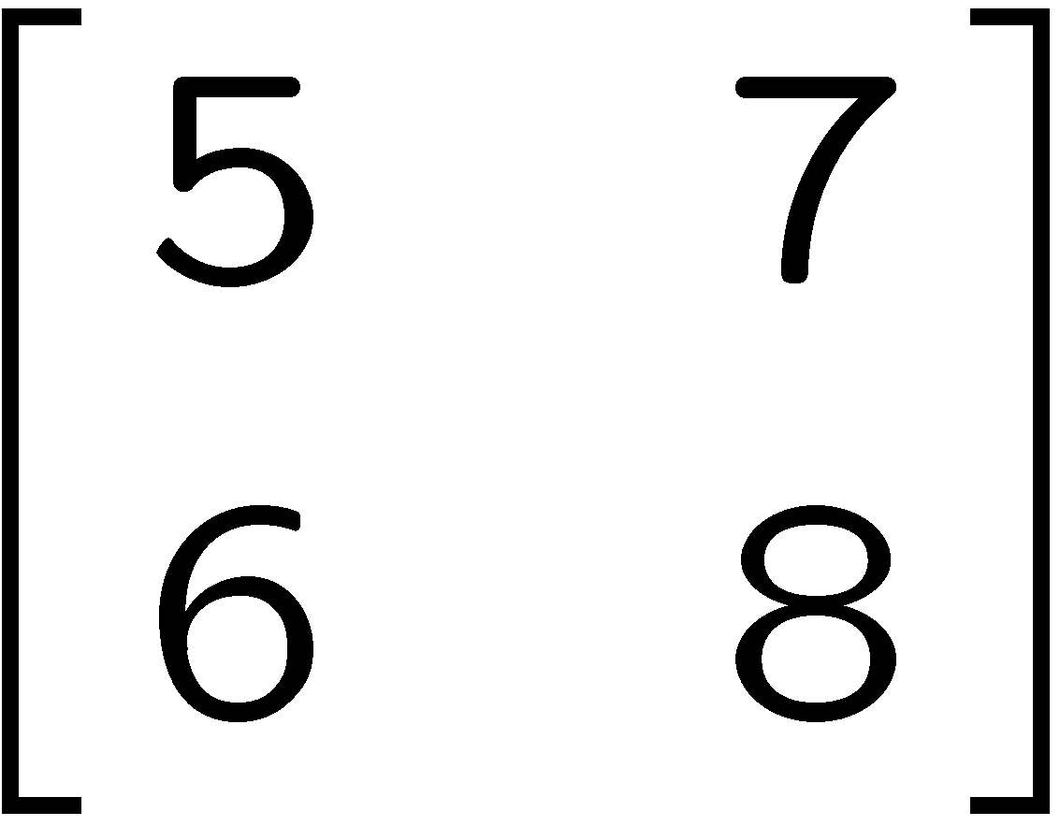
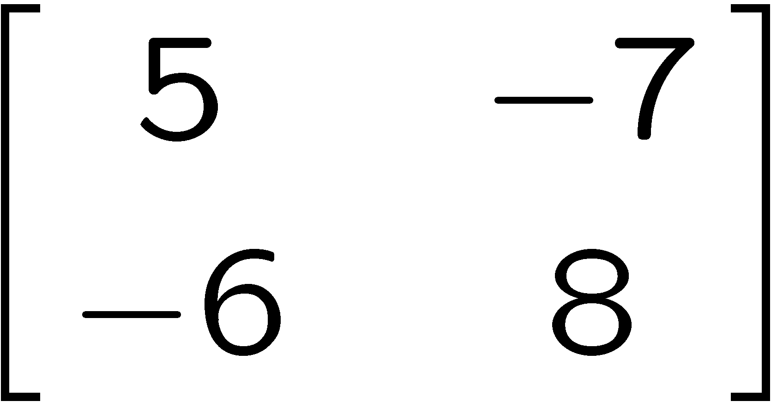
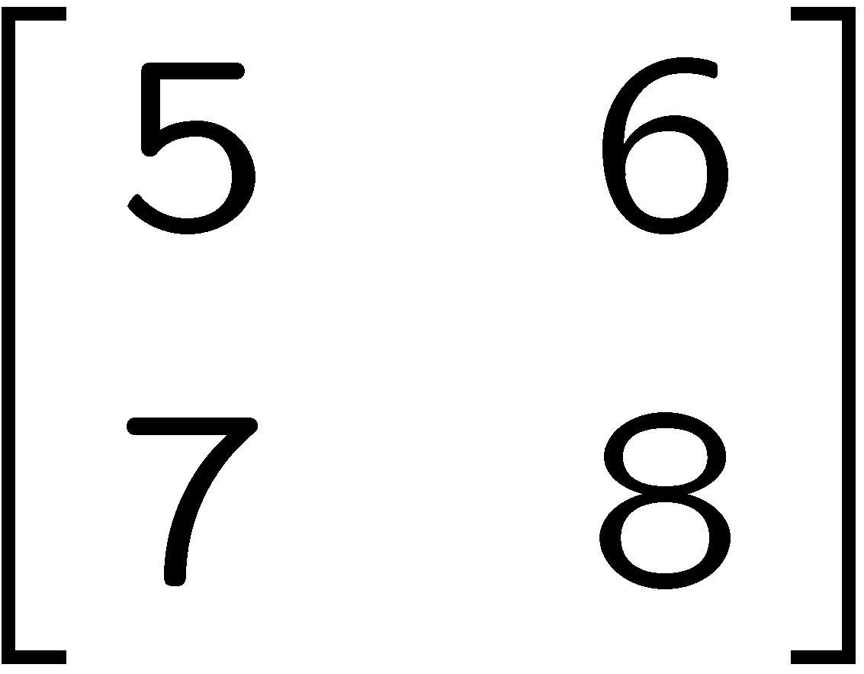
1+1=
1
2
3
4
0 of 5

Slide 44
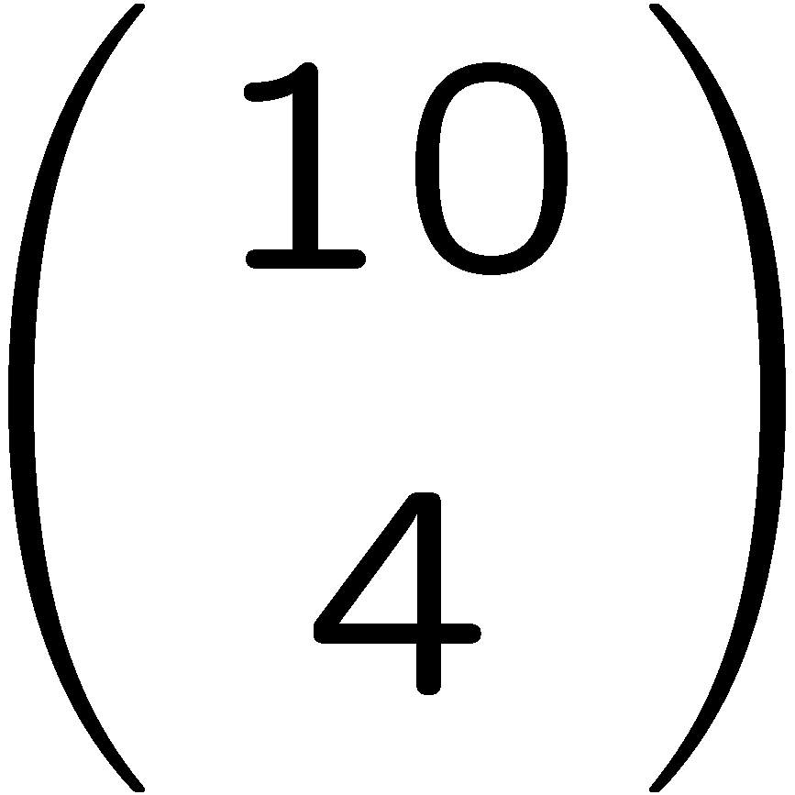
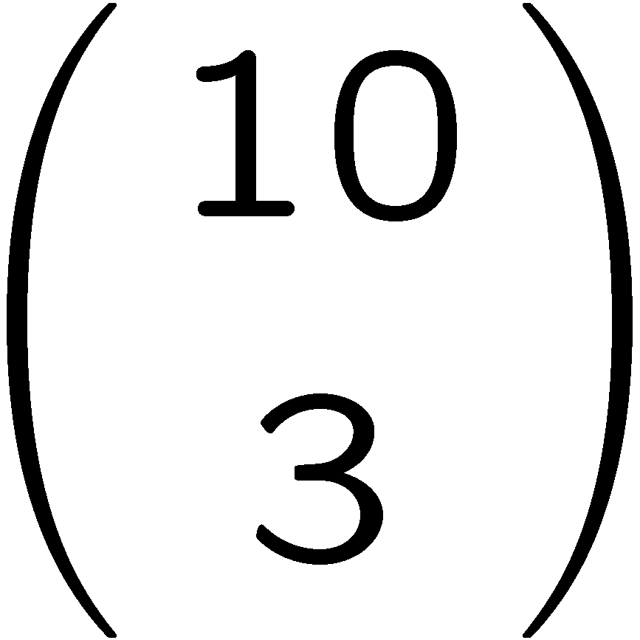
1+1=
1
2
3
4
0 of 5

Slide 45
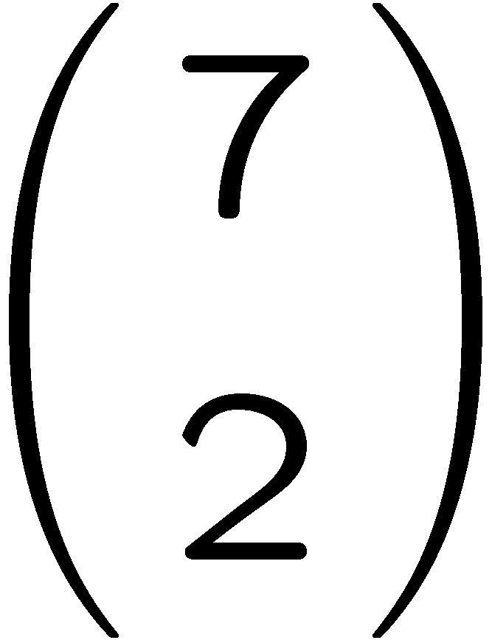
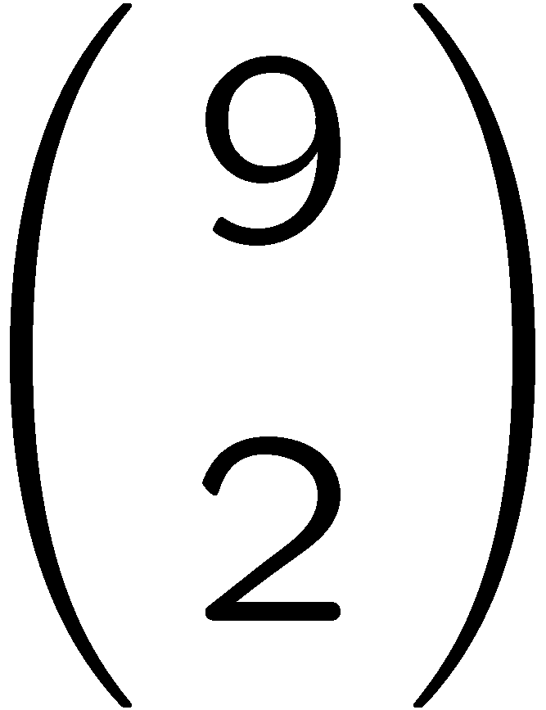
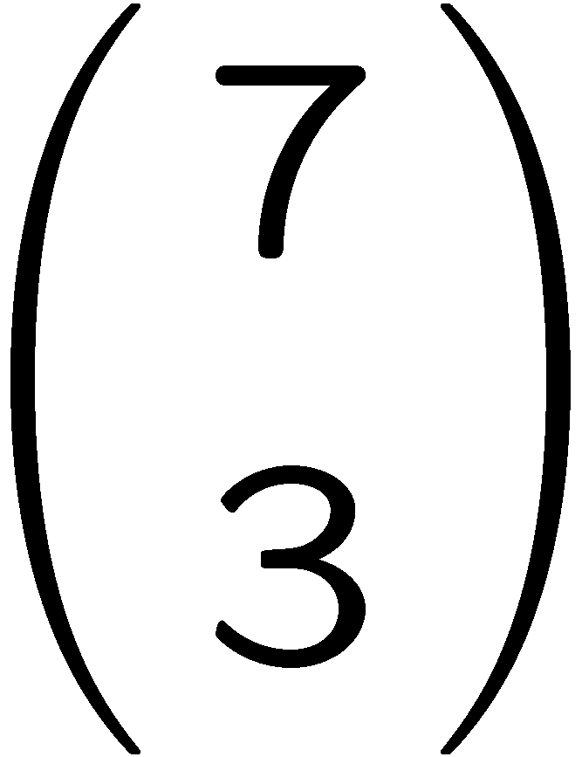
1+1=
1
2
3
4
0 of 5

Slide 46
1+1=
1
2
3
4
0 of 5

Slide 47
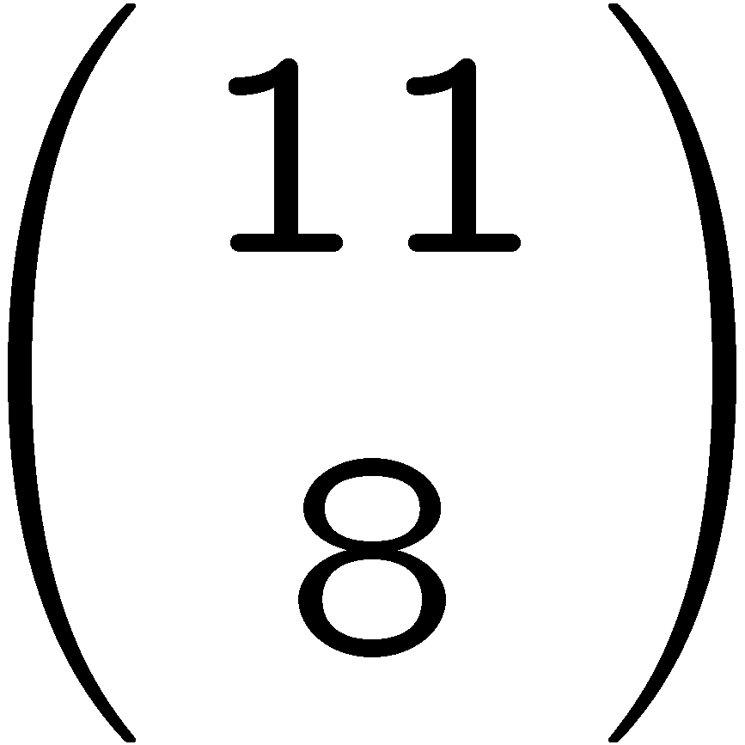
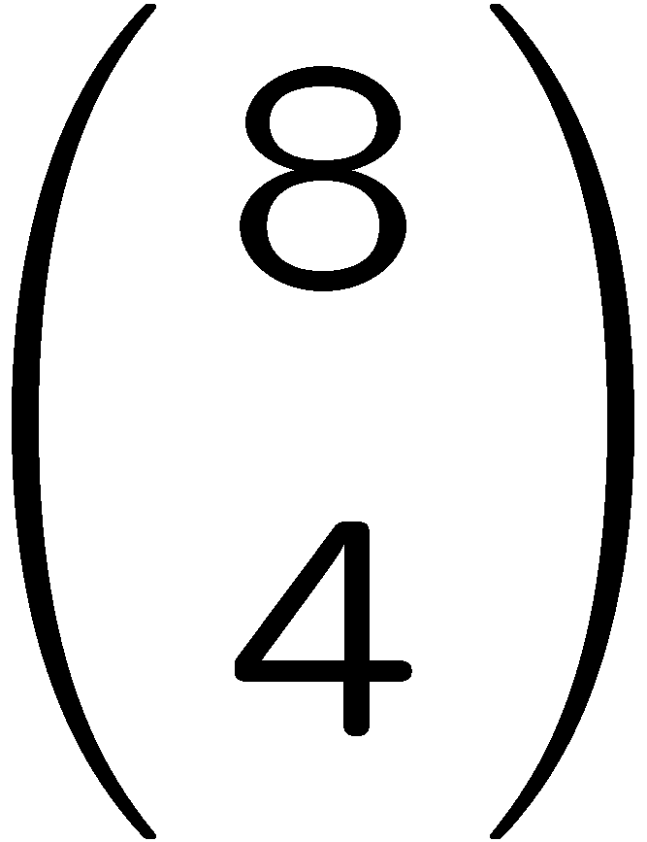
1+1=
1
2
3
4
0 of 5

Slide 48
1+1=
1
2
3
4
0 of 5

Slide 49
1+1=
1
2
3
4
0 of 5

Slide 50
1+1=
1
2
3
4
0 of 5

Slide 51
1+1=
1
2
3
4
0 of 5

Slide 52
1+1=
1
2
3
4
0 of 5

Slide 53
1+1=
1
2
3
4
0 of 5

Slide 54
1+1=
1
2
3
4
0 of 5

Slide 55
1+1=
1
2
3
4
0 of 5

Slide 56
1+1=
1
2
3
4
0 of 5

Slide 57
1+1=
1
2
3
4
0 of 5

Slide 58
1+1=
1
2
3
4
0 of 5

Slide 59
1+1=
1
2
3
4
0 of 5

Slide 60
1+1=
1
2
3
4
0 of 5

Slide 61
1+1=
1
2
3
4
0 of 5

Slide 62
1+1=
1
2
3
4
0 of 5

Slide 63
1+1=
1
2
3
4
0 of 5

Slide 64
1+1=
1
2
3
4
0 of 5

Slide 65
1+1=
1
2
3
4
0 of 5

Slide 66
1+1=
1
2
3
4
0 of 5

Slide 67
1+1=
1
2
3
4
0 of 5

Slide 68
1+1=
1
2
3
4
0 of 5

Slide 69
1+1=
1
2
3
4
0 of 5

Slide 70
1+1=
1
2
3
4
0 of 5

Slide 71
1+1=
1
2
3
4
0 of 5

Slide 72
1+1=
1
2
3
4
0 of 5

Slide 73
1+1=
1
2
3
4
0 of 5

Slide 74
Financial Mathematics
Regular review session, Final

