Slide 1
Financial Mathematics
Clicker review session B, Final

Slide 2
1+1=
1
2
3
4
0 of 5

Slide 3
1+1=
1
2
3
4
0 of 5

Slide 4
1+1=
1
2
3
4
0 of 5

Slide 5
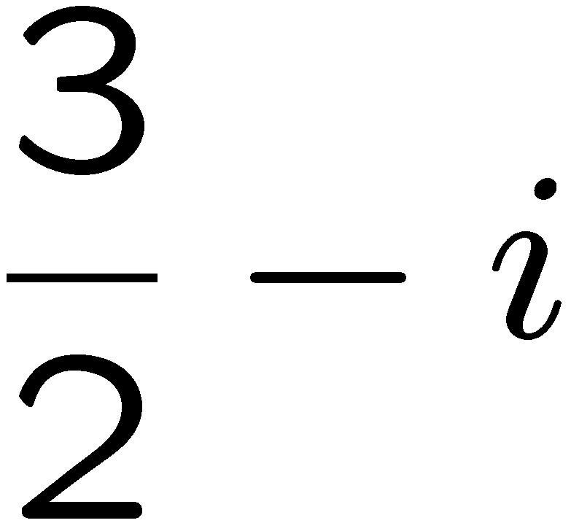
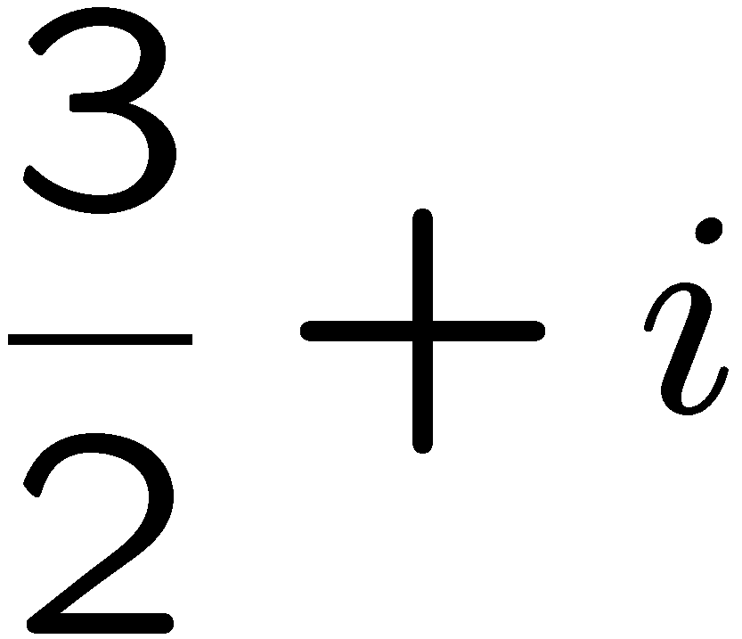
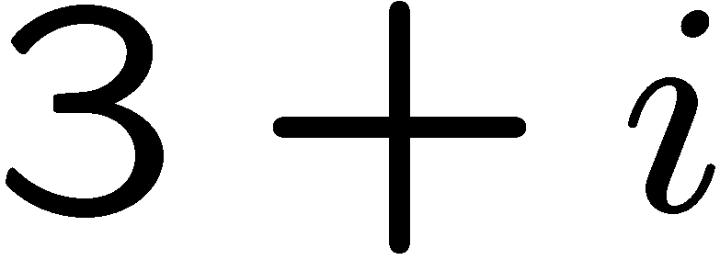
1+1=
1
2
3
4
0 of 5

Slide 6
xxx
a
b
c
d
0 of 5

Slide 7
xxx
a
b
c
d
0 of 5

Slide 8
xxx
a
b
c
d
0 of 5

Slide 9
xxx
a
b
c
d
0 of 5

Slide 10
xxx
a
b
c
d
0 of 5

Slide 11
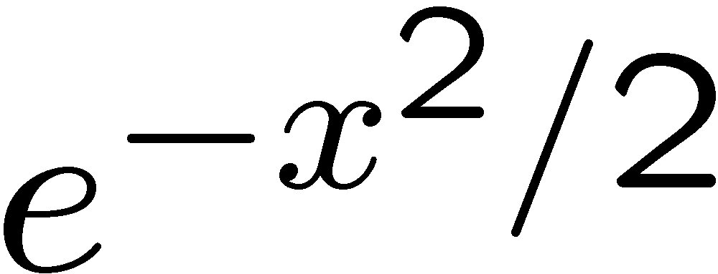
1+1=
1
2
3
4
0 of 5

Slide 12
1+1=
1
2
3
4
0 of 5

Slide 13
STOP

