Slide 1
Financial Mathematics
Topology

Slide 2







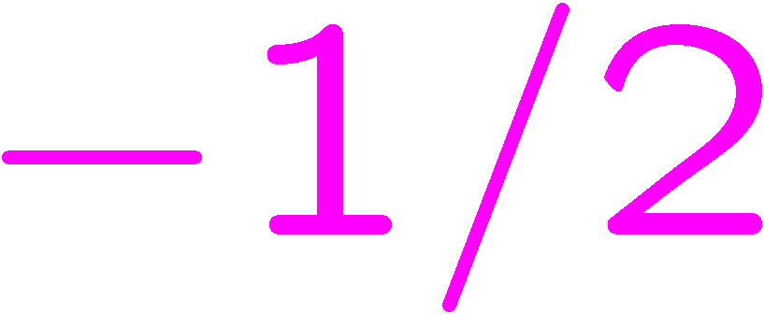

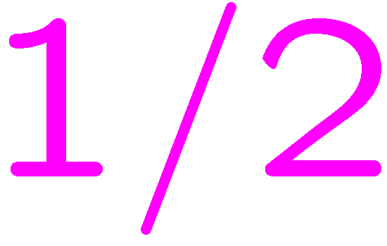








Slide 3


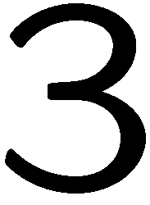




Slide 4







Slide 5








Slide 8
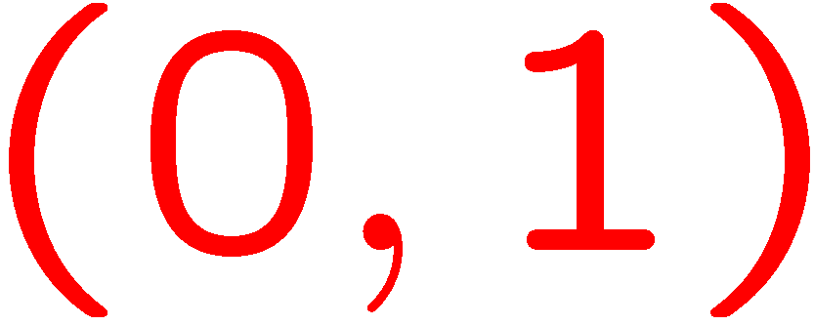


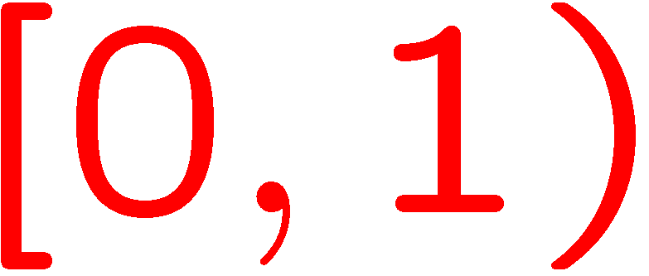


Slide 9



Slide 10


Slide 11


Slide 12
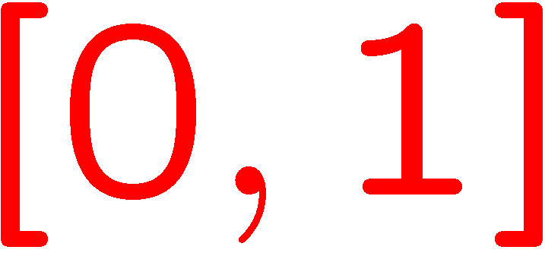



Slide 16



Slide 17



Slide 18












Slide 19



Slide 20

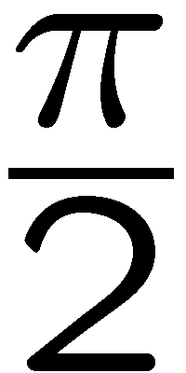








Slide 23






Slide 24






STOP

