Slide 1

BIG Cache Abstraction for Cache Networks
Eman Ramadan ∗, Arvind Narayanan ∗, Zhi-Li Zhang ∗,
Runhui Li †, and Gong (Nickolas) Zhang †
∗University of Minnesota,
† Huawei Future Network Theory Lab Hong Kong

Slide 2
Outline
Introduction & Related Work
Motivation
Contribution:
  BIG Cache Abstraction
  dClimb Caching Strategy for BIG Cache
Evaluation
Future Work & Conclusion

Slide 3

Content is the King!
Content or information delivery (either “static” or “dynamic”): a major function of today’s Internet
  static: e.g., video, which can be cached
  dynamic: e.g., search responses, generated dynamically
Large content delivery system is a hugely complex system: not only network, but also compute & storage
Content (esp. video) delivery places significant burden on the Internet infrastructure

Slide 4
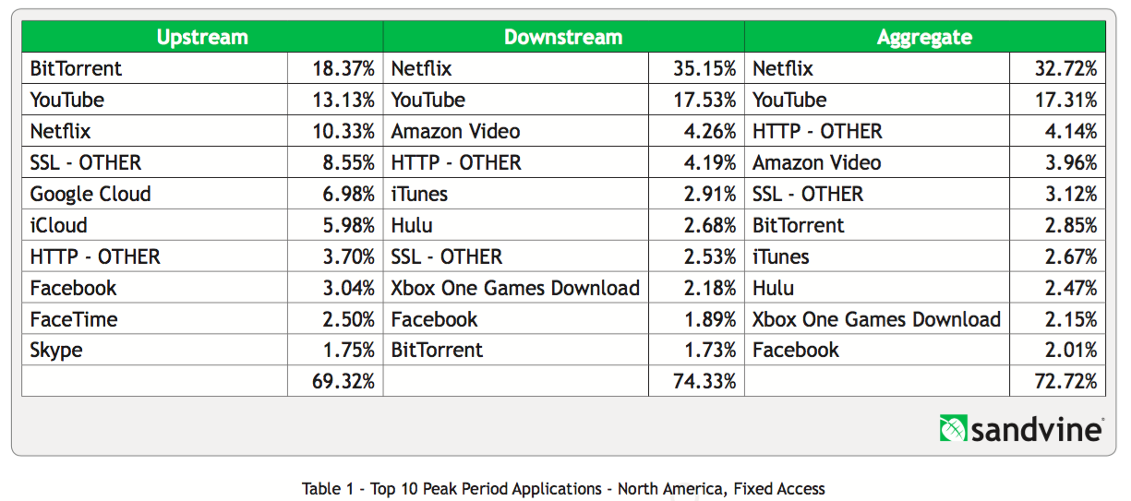
Content is the King!
Netflix and YouTube alone account for more than 50% of the peak download traffic in US in 2016.
Everyday more content is published by content providers (CPs) and requested by users.

Slide 5
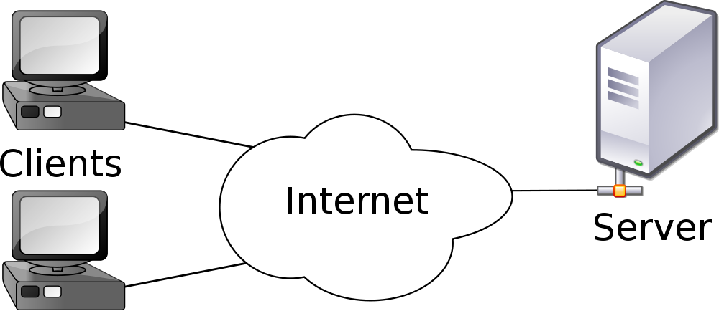








Cloud Content Distribution
request
Web: from simple client-server model for file downloads
➔ Cloud Computing + CDNs
reply
CDN₂ & its servers
CDN₁ & its servers
CP2
data centers
CP1
ISP
data centers
media
players
ISP
ISP
users

Slide 6
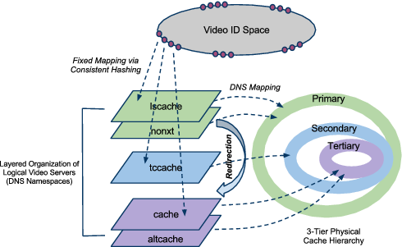
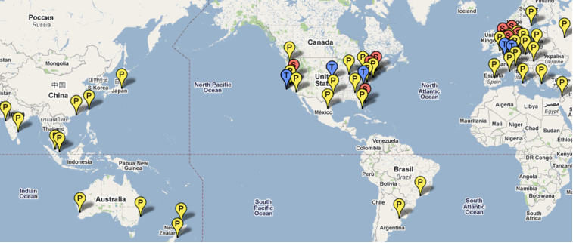
Content Distribution
YouTube^{[1]} as a Case Study: world’s largest video sharing site
User interaction with content (e.g., search for a video) is separated from video delivery
Employs a combination of various “tricks” and mechanisms to scale with YouTube size & handle video delivery dynamics

Slide 7
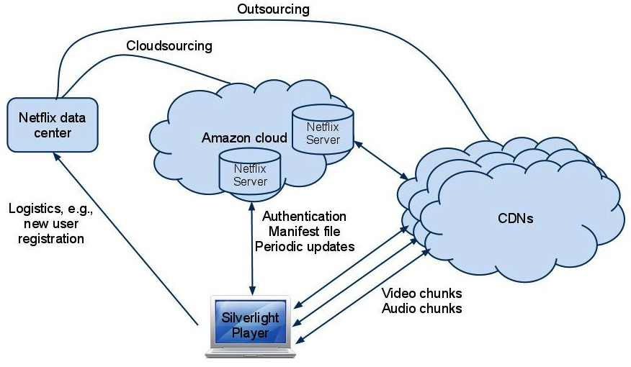
Content Distribution
Netflix^{[2]} as a Case Study: “first” large-scale cloud-sourcing success
  Has its own “data center” for certain crucial operations (e.g., user registration, …)
  Most web-based user-video interaction, computation/storage operations are cloud-sourced to Amazon AWS
  Users need to use MS Silverlight or other players for video streaming
  Video delivery was/is partly out/cloud-sourced to 3 CDNs;
  but now most utilizes its “own” OpenConnect boxes placed at participating ISPs, forming its own CDN
Google: deploys its own CDN
Netflix/Bing: utilized Akamai CDN
(it now also builds its own CDN)
Amazon and Facebook have also built its own CDNs
OpenConnect
CDN

Slide 8
Information Centric Networking (ICN)
An approach to shift the Internet infrastructure from a host-centric paradigm, to focus on ‘’named information”.
ICN Primitives
  Storage is an integral part of network substrate
  Caching-along-the-path

Slide 9



Cache Management Issues
Q: How shall we effectively utilize the cache resources?
Caching Policy
  What content to cache, and when to cache?
    e.g., only cache popular content, cache at first request, … etc.
Cache Replacement Strategy
  If the cache is full, which cached content is evicted?
    e.g., LRU, LFU, … etc.
Object Allocation
  Which caches keep a copy of the requested object on its way to users?
    e.g., cache everywhere, cache probablistically, ... etc.
Origin Content Servers
Cache Nodes/Servers
Interests or
Content Requests
User Bases

Slide 10



Hierarchical Caching Structure
Request Routing
Caching Along the Path
Request
cache hit
Origin Server
L _{H+1}
Object
cache miss
….......
Intermediate Servers
L ₂
cache miss
Edge Servers
L ₁
…. ..... ..... .....
Users

Slide 11
Caching Along the Path
Object Allocation
Caching Along the Path
aka: Leave Copy Everywhere (LCE)
Request
Object
Is caching along the path useful, or is edge caching only sufficient?
…. ..... ..... .....

Slide 12
Network Simulation Setup
A tandem line of four caches
  1 Edge server, 3 intermediate servers, & Origin server
Origin server serves a collection of 100 objects
  O₁: most popular, O_{N}: least popular
  Object access probabilities follows Zipf. dist. with α = 1
Size of each cache server = 10
Object Allocation: cache along the path (i.e., leave copy everywhere LCE)
Cache replacement policy: LRU
Measure percentage of requests served by each layer

Slide 13
LCE with LRU – Object Hit Probability
only 40% of requests for O5 served from L1
Intermediate layers are useless
Less than 5% of requests for any object

Slide 14
LCE with K-Hit – Object Hit Probability
K-Hit: only cache objects after receiving K requests within a pre-threshold time
K = 4

Slide 15
Problem of Thrashing
Happens when objects are cached, and then quickly evicted, before receiving their next request.
Frequent occurrences lead to significant reduction in cache efficiency for being under-utilized.

Slide 16
Problem of Thrashing
LCE with LRU
miss
L3
X
9
3
2
9
3
2
X
3
2
5
9
3
2
9
3
2
9
9
3
3
2
2
6
9
3
hit
hit
L2
X
9
2
4
2
9
4
X
2
4
7
9
2
4
2
9
4
4
4
2
2
9
9
6
4
2
X
9
X
X
X
1
8
2
9
9
1
1
1
8
8
7
2
9
1
4
4
2
2
9
9
6
L1
4
2
Most recently used
Least recently used
Requests
9
2
4
6
time
O9 Cached at L1, L2 & L3
O9 Evicted from L1 & L2 before its next request

Slide 17
Problem of Thrashing
LCE with LRU
One of the main reasons for poor performance: independent operation of cache servers
Percentage of Objects cached & directly evicted

Slide 18
Insights & Motivation
Caching “along-the-path” leads to the problem of “Thrashing”
  Cached objects are evicted before receiving their next request
  Evicted objects from any layer are discarded
Cache servers at intermediate layers are under-utilized
  Limited effect in enhancing object hit probabilities (even for popular objects)
  Diminishing effect at higher-tiered layers
Low hit rates increase latency, origin server load, and network bandwidth
We need to fully utilize the storage and processing capacities of all cache servers to handle the explosive growth of content!

Slide 19
Outline
Introduction & Related Work
Motivation
Contribution:
  BIG Cache Abstraction
  dClimb Caching Strategy for BIG Cache
Evaluation
Future Work & Conclusion

Slide 20
BIG Cache Abstraction
L4
L4
L3
L3
L2
L2
BIG Cache
L1
LRU, K-Hit, …..
L1

Slide 21
BIG Cache Abstraction
Cache pieces at different layers are “glued” together to form one “BIG” virtual cache
Objects are placed in the BIG virtual cache under one consistent caching policy
The BIG cache is organized in a single (global) queue data structure
  Linked together by individual queues maintained at each cache server
  Objects in queues are sorted according to the caching policy (recently used, frequently used, ..)

Slide 22
Applying LRU to BIG Cache
hit
L3
6
2
7
6
7
6
7
3
6
7
3
6
7
L2
5
8
3
5
8
3
9
5
8
3
9
5
8
9
5
8
1
4
9
2
1
1
4
4
9
2
1
4
2
L1
2
1
4
2

Slide 23
BIG Cache Abstraction – Adv. & Issues
Advantages
  Objects are evicted only if removed from a cache piece and not placed in another
  Enables full-utilization of the allotted cache space at all (intermediate) cache servers
  Yields higher overall hit rates, which decreases the origin server load, and network latency
  Minimizes/eliminates the problem of thrashing
Issues
  Additional overhead – e.g., moving objects across boundaries of cache pieces

Slide 24
Applying LRU to BIG Cache
hit
L3
6
2
7
6
7
6
7
3
6
7
3
6
7
3
L2
5
8
3
5
8
3
9
5
8
3
9
5
8
9
5
8
1
2
1
4
9
2
1
1
4
4
9
2
1
4
2
L1
2
1
4
2
1 Request ➔ 3 Object Movements

Slide 25
DCLIMB: CACHING strategy for BIG cache

Slide 26
dClimb Caching Strategy
dClimb considers BIG cache as a large single (global) queue
  Linked together by individual queues maintained at each cache
  Each object in the queue has an index
  A request for a cached object, causes a swap with the object ahead of it
dClimb is a generalization of the Climb[*] algorithm introduced for single cache

Slide 27
dClimb for BIG Cache
miss
hit
hit
L3
2
2
6
6
7
10
7
3
6
2
6
2
7
3
6
7
7
index 7 8 9
L2
5
5
8
8
3
3
5
8
2
5
8
3
5
8
3
2
index 4 5 6
hit
L1
1
1
4
4
9
9
1
1
4
9
4
9
1
4
9
index 1 2 3
Request O7
: Not Cached ➔ Insert at tail of L3
  : Cached at L3➔ Local swap at L3
Request O2
  : Cached at head of L3➔ Swap with tail of L2
Request O2
Request O1
  : Cached at head of L1➔ Do Nothing

Slide 28
Outline
Introduction & Related Work
Motivation
Contribution:
  BIG Cache Abstraction
  dClimb Caching Strategy for BIG Cache
Evaluation
Future Work & Conclusion

Slide 29
Evaluation
BIG Cache Abstraction
dClimb Caching Strategy
Large-Scale Hierarchical Tree Evaluation

Slide 30
Notation & Assumptions

Slide 31
Metrics

Slide 32
Object Allocation Strategies
Leave Copy Everywhere (LCE)
Leave Copy Down (LCD)
Leave Copy Probabilistically (LCP)
Edge Caching Only (OE)

Slide 33
Object Allocation Strategies
Leave Copy Down (LCD)
Request
Object
…. ..... ..... .....

Slide 34
Object Allocation Strategies
Leave Copy Probabilistically (LCP)
q = 0.5
Request
Object
rand = 0.6
> q
don’t cache
rand = 0.4
< q
cache
…. ..... ..... .....

Slide 35
Object Allocation Strategies
Edge Caching Only (OE)
Request
Object
…. ..... ..... .....

Slide 36
Network Simulation Setup
A tandem line of four caches
  1 Edge server, 3 intermediate servers, & Origin server
Origin server serves a collection of 100 objects
  O₁: most popular, O_{N}: least popular
  Object access probabilities follows Zipf. dist. with α = 1
Size of each cache server = 10
Object Allocation: LCE, LCD, LCP, OE
Cache replacement policy: LRU

Slide 37
BIG Cache Abstraction
LRU – Object Hit Probability per Layer

Slide 38
BIG Cache Abstraction
LRU – Overall Performance
Overall Object Hit Probability
Overall Cache Hit

Slide 39
BIG Cache Abstraction
LRU – Latency & Origin Server Load
Object Latency
Origin Server Load Percentage

Slide 40
BIG Cache Abstraction
Network Usage/Overhead
LRU

Slide 41
BIG Cache Abstraction
K-Hit – Object Hit Probability per Layer

Slide 42
BIG Cache Abstraction
K-Hit – Overall Performance
Overall Object Hit Probability
Overall Cache Hit

Slide 43
BIG Cache Abstraction
K-Hit – Latency & Origin Server Load
Object Latency
Origin Server Load Percentage

Slide 44
BIG Cache Abstraction
Network Usage/Overhead
LRU
K-Hit

Slide 45
dClimb for BIG Cache
Object Hit Probability per Layer

Slide 46
dClimb for BIG Cache
Origin Server Load & Latency

Slide 47
dClimb for BIG Cache
Network Usage/Overhead
Network Usage/Overhead
Object Cached by dClimb

Slide 48
Cache Occupancy
LRU
K-Hit
dClimb

Slide 49
Summary
dCLIMB is a self-adaptive request-driven strategy
  Can adapt to changes in user access patterns
Knowledge of access patterns a priori is not required
Leads to caching most popular objects at edge servers, less popular objects at higher layers
Incurs minimal object movement overhead compared to other caching policies
Performance close to static caching without counters or timers

Slide 50
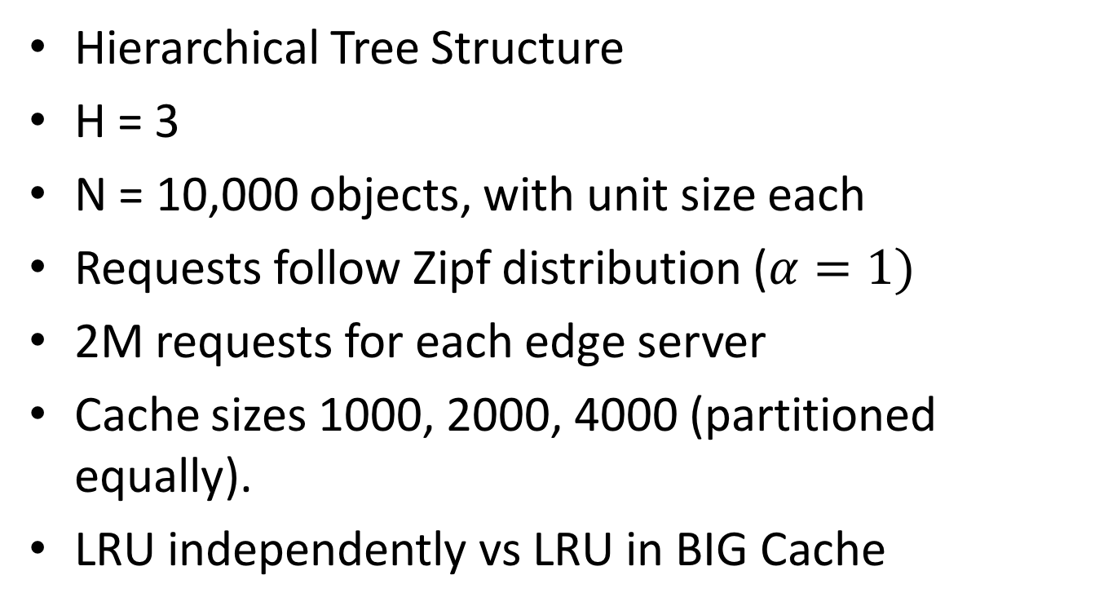
Large Scale Experiment
Hierarchical Tree Structure
H = 3
N = 10,000 objects, with unit size each
Requests follow Zipf distribution ($α=1)$
2M requests for each edge server
Cache sizes 1000, 2000, 4000 (partitioned equally).
LRU independently vs LRU in BIG Cache

Slide 51
Large-Scale Evaluation
Hit Probability

Slide 52
Evaluation
Origin Server Load & Latency

Slide 53
Outline
Introduction & Related Work
Motivation
Contribution:
  BIG Cache Abstraction
  dClimb Caching Strategy for BIG Cache
Evaluation
Future Work & Conclusion

Slide 54
Future Work
Cache Allotment
Performance Estimation
Applying BIG Cache in General Topology
Developing Caching mechanisms for BIG Cache

Slide 55
Cache Allotment
Each intermediate cache allots a portion of its capacity to serve requests from each edge server sharing it
Cache pieces at different layers are “glued” together to form one “BIG” virtual cache
Objects are placed in the BIG virtual cache under one consistent caching policy

Slide 56
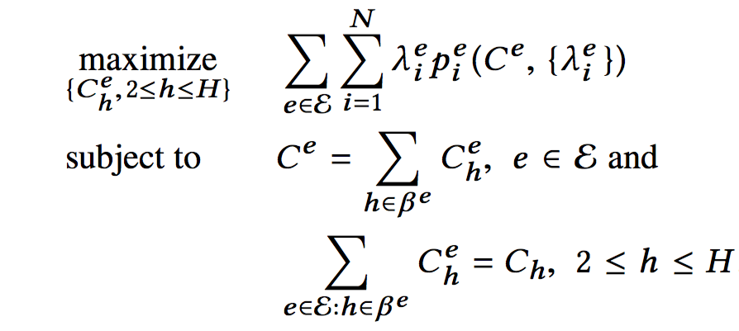
Cache Allotment

Slide 57
Future Work
Cache Allotment
Performance Estimation
Applying BIG Cache in General Topology
Developing Caching mechanisms for BIG Cache

Slide 58
Conclusion
BIG cache abstraction decouples cache allocation issues from content placement/replacement policies
It allows any existing cache replacement strategy (e.g., LRU, FIFO, K-HIT, K-LRU, ..etc) to be applied as a single consistent strategy to the entire (virtual) cache.
The best cache replacement policy should depend on the object access patterns.
BIG cache allows us to utilize all caching resources
  Only one copy cached along the path from the origin to the edge.
Moreover, evicted objects are not totally discarded.

Slide 59
References
YouTube
  Vijay Adhikari, Sourabh Jain, Yingying Chen, and Zhi-Li Zhang. "Vivisecting youtube: An active measurement study." In INFOCOM, 2012 Proceedings IEEE.
Netflix,
  Vijay Adhikari, Yang Guo, Fang Hao, Matteo Varvello, Volker Hilt, Moritz Steiner, and Zhi-Li Zhang. "Unreeling netflix: Understanding and improving multi-cdn movie delivery." In INFOCOM, 2012 Proceedings IEEE.
  Netflix OpenConnect https://openconnect.netflix.com/
Akamai
  Erik Nygren, Ramesh K. Sitaraman, and Jennifer Sun. "The akamai network: a platform for high-performance internet applications." ACM SIGOPS Operating Systems Review 44, no. 3 (2010)

Slide 60
Thank you!

