Slide 1

A Framework for Evaluating Caching Policies in a Hierarchical Network of Caches
Eman Ramadan, Pariya Babaie, Zhi-Li Zhang
Presented By: Arvind Narayanan
University of Minnesota, USA

Slide 2
Outline
Introduction
Motivation & Related Work
Contribution:
  Hit Probability Estimation
  Comparison Framework
Evaluation
Conclusion

Slide 3
Caching is Important!
Caching is essential factor in the performance of large-scale streaming video delivery, due to the size of video objects and the scale of content delivery system.
Several studies have focused on the performance analysis of cache networks under various caching policies.
ICN architectures have renewed research interest in caching policies and their performance, due to ICN primitives:
  Storage is an integral part of network substrate
  Caching-along-the-path

Slide 4



Cache Management Issues
Q: How shall we effectively utilize the cache resources?
Caching Policy
  What content to cache, and when to cache?
    e.g., only cache popular content, cache at first request, … etc.
Cache Replacement Strategy
  If the cache is full, which cached content is evicted?
    e.g., LRU, LFU, … etc.
Object Replication
  Which caches keep a copy of the requested object on its way to users?
    e.g., cache everywhere, cache probablistically, ... etc.
Origin Content Servers
Cache Nodes/Servers
Interests or
Content Requests
User Bases

Slide 5



Hierarchical Caching Structure
Request Routing
Caching Along the Path
Request
cache hit
Origin Server
L _{H}
Object
cache miss
….......
Intermediate Servers
L ₂
cache miss
Edge Servers
L ₁
…. ..... ..... .....
Users

Slide 6
Object Replication Strategies
Caching Along the Path
Caching Along the Path
aka: Leave Copy Everywhere (LCE)
Request
Object
…. ..... ..... .....

Slide 7
Object Replication Strategies
Leave Copy Probabilistically (LCP)
q = 0.5
Request
Object
rand = 0.6
> q
don’t cache
Is Caching Along the Path Useful?
Which Strategy is Better?
How can we analyze their performance?
rand = 0.4
< q
cache
…. ..... ..... .....

Slide 8
Performance Analysis of Cache Networks
Requests to 1st Layer
are Independent
L4
L3
L3
L2
L2
L2
L2
L1
L1
L1
L1
L1
L1
L1
L1

Slide 9
Performance Analysis of Cache Networks
Requests to higher Layers are NOT Independent due to miss rate at lower Layers
L4
L3
L3
Thus, we need to calculate the request arrival streams at the upstream caches!
L2
L2
L2
L2
L1
L1
L1
L1
L1
L1
L1
L1

Slide 10
Performance Analysis of Cache Networks
The main issue with the current approaches lies in the accuracy of estimating the superposition of the miss streams arriving at the intermediate caches.
Also, these approaches are computationally very extensive when the size of the cache network grows, thus, they are not scalable.
There exists no general methodology for computing, approximating, or even bounding the hit probabilities for a network of caches within a reasonable computation cost.

Slide 11
Outline
Introduction
Motivation & Related Work
Contribution:
  Hit Probability Estimation
  Comparison Framework
Evaluation
Conclusion

Slide 12
Hit Probability Estimation for Cache Network
Given the hit probability of object O_{i} for a single cache under caching policy P as a function of the cache size C, and the object request rate λ_{i}.
We propose a general simplified approach to calculate the hit probability for a tandem cache network using “BIG” cache abstraction.
p_{i}(C, λ_{i}, P)
Single Cache

Slide 13
Review: BIG Cache Abstraction
L4
L4
L3
L3
L2
L2
BIG Cache
L1
LRU, K-Hit, …..
L1

Slide 14
Hit Probability Estimation
LH
Origin Server
Apply the hit prob. function to the virtual cache composed of the first two layers with total capacity C_{[1:2]} = C₁ + C₂ ➔ hit prob. for O_{i} from one of these 2 layers (L1+L2) p_{i}(C_{[1:2]}, λ_{i}, P) .
Subtracting the hit prob. of O_{i} at L1 from this value results in the hit prob. of O_{i} at L2.
L(H-1)
C_{H-1}
Lj
C_{j}
L3
C₃
Hit Prob. of O_{i} at L2 = p_{i}(C_{[1:2]}, λ_{i}, P) - p_{i}(C_{[1:1]}, λ_{i}, P)
L2
C₂
L1
L2
L1
C₁

Slide 15
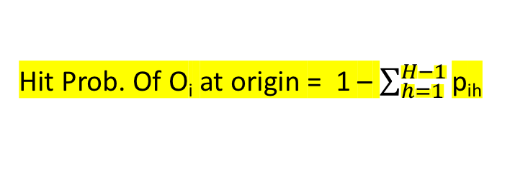
Hit Probability Estimation
LH
Origin Server
Generally, the hit prob. of O_{i} at Lj can be obtained by subtracting the hit prob. of O_{i} at the first j-1 layers from the the hit prob. of O_{i} at the first j layers.
L(H-1)
C_{H-1}
“BIG” cache abstraction completely avoids the interdependency between cache layers.
Lj
C_{j}
Hit Prob. of O_{i} at Lj = p_{i}(C_{[1:j]}, λ_{i}, P) - p_{i}(C_{[1:j-1]}, λ_{i}, P)
Hit Prob. Of O_{i} at origin = 1 – $\sum_{h=1}^{H−1}{\text{p}\text{ih}}$
L3
C₃
L1
L2
Lj
L2
C₂
L1
C₁

Slide 16
Estimation Approach Validation
LRU-LCE
Hit prob. at a single cache can be calculated by^{[1]}:
T_{C}: characteristic time of the cache
λ_{i}: request rate of O_{i}
LRU-model: estimated hit prob.
LRU(B): simulating LRU-LCE using
BIG cache abstraction
LRU(I): simulating LRU-LCE at each
cache independently

Slide 17
Estimation Approach Validation
LRU-LCP (q-LRU)
Hit prob. at a single cache can be calculated by^{[1]}:
q: prob. to cache objects
T_{C}: characteristic time of the cache
λ_{i}: request rate of O_{i}
q-LRU-model: estimated hit prob.
q-LRU(B): simulating LRU-LCP using
BIG cache abstraction
q-LRU(I): simulating LRU-LCE at each
cache independently
1- “BIG” cache leads to better performance.
2- Our estimated hit prob. matches the hit prob. when simulating caching policies using “BIG” cache abstraction.

Slide 18
Outline
Introduction
Motivation & Related Work
Contribution:
  Hit Probability Estimation
  Comparison Framework
Evaluation
Conclusion

Slide 19
Caching Policies Comparison Framework
We propose a general framework to compare the network performance of two caching
policies P and Q.
P and Q can represent any caching policy such as LRU, static caching, K-LRU, … etc.
We represent the hit probabilities of each policy as a hit probability matrix, and define a majorization condition for these matrices to compare them.

Slide 20
Hit Probability Matrix
LH
Origin Server
N: number of Objects
H: number of layers
p_{ij}: hit prob. of O_{i} at layer Lj
λ_{i}: request rate of O_{i}
λ: aggregate request rate for all objects
a_{i}= λ_{i}/λ: access prob. of O_{i}
L(H-1)
C_{H-1}
Lj
C_{j}
L3
C₃
L2
C₂
L1
C₁

Slide 21
Majorization of Hit Probability Matrices
Condition
The summation of the hit probabilities in the top-left (k, h) sub-matrix of P is equal to or larger than that of Q for all values of k, h, i.e., policy P utilizes the first h cache layers to serve the top k objects better than policy Q.
Thus, we say caching policy P dominates Q if and only if P majorizes Q.

Slide 22
Comparing Overall Performance
Expected Overall Performance
Condition: If policy P majorizes policy Q, then:
Theorem 1: The overall expected latency for P is less than or equal to that of Q.
Theorem 2: The origin server load under policy P is less than or equal to that of Q.

Slide 23
Outline
Introduction
Motivation & Related Work
Contribution:
  Hit Probability Estimation
  Comparison Framework
Evaluation
Conclusion

Slide 24
Network Simulation Setup
A tandem line of three caches
  1 Edge server, 2 intermediate servers, & Origin server
Origin server serves a collection of N = 10K objects
  O₁: most popular, O_{N}: least popular
  Object access probabilities follows Zipf. dist. with α = 1
Size of each cache server lies in range [50, 100, 500, 1000, 2500, 3000]
  e.g., the edge server and intermediate servers have cache size 50 each
Object replication strategy: LCE, LCD, LCP
Cache replacement policy: LRU
Other policies: static, LRU(B), qLRU(B)

Slide 25
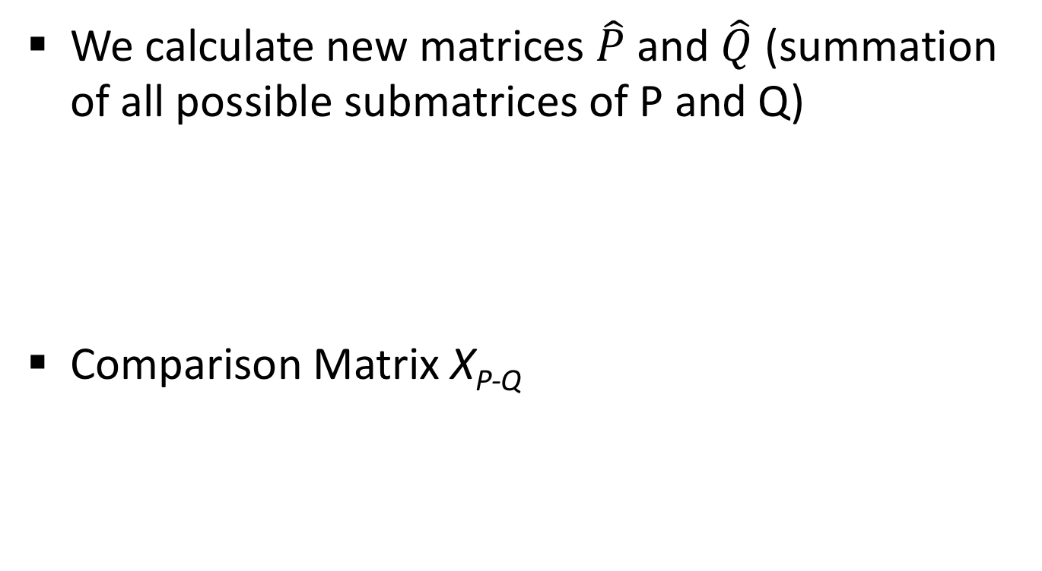
Majorization Condition Representation
We calculate new matrices $\hat{P}$ and $\hat{Q}$ (summation of all possible submatrices of P and Q)
Comparison Matrix X_{P-Q}
Majorization Condition
Represented as a binary heatmap of two values (0 = white, 1 = black)

Slide 26
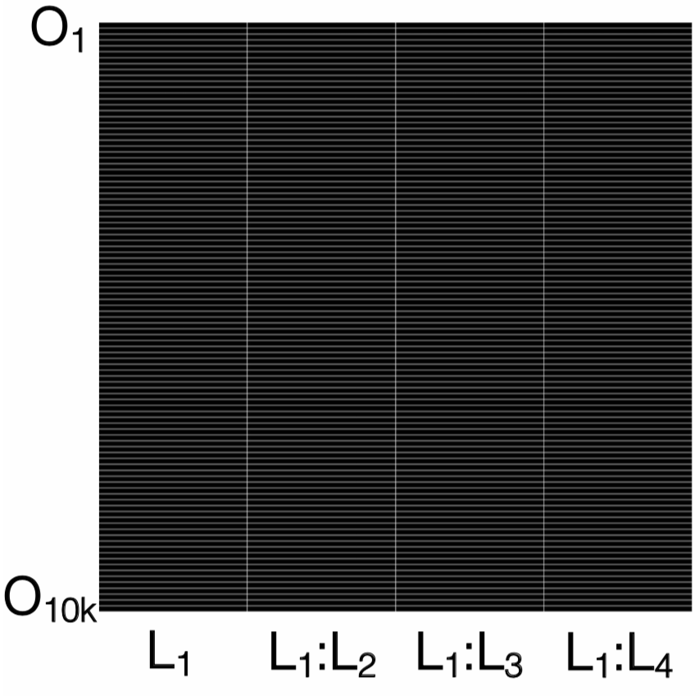
Comparing Caching Policies
P = Static, Q = LRU(B)
a) CS = 50
b) CS = 100
c) CS = 500
d) CS = 1000
e) CS = 2500
f) CS = 3000

Slide 27
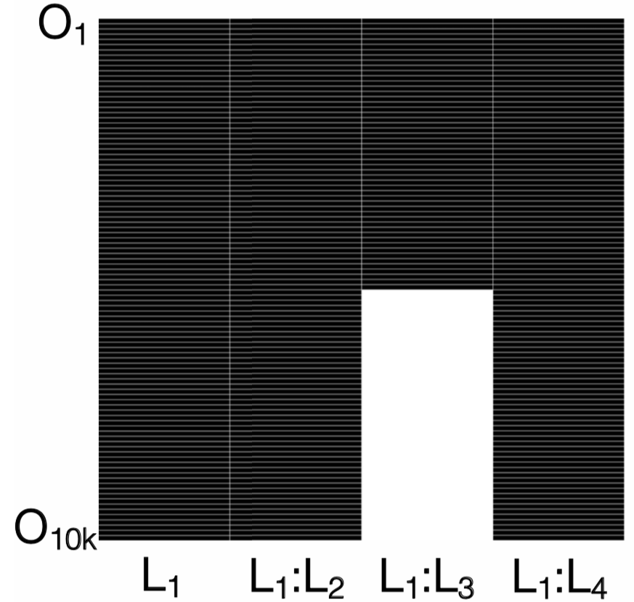
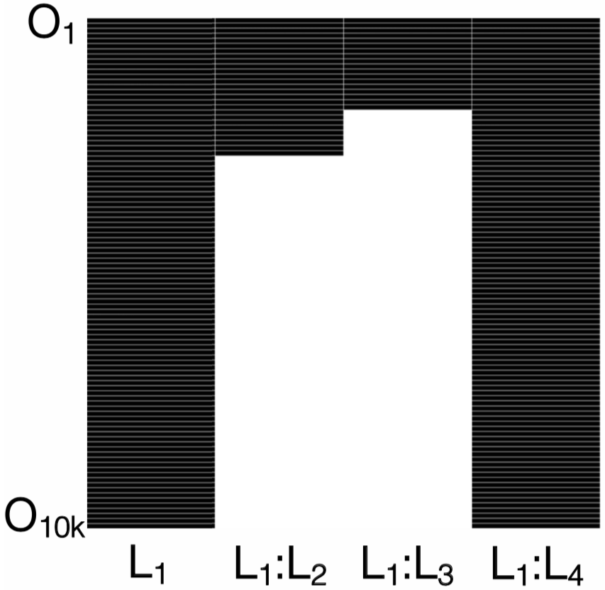
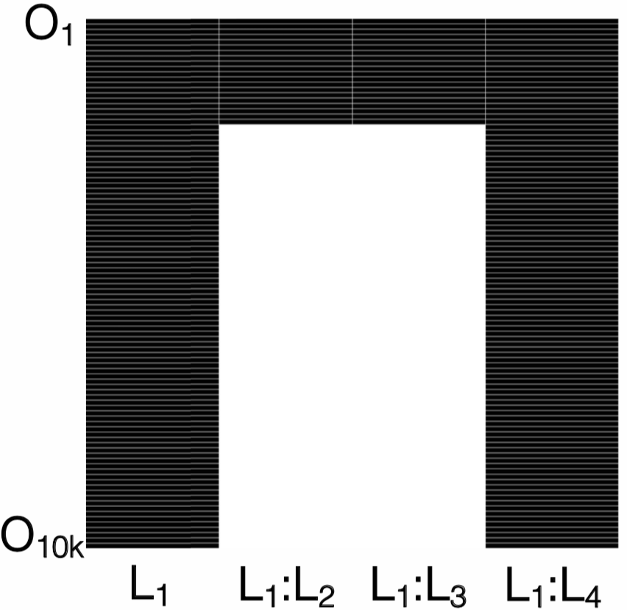
Comparing Caching Policies
P = LRU-LCD, Q = LRU(B)
a) CS = 50
b) CS = 100
c) CS = 500
d) CS = 1000
e) CS = 2500
f) CS = 3000

Slide 28
Conclusion
The analysis of caching policies for a cache network is complicated and challenging.
BIG cache abstraction avoids the interdependency between cache layers.
We proposed a general methodology for approximating the hit probabilities for a network of caches.
We introduced the notion of a hit probability matrix, and employed (a generalized notion of) majorization as the basic tool for evaluating and comparing cache policies.

Slide 29
Thank you!

