Slide 1

Adaptive Resilient Routing via Preorders in SDN
Eman Ramadan, Hesham Mekky, Braulio Dumba and Zhi-Li Zhang
University of Minnesota

Slide 2
Agenda
Introduction
Limitations of Path-based Routing
Routing via Preorders
Realization in SDN
Conclusion

Slide 3
Introduction
Adding more switches and links to networks
  Increases available parallelism
  An effective way to meet insatiable application demands for bandwidth
  Leads to a far richer network topology (often many diverse paths between two end points)
However, with the growing network scale
  The probability of failures becomes higher
  Resilient routing – e.g., via pro-active fast failover mechanisms – is imperative, to meet ever stringent availability, reliability and QoS requirements demanded by applications

Slide 4
Path-based Routing Doesn’t Work!
Existing routing schemes for communication & SCADA control networks are path-based!
  compute one path (e.g., shortest) or multiple paths from s to d
  route traffic along the path or paths, e.g., via IP or MPLS protocol
Fundamental Limitations of Conventional Path-based Routing:
  paths are rigid: must be precisely specified a seq. of nodes & links
  paths are fragile: failure of any node or link renders it invalid!

Slide 5
Path-based Routing Doesn’t Work!
Fundamental Limitations of Conventional Path-based Routing:
  paths are rigid: must be precisely specified a seq. of nodes & links
  paths are fragile: failure of any node or link renders it invalid!
Toy Network Example
O(2^{L}) many (shortest) paths of length 2L!
v₂
v₆
v₁₀
v_{4L-2}
v₃
v₅
v₇
s=v₁
…
d=v_{2L+1}
v₄
v₈
v₁₂
v_{4L}

Slide 6

Path-based Routing Doesn’t Work!
Fundamental Limitations of Conventional Path-based Routing:
  paths are rigid: must be precisely specified a seq. of nodes & links
  paths are fragile: failure of any node or link renders it invalid!
Toy Network Example
v₂
v₆
v₁₀
v_{4L-2}
v₃
v₅
v₇
s=v₁
…
d=v_{2L+1}
v₄
v₈
v₁₂
v_{4L}

Slide 7
Path-based Routing Doesn’t Work!
Fundamental Limitations of Conventional Path-based Routing:
  paths are rigid: must be precisely specified a seq. of nodes & links
  paths are fragile: failure of any node or link renders it invalid!
Toy Network Example
v₂
v₆
v₁₀
v_{4L-2}
v₃
v₅
v₇
s=v₁
…
d=v_{2L+1}
v₄
v₈
v₁₂
v_{4L}

Slide 8
Path-based Routing Doesn’t Work!
Fundamental Limitations of Conventional Path-based Routing:
  paths are rigid: must be precisely specified a seq. of nodes & links
  paths are fragile: failure of any node or link renders it invalid!
Toy Network Example
v₂
v₆
v₁₀
v_{4L-2}
v₃
v₅
v₇
s=v₁
…
d=v_{2L+1}
v₄
v₈
v₁₂
v_{4L}

Slide 9
Path-based Routing Doesn’t Work!
Fundamental Limitations of Conventional Path-based Routing:
  paths are rigid: must be precisely specified a seq. of nodes & links
  paths are fragile: failure of any node or link renders it invalid!
Toy Network Example: fairly robust topology
v₂
v₆
v₁₀
v_{4L-2}
v₃
v₅
v₇
s=v₁
…
d=v_{2L+1}
v₄
v₈
v₁₂
v_{4L}

Slide 10
Path-based Routing Doesn’t Work!
Fundamental Limitations of Conventional Path-based Routing:
  paths are rigid: must be precisely specified a seq. of nodes & links
  paths are fragile: failure of any node or link renders it invalid!
Toy Network Example
v₂
v₆
v₁₀
v_{4L-2}
v₃
v₅
v₇
s=v₁
…
d=v_{2L+1}
v₄
v₈
v₁₂
v_{4L}

Slide 11
Path-based Routing Doesn’t Work!
Fundamental Limitations of Conventional Path-based Routing:
  paths are rigid: must be precisely specified a seq. of nodes & links
  paths are fragile: failure of any node or link renders it invalid!
Toy Network Example
v₂
v₆
v₁₀
v_{4L-2}
v₃
v₅
v₇
s=v₁
…
d=v_{2L+1}
v₄
v₈
v₁₂
v_{4L}

Slide 12
Path-based Routing Doesn’t Work!
Fundamental Limitations of Conventional Path-based Routing:
  paths are rigid: must be precisely specified a seq. of nodes & links
  paths are fragile: failure of any node or link renders it invalid!
Toy Network Example
v₂
v₆
v₁₀
v_{4L-2}
v₃
v₅
v₇
s=v₁
…
d=v_{2L+1}
v₄
v₈
v₁₂
v_{4L}

Slide 13
Path-based Routing Doesn’t Work!
Fundamental Limitations of Conventional Path-based Routing:
  paths are rigid: must be precisely specified a seq. of nodes & links
  paths are fragile: failure of any node or link renders it invalid!
Toy Network Example
v₂
v₆
v₁₀
v_{4L-2}
v₃
v₅
v₇
s=v₁
…
d=v_{2L+1}
v₄
v₈
v₁₂
v_{4L}

Slide 14
Beyond Path: Can We Do Better?
Fundamental Limitations of Conventional Path-based Routing:
  paths are rigid: must be precisely specified a seq. of nodes & links
  paths are fragile: failure of any node or link renders it invalid!
What about using a Routing DAG (directed acyclic graph)?
  no need to pre-specify any specific path
  any outgoing link in the routing DAG can be dynamically utilized
Toy Network Example
v₂
v₆
v₁₀
v_{4L-2}
v₃
v₅
v₇
s=v₁
…
d=v_{2L+1}
v₄
v₈
v₁₂
v_{4L}

Slide 15
Beyond Path: Can We Do Better?
Fundamental Limitations of Conventional Path-based Routing:
  paths are rigid: must be precisely specified a seq. of nodes & links
  paths are fragile: failure of any node or link renders it invalid!
What about using a Routing DAG (directed acyclic graph)?
  no need to pre-specify any specific path
  any outgoing link in the routing DAG can be dynamically utilized
Toy Network Example
v₂
v₆
v₁₀
v_{4L-2}
v₃
v₅
v₇
s=v₁
…
d=v_{2L+1}
v₄
v₈
v₁₂
v_{4L}
Can survive arbitrary link/node failures as long as they do not disconnect s and d!

Slide 16
Routing DAGs Sufficient for Resiliency?
Routing DAG (directed acyclic graph)
  no need to pre-specify any specific path
  any outgoing link in the routing DAG can be dynamically
Sufficient to guarantee optimal resiliency for any topology?
i.e., ensure data delivery from s to d under arbitrary failures as long as they do not disconnect the two nodes?
New (slightly modified) Toy Network Example
v₂
v₆
v₁₀
v_{4L-2}
v₃
v₅
v₇
s=v₁
…
d=v_{2L+1}
v₄
v₈
v₁₂
v_{4L}

Slide 17
Routing DAGs Sufficient for Resiliency?
Routing DAG (directed acyclic graph)
  no need to pre-specify any specific path
  any outgoing link in the routing DAG can be dynamically
Sufficient to guarantee optimal resiliency for any topology?
i.e., ensure data delivery from s to d under arbitrary failures as long as they do not disconnect the two nodes?
New (slightly modified) Toy Network Example
v₂
v₆
v₁₀
v_{4L-2}
v₃
v₅
v₇
s=v₁
…
d=v_{2L+1}
v₄
v₈
v₁₂
v_{4L}

Slide 18
Routing DAGs Sufficient for Resiliency?
Routing DAG (directed acyclic graph)
  no need to pre-specify any specific path
  any outgoing link in the routing DAG can be dynamically
Sufficient to guarantee optimal resiliency for any topology?
i.e., ensure data delivery from s to d under arbitrary failures as long as they do not disconnect the two nodes?
New (slightly modified) Toy Network Example
v₂
v₆
v₁₀
v_{4L-2}
v₃
v₅
v₇
s=v₁
…
d=v_{2L+1}
v₄
v₈
v₁₂
v_{4L}

Slide 19
Routing DAGs Sufficient for Resiliency?
Routing DAG (directed acyclic graph)
  no need to pre-specify any specific path
  any outgoing link in the routing DAG can be dynamically
Sufficient to guarantee optimal resiliency for any topology?
i.e., ensure data delivery from s to d under arbitrary failures as long as they do not disconnect the two nodes?
New (slightly modified) Toy Network Example
v₂
v₆
v₁₀
v_{4L-2}
v₃
v₅
v₇
s=v₁
…
d=v_{2L+1}
v₄
v₈
v₁₂
v_{4L}

Slide 20
Routing DAGs Sufficient for Resiliency?
Routing DAG (directed acyclic graph)
  no need to pre-specify any specific path
  any outgoing link in the routing DAG can be dynamically
Sufficient to guarantee optimal resiliency for any topology?
i.e., ensure data delivery from s to d under arbitrary failures as long as they do not disconnect the two nodes?
New (slightly modified) Toy Network Example
v₂
v₆
v₁₀
v_{4L-2}
v₃
v₅
v₇
s=v₁
…
d=v_{2L+1}
?
v₄
v₈
v₁₂
v_{4L}

Slide 21
Routing DAGs Sufficient for Resiliency?
Routing DAG (directed acyclic graph)
  no need to pre-specify any specific path
  any outgoing link in the routing DAG can be dynamically
Sufficient to guarantee optimal resiliency for any topology?
i.e., ensure data delivery from s to d under arbitrary failures as long as they do not disconnect the two nodes?
New (slightly modified) Toy Network Example
v₂
v₆
v₁₀
v_{4L-2}
v₃
v₅
v₇
s=v₁
…
d=v_{2L+1}
v₄
v₈
v₁₂
v_{4L}

Slide 22
Routing via PreOrders

Slide 23
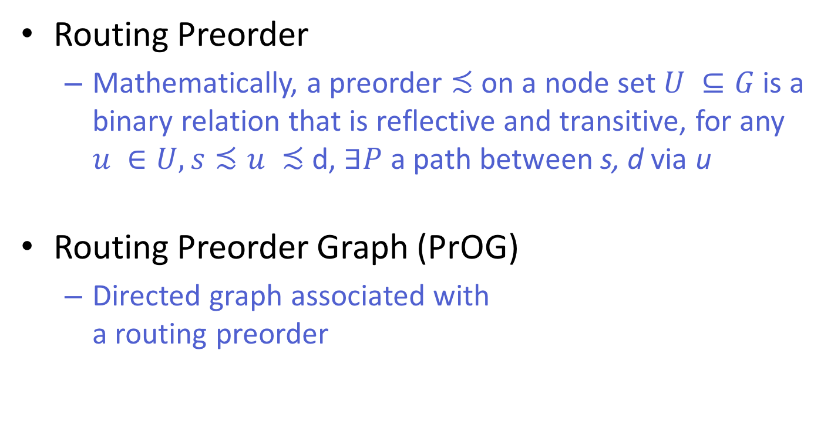
Routing via Preorders
Routing Preorder
  Mathematically, a preorder $≾$on a node set $U ⊆G$ is a binary relation that is reflective and transitive, for any $u ∈U, s≾u ≾$ d, $∃P$ a path between s, d via u
Routing Preorder Graph (PrOG)
  Directed graph associated with
  a routing preorder
d = O
A
B
C
D
E
F
G
H
I
s = J

Slide 24
Routing via Preorder & PrOG
Routing Preorder
Routing Preorder Graph (PrOG)
Traffic forwarding
  Split proportionally across outgoing links
  Bi-directed links generally not used under normal operations; invoked (along one direction) under failures
C
B
E
s = A
d = G
F
D

Slide 25
Routing via Preorder: Failure Handling
Failure Handling Process:
  Upon failures, use alternative outgoing links if exist
C
B
E
s = A
d = G
F
D

Slide 26
Routing via Preorder: Failure Handling
Failure Handling Process:
  Upon failures, use alternative outgoing links if exist
  If a node becomes a “sink”, de-activate incoming links
C
No Need for Global Topology
Information Exchange &
Route Recomputation
B
E
s = A
d = G
F
D

Slide 27
Routing via Preorder: Recovery Process
Recovery Process:
  If a node/link recovers, re-activate outgoing links
C
B
E
Guarantee to Restore to the Original
Routing State
s = A
d = G
F
D

Slide 28
Optimal Resilient PrOG Construction with Latency Constraints
C
C
Questions: do such PrOGS exist?
If yes, can they be constructed in polynomial time?
B
E
B
E
s = A
d = G
s = A
d = G
F
F
D
D
H
K
I
J
Primary PrOG
Backup PrOG

Slide 29
-Complete Preorder Graphs (PrOGs)
B

Slide 30
Realization in SDN

Slide 31
Realization in Emerging
Software-Defined Networks (SDNs)
The controller computes the routing preorder (satisfying latency constraints), then installs the corresponding rules in the relevant switches
Each switch forwards packets using the match-action data plane abstraction
Small functionality added to switches to maintain and update some internal states, and generate activation and deactivation tags
Switches perform some actions to handle link activation, deactivation and failure

Slide 32
Resilient Routing via Preorders: Packet Forwarding
Each switch/router maintains a set of routing rules and states
Each packet carries two header fields
Eligible outgoing links at node u for forwarding packet to d:
Upon failure, update both header fields before rerouting

Slide 33
Simple Demonstration & Evaluation
Routing via preorder implemented in Mininet with slightly modified Open vSwitch (OVS) using v.2.4
Simple Demonstration:

Slide 34
Realization in SDN: Rule Examples
Match-action rules for switch D

Slide 35
Simple Demonstration & Evaluation
Simple Demonstration:
a UDP traffic generator at host h₁, attached to node A, sends datagrams to host h₂, attached to node G
Traffic lasts for 20 seconds, sending around 90 pks/sec

Slide 36
Simple Demonstration & Evaluation
Simple Demonstration:
a UDP traffic generator at host h₁, attached to node A, sends datagrams to host h₂, attached to node G
Traffic lasts for 20 seconds, sending around 90 pks/sec

Slide 37
Simple Demonstration & Evaluation
Simple Demonstration:
a UDP traffic generator at host h₁, attached to node A, sends datagrams to host h₂, attached to node G
Traffic lasts for 20 seconds, sending around 90 pks/sec

Slide 38
Simple Demonstration & Evaluation
Simple Demonstration:
a UDP traffic generator at host h₁, attached to node A, sends datagrams to host h₂, attached to node G
Traffic lasts for 20 seconds, sending around 90 pks/sec

Slide 39
Simple Demonstration & Evaluation
Simple Demonstration:
a UDP traffic generator at host h₁, attached to node A, sends datagrams to host h₂, attached to node G
Traffic lasts for 20 seconds, sending around 90 pks/sec

Slide 40
Simple Demonstration & Evaluation
Simple Demonstration:
a UDP traffic generator at host h₁, attached to node A, sends datagrams to host h₂, attached to node G
Traffic lasts for 20 seconds, sending around 90 pks/sec
link up

Slide 41
Conclusion
Proposed a new routing paradigm – routing via preorders
  Circumvents the limitations of conventional path-based routing schemes
  Effectively takes advantage of topological diversity inherent in a network with rich topology for adaptive resilient routing
  Meets the QoS requirements (e.g., latency) of applications or flows
  Resilient against arbitrary k link or node failures (if network not partitioned)
Realized routing via preorders in SDN networks using the “match-action” data plane abstraction, with a preliminary implementation of it in Mininet

Slide 42
Thank you

