Slide 1
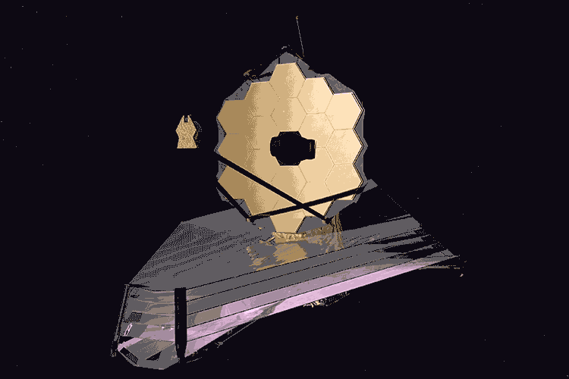
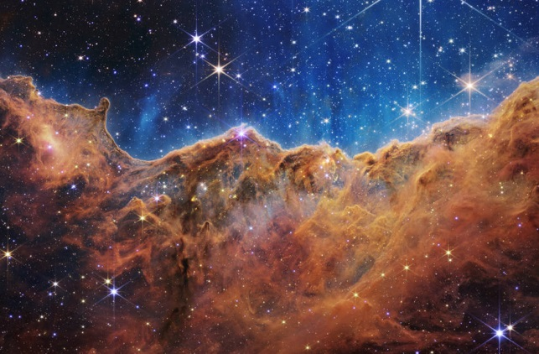
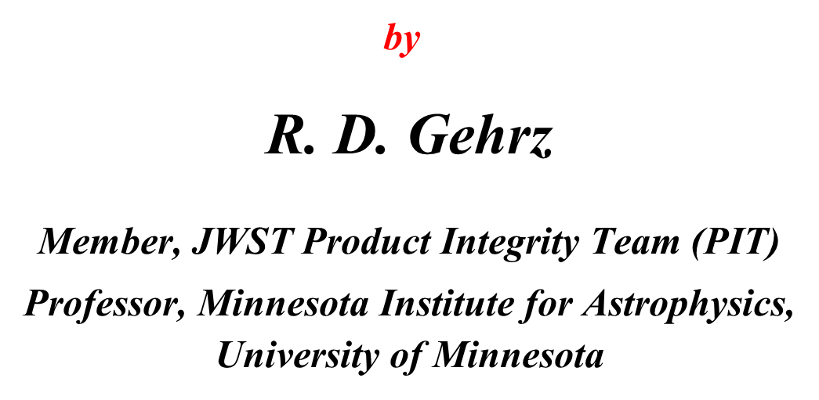
Observing the Dawn of the Universe with the
James Webb Space Telescope (JWST)
These slides will be posted at
https://www-users.cse.umn.edu/~gehrz001/links.html
Notes:
RDG

Slide 2
Outline
Why the dawn of the universe is seen only in the infrared
Designing JWST to see the dawn (first generation of stars)
and subsequent chemical evolution of the universe
Building JWST and making it work on reaching orbit
Early science results from JWST observations
Discussion and Q & A
Notes:
RDG

Slide 3
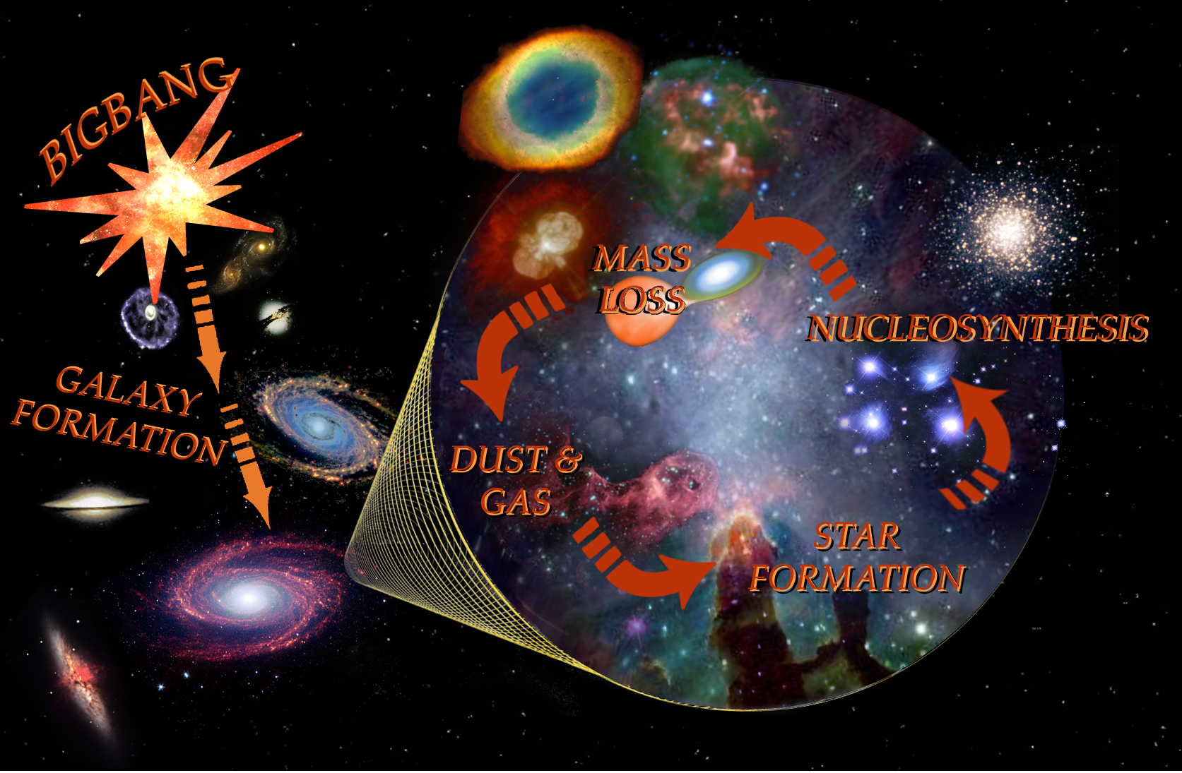
The Dawn and Chemical Evolution of the Universe
Notes:
RDG

Slide 4
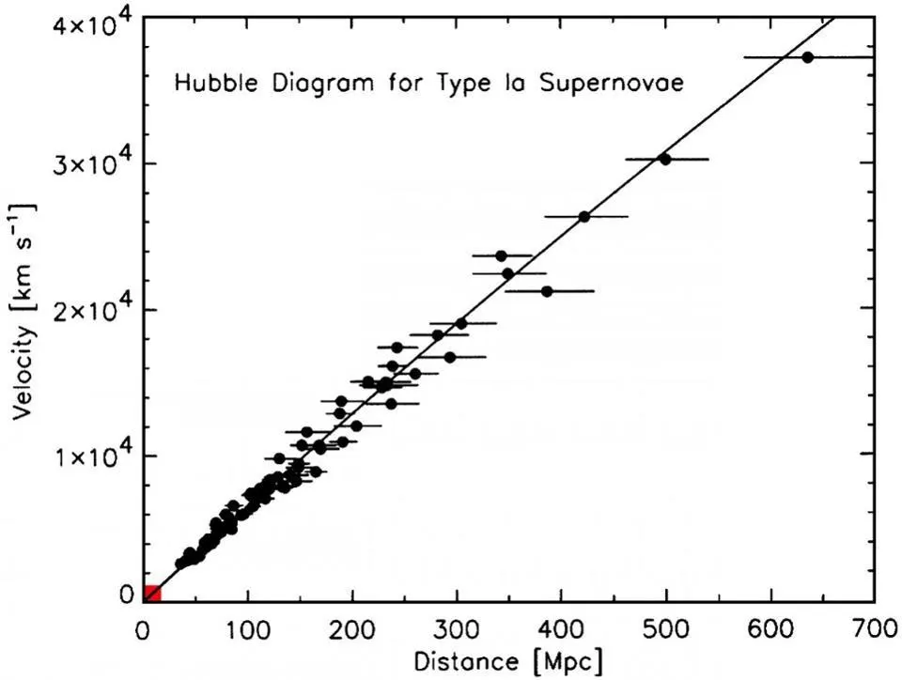
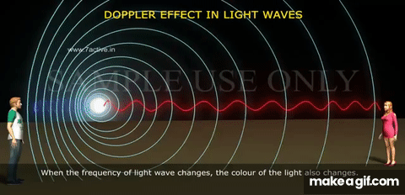
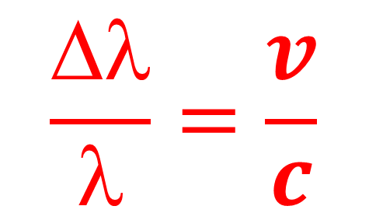
The Expanding Universe and The Doppler Shift
$$\frac{Δλ}{λ}=\frac{v}{c}$$
Hubbles Law for the
expansion of the
universe: V = HD

Slide 5
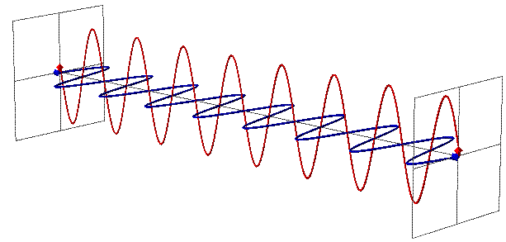
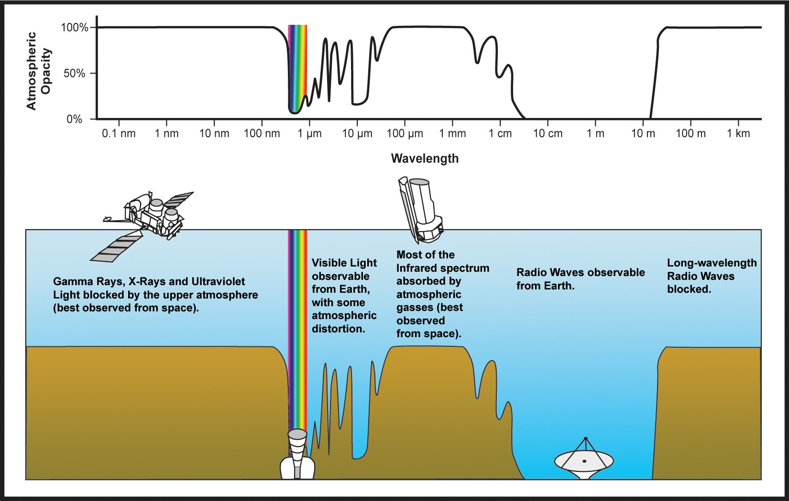
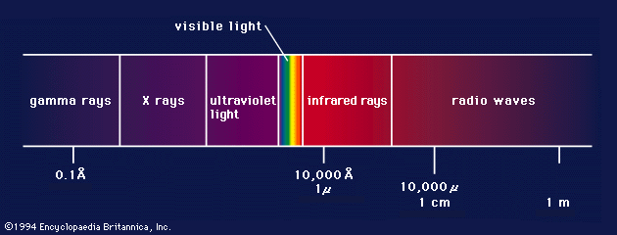
Electromagnetic Radiation and the Infrared
Wavelength λ
Magnetic Field
Electric Field
Frequency ν = peaks/second
The Speed of
Light, c, is 186,000
miles per second
In a vacuum
λν = c
JWST: 0.6 – 28 µm →
Notes:
RDG

Slide 6
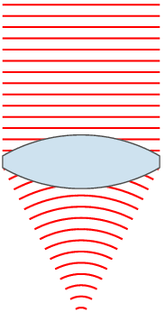

How a Telescope Collects Light
Notes:
RDG

Slide 7
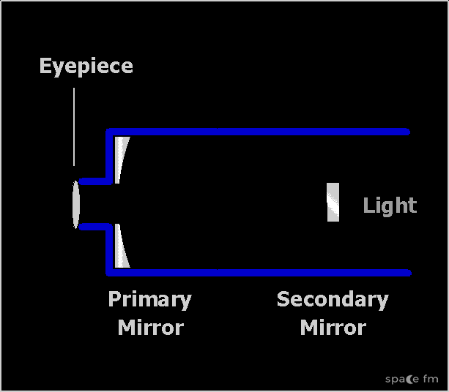
How a Reflecting Telescope Collects Light

Slide 8
Specifications Required to See Distant, Redshifted Galaxies at the Dawn
Large aperture: 6.5 m diameter; 25 m² collecting area
Infrared eyes: spectral range 0.6 to 28 µm
Long duration: 5-10 year mission lifetime
Cold: < 50 K operating temperature; SIs as low as 7 K
Hide from heat: ~22 m² (22 m x 10 m) Sun shield
Notes:
RDG

Slide 9
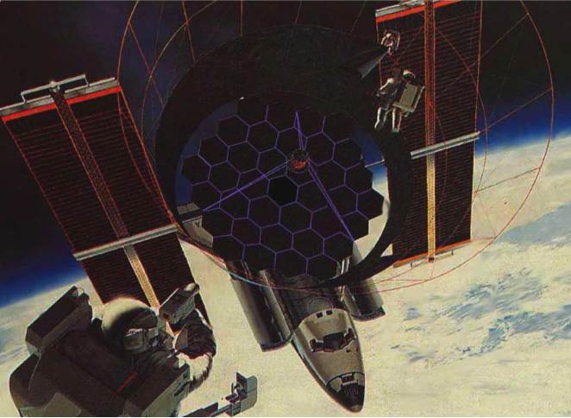
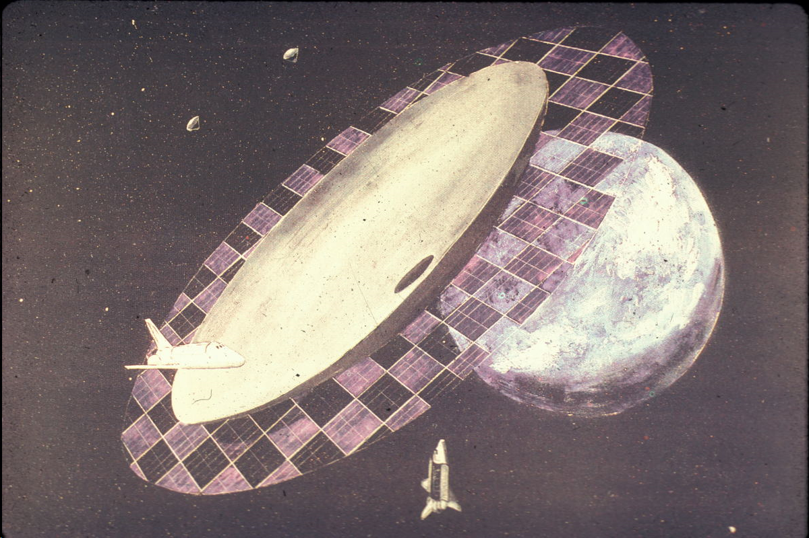
  Early Large Deployable Reflector (LDR) Concepts
What we were showing
students in the 1970’s
Artists concept of a 20-meter Large Deployable
Reflector (LDR) for infrared Astronomy (1989)

Slide 10
The Genesis of JWST
Astronomy and Astrophysics for the 1980‘s:
(Report of the NAS Astronomy Survey Committee;
G. B. Field, …… R. D. Gehrz ……, et al. 1982) recommends the development of the Large Deployable Reflector (LDR) – a 10-meter class space telescope
Notes:
RDG

Slide 11
The 1980 Astronomy Survey Committee
(The Field C ommittee)
GEORGE B. FIELD, Harvard-Smithsonian Center for Astrophysics, Chairman
MICHAEL J. S. BELTON, Kitt Peak National Observatory
E. MARGARET BURBIDGE, University of California, San Diego
GEORGE W. CLARK, Massachusetts Institute of Technology
S.ANDRA M. FABER, University of California, Santa Cruz
CARL E. FICHTEL, NASA Goddard Space Flight Center
ROBERT D. GEHRZ, University of Wyoming
EDWARD J. GROTH, Princeton University
JAMES E. GUNN, Princeton University
DAVID HEESCHEN, National Radio Astronomy Observatory
RICHARD C. HENRY, The Johns Hopkins University
RICHARD A. McCRAY, Joint Institute for Laboratory Astrophysics and the University of Colorado
JEREMIAH OSTRIKER, Princeton University
EUGENE N. PARKER, University of Chicago
MAARTEN SCHMIDT, California Institute of Technology
HARLAN J. SMITH, University of Texas, Austin
STEPHEN E. STROM, Kitt Peak National Observatory (ex officio)
PATRICK THADDEUS, NASA Goddard Institute for Space Studies and Columbia University
CHARLES H. TOWNES, University of California, Berkeley
ARTHUR B. C. WALKER, Stanford University
E. JOSEPH WAMPLER, University of California, Santa Cruz
Notes:
RDG

Slide 12
Recommendations of the Field
Committee WRT LDRs
1. “The Astronomy Survey Committee recommends the construction of a Large Deployable Reflector (LDR) of the 10-m class in space to carry out observations in the far-infrared and submillimeter regions of the spectrum that are inaccessible from the ground. Design studies for such a facility should begin at once.”
2. “The Astronomy Survey Committee recommends the study and development of the technology required to place a very large telescope in space early in the next century [2000]. ….. By the turn of the century it may be possible to place in orbit a very large telescope — perhaps 30 m in diameter….”
These recommendations led to the formulation of the 8-meter Next Generation Space Telescope (NGST)) Project

Slide 13
The 1990 Astronomy Survey Committee
(The Bahcall Committee)
JOHN N. BAHCALL, Institute for Advanced Study, Chair
CHARLES A. BEICHMAN, Institute for Advanced Study, Executive Secretary
CLAUDE CANIZARES, Massachusetts Institute of Technology
JAMES CRONIN, University of Chicago
DAVID HEESCHEN, National Radio Astronomy Observatory
JAMES HOUCK, Cornell University
DONALD HUNTEN, University of Arizona
CHRISTOPHER F. McKEE, University of California, Berkeley
ROBERT NOYES, Harvard-Smithsonian Center for Astrophysics
JEREMIAH P. OSTRIKER, Princeton University Observatory
WILLIAM PRESS, Harvard-Smithsonian Center for Astrophysics
WALLACE L.W. SARGENT, California Institute of Technology
BLAIR SAVAGE, University of Wisconsin
ROBERT W. WILSON, AT&T Bell Laboratories
SIDNEY WOLFF, National Optical Astronomy Observatories
The UV-Optical in Space Panel recommended a 6-meter cooled
space telescope as a successor to Hubble. This recommendation
did not appear as a recommendation in the final report.

Slide 14
The Final Path to JWST
1991: The Bacall Committee “UV-Optical in Space Panel” recommends a 6-meter cooled Large Space Telescope (LST)
January, 1996: NASA Administrator Dan Goldin calls for a return to the 8-meter NGST concept (instead of a 4-meter follow-up to HST as recommended by the AURA “HST and Beyond” Committee led by Alan Dresseler)
1999: The 8-m NGST is ranked first priority by the 2000 Decadal Survey Committee (McKee/Taylor Report); NASA Associate Administrator Ed Weiler approves a new start.
2001: NGST is down-sized to 6.5-meters, NASA appoints a Product Integrity Team (PIT) to provide independent oversight
2002: The name is changed from NGST to JWST

Slide 15
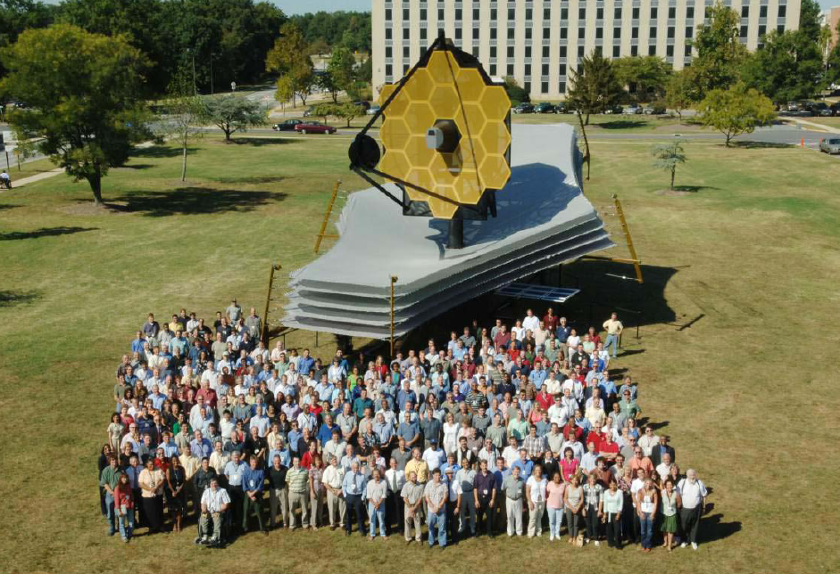

Slide 16
The JWST Product Integrity Team (PIT)
DUNCAN MOORE: PhD Optics 1974, U. Rochester (led HST optical repair); PIT Co-chair
JAMES WYANT: PhD Optics 1968, U. Rochester (optical systems design); PIT Co-chair
GARY CHANAN: PhD Physics, 1978, UC Berkeley (AO Keck Observatory)
JAMES BURGE: PhD Optical Sciences, 1993, U. of Arizona (LBT, MMT)
JAMES FIENUP: PhD Applied Physics 1975, Stanford (phase retrieval, HST)
JOSEPH GEARY: PhD Optics 1984, U. Arizona (optical testing, optical metrology)
ROBERT GEHRZ: PhD Physics 1971, U of MN (Spitzer CTA Facility Scientist, Be optics)
GEORGE HARTIG: Optical Systems Scientist, STScI; PhD Optical Engineering (HST)
MARK KAHAN: M.S. Structural Mechanics 1966, Northeastern (systems engineering)
MICHAEL KRIM: Perkin Elmer and JPL; (developed opto-mechanical design of HST)
ROBERT LASKIN: PhD Mech E. 1987, Columbia, (precision pointing, stabilization}
JOHN MANGUS: Optical Engineering, Penn State (HST, Spitzer)
DAVID MILLER: Sc.D. Optical/Mechanical Eng, MIT (Systems design and engineering)
DANIEL SCHROEDER: PhD Physics, 1962 U. Wisconsin (optical design; HST)
LAWRENCE STEPP: Optical Engineer (GEMINI Observatory Optics Manager, LBT)

Slide 17
A Few Milestones in the PIT Oversight Process
August. 2002: NASA selects TRW/Ball for Phase B design
March, 2004: Construction of science instruments (SIs) and
primary mirror segments begins
January, 2007: Main construction begins
January, 2012: NASA collects the SIs
October, 2015: Primary mirrors installed, CTA cryo test
December, 2017: Final testing of integrated telescope and
SIs; PIT evaluates data and recommends launch
June, 2022: Pit is briefing on in orbit performance
,

Slide 18
Typical PIT Agenda (2017)

Slide 19
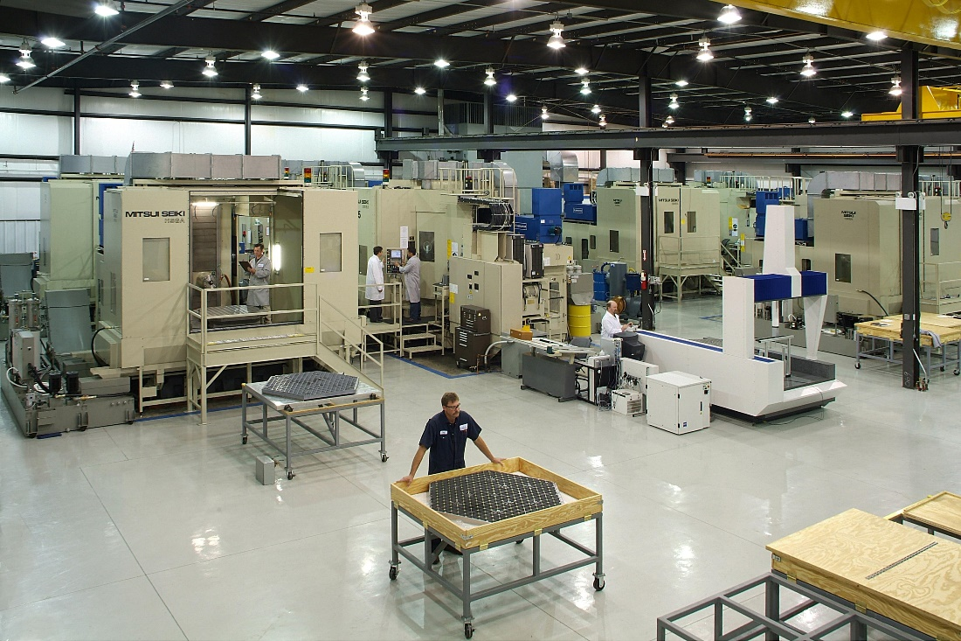
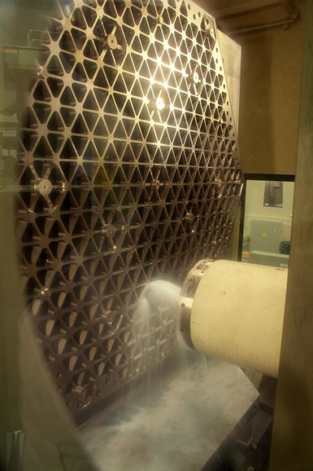
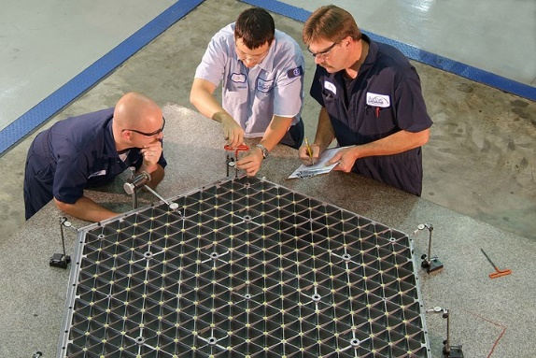
Segment Fabrication at Brush-Wellman, Inc.

Slide 20
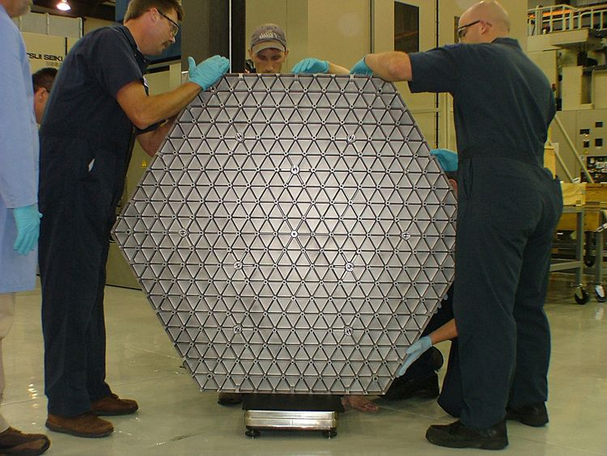
Ready to Grind and Polish at Tinsley

Slide 21
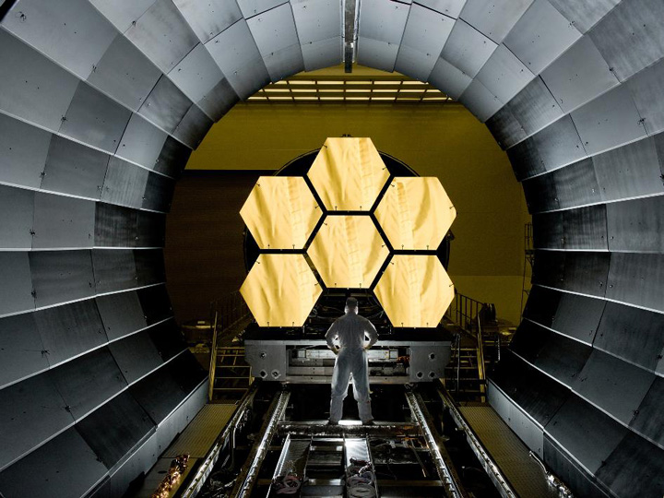
JWST Primary Mirror: Cryo-testing at 50K
Notes:
RDG

Slide 22
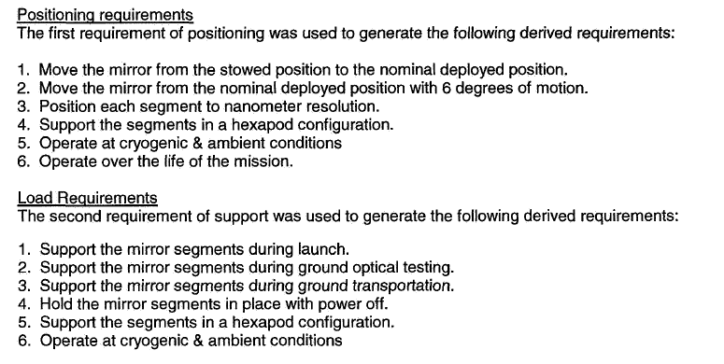
Actuator Requirements

Slide 23
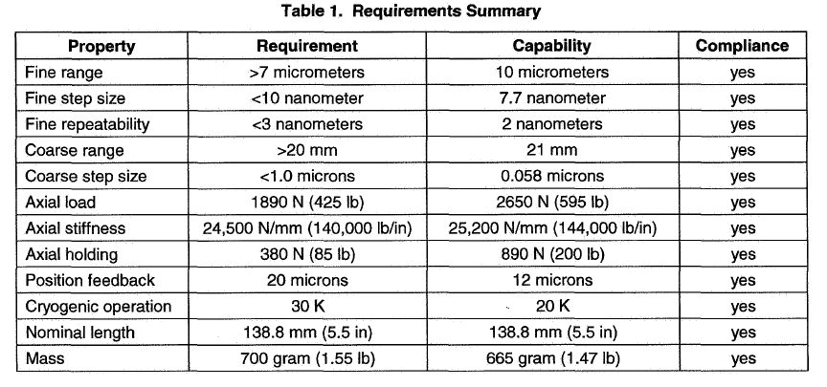
Actuator Requirements Summary

Slide 24
Mirror Actuator Fine Stage Concept
20 mm range

Slide 25
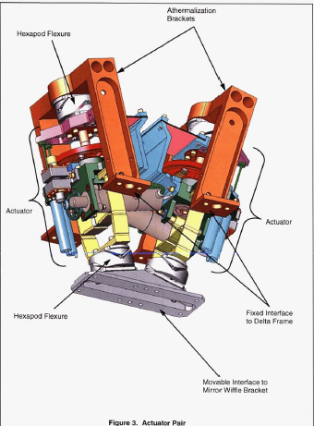
Actuator pair

Slide 26
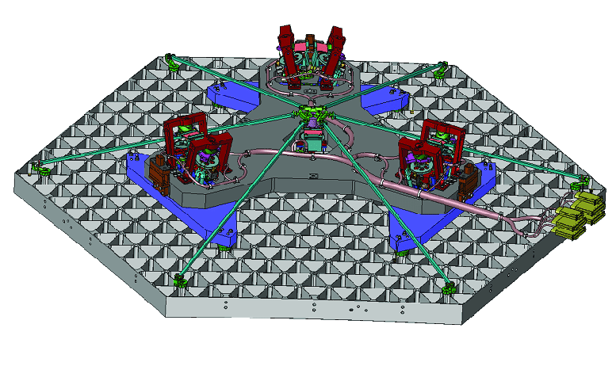
Detail of Segment Actuation System

Slide 27
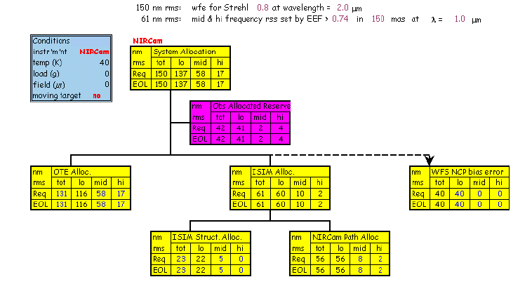
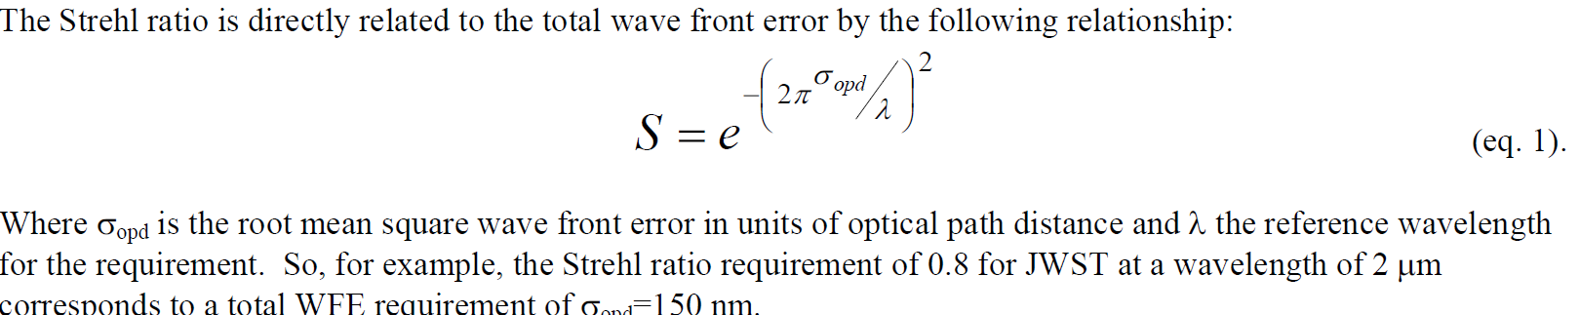
JWST Optics Error Budgets
  https://wp.optics.arizona.edu/optomech/wp-content/uploads/sites/53/2016/10/for-Jed.pdf

Slide 28
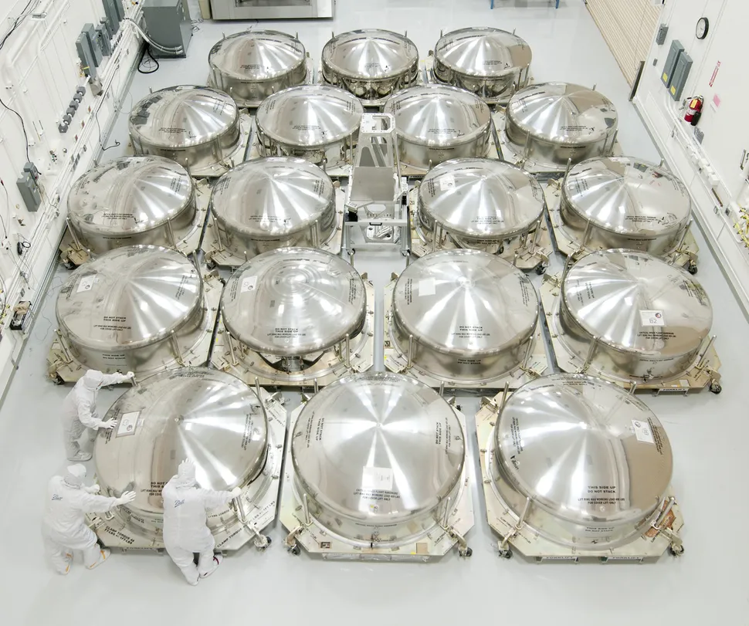
Eighteen Segments Ready to Ship

Slide 29
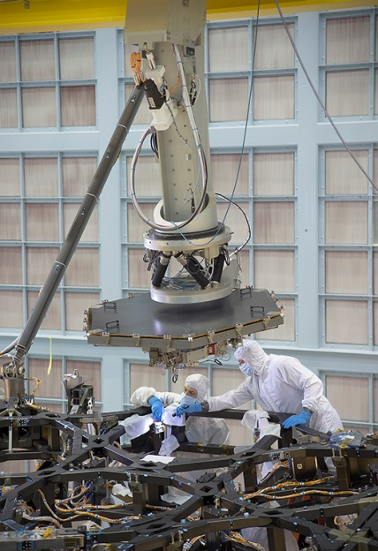
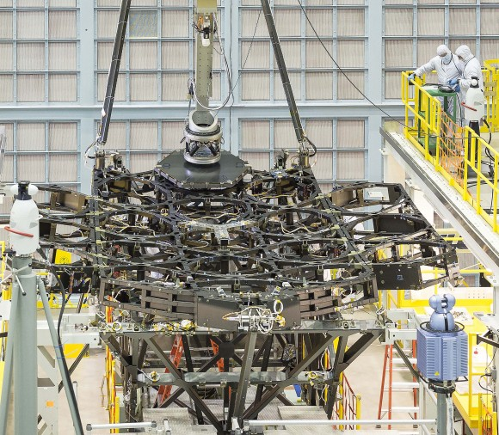
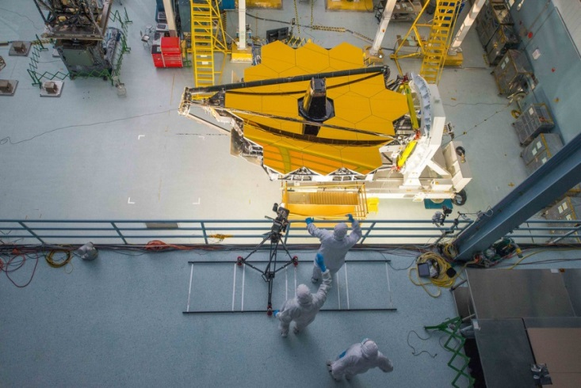
JWST Optical Telescope Assembly at GSFC
Graphite-epoxy backplane
Notes:
RDG

Slide 30
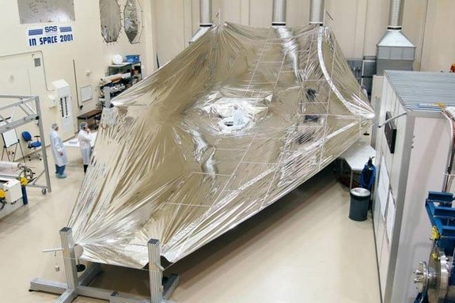
JWST Sun Sheild

Slide 31
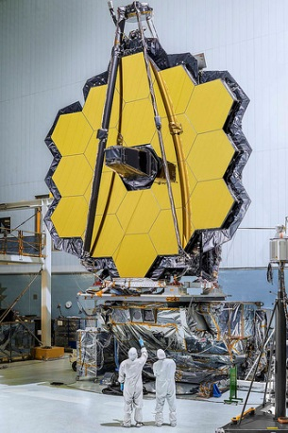
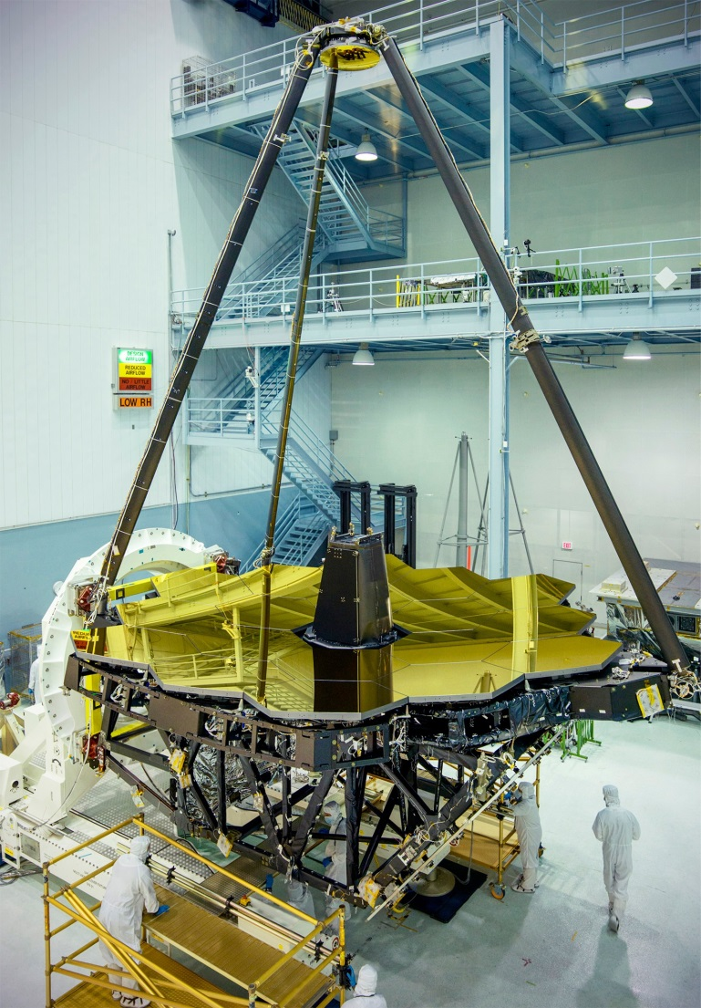
JWST Center-of-Curvature Pre-test at GSFC
Notes:
RDG

Slide 32
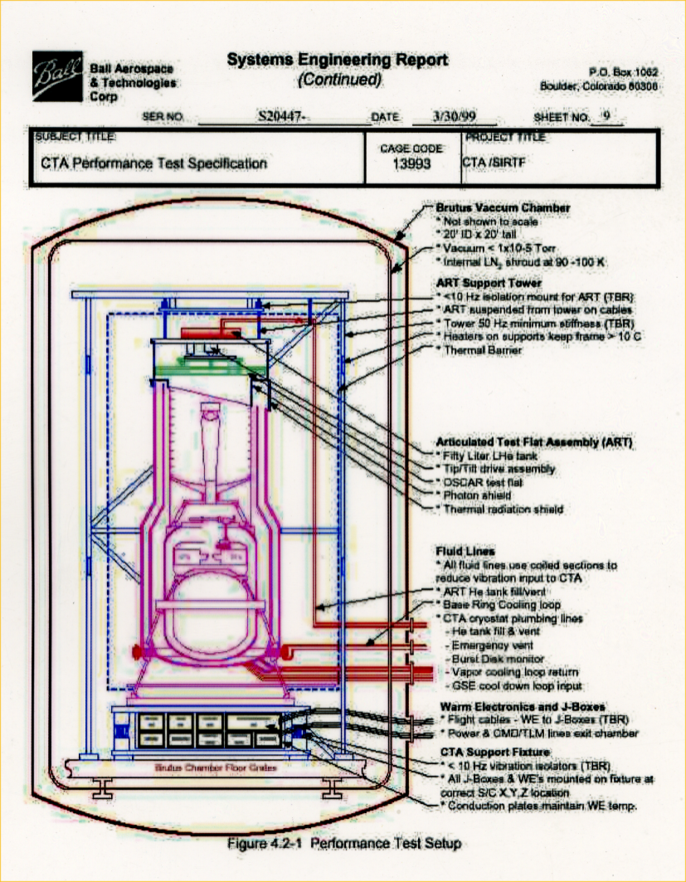
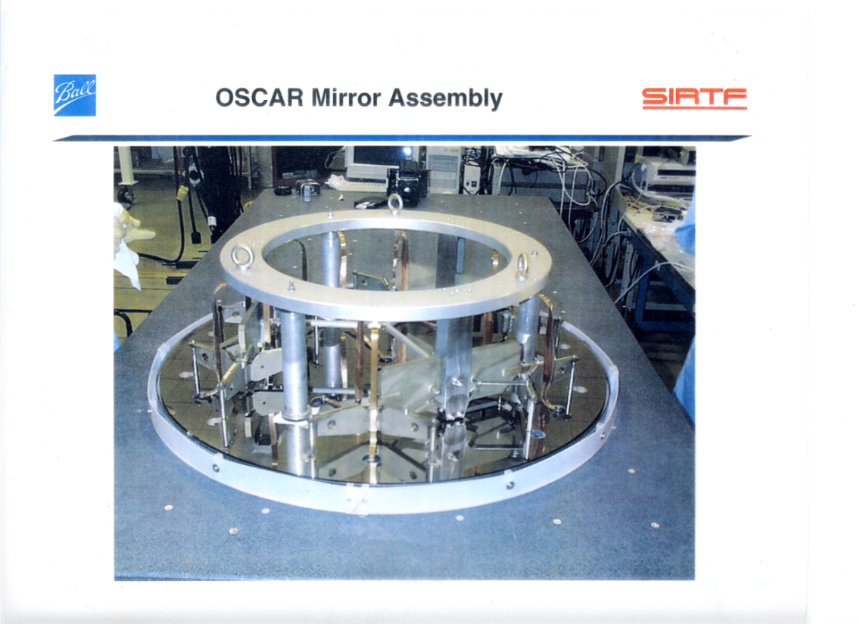
The BRUTUS End-to-End Optical Test
The OSCAR “auto-collimation” test
flat has a convex radius of curvature
of 3 km at the 5.5 K test temperature
160,000 L of Liquid He in 87 days!
Notes:
RDG

Slide 33
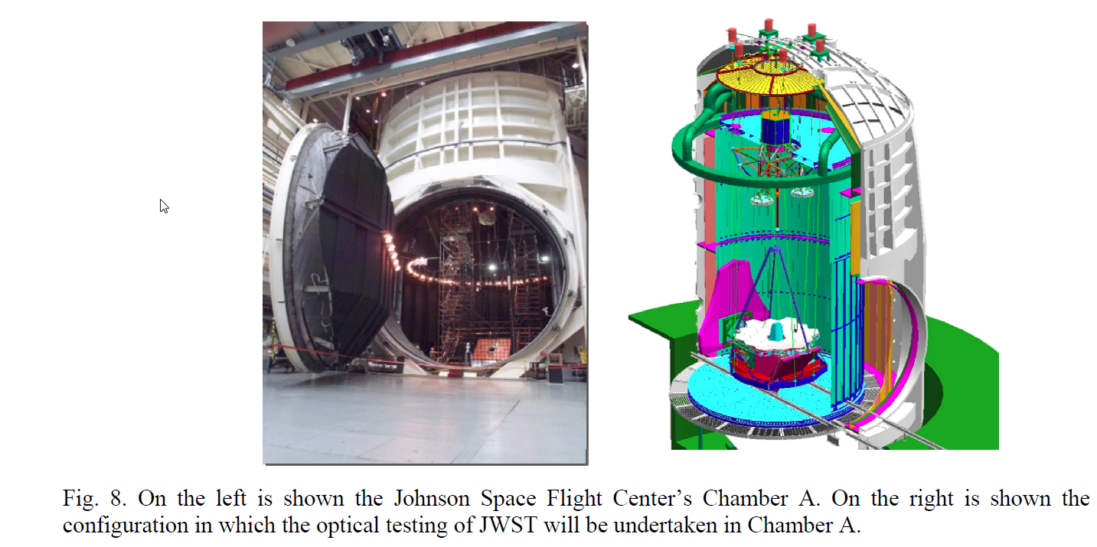
JWST Cold Center-of-Curvature Test at GSFC
Notes:
RDG

Slide 34
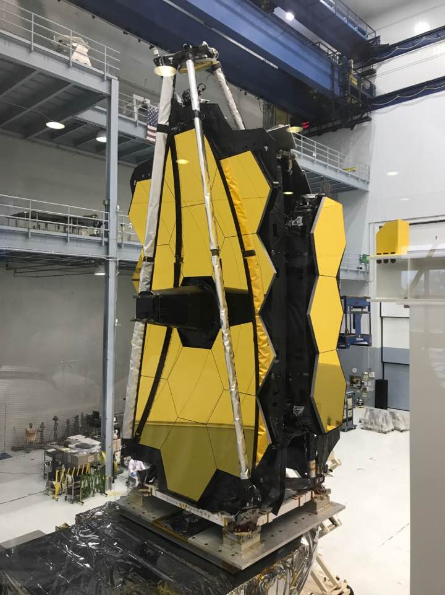
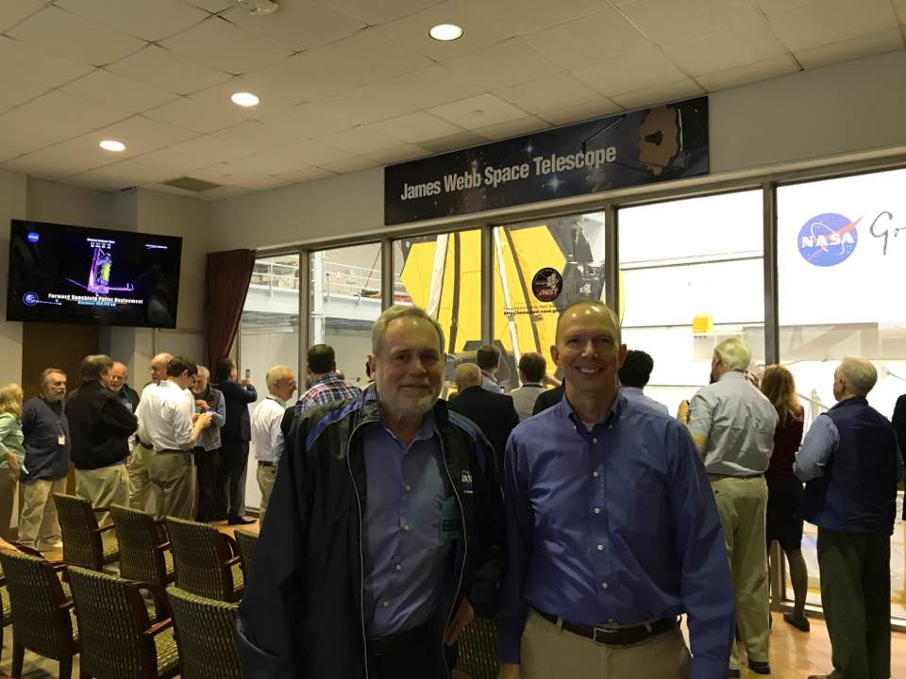
Status on April 24, 2017 at GSFC
Bob Gehrz (UMN) and Dave Chaney (BATC)
JWST all folded up and ready to go to JSFC for the CoC test

Slide 35
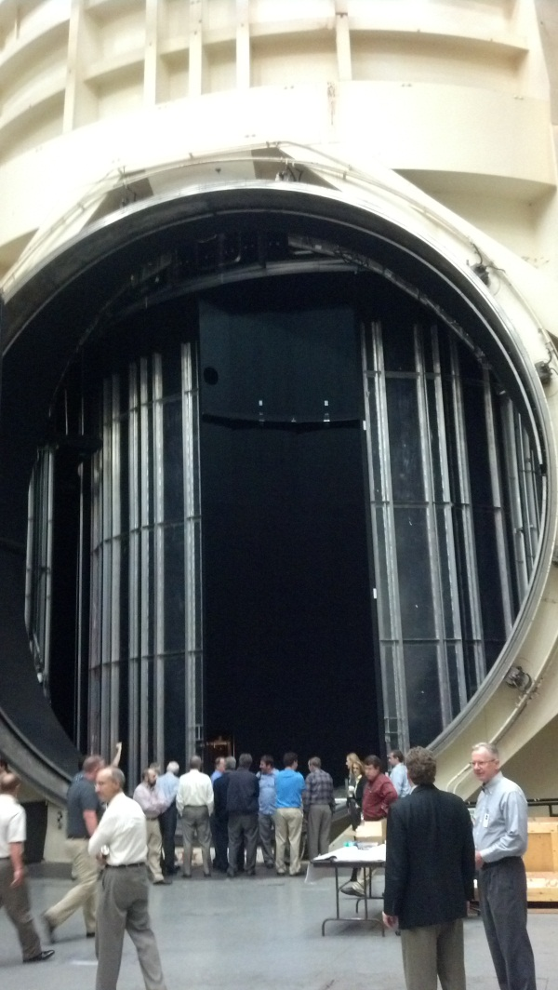
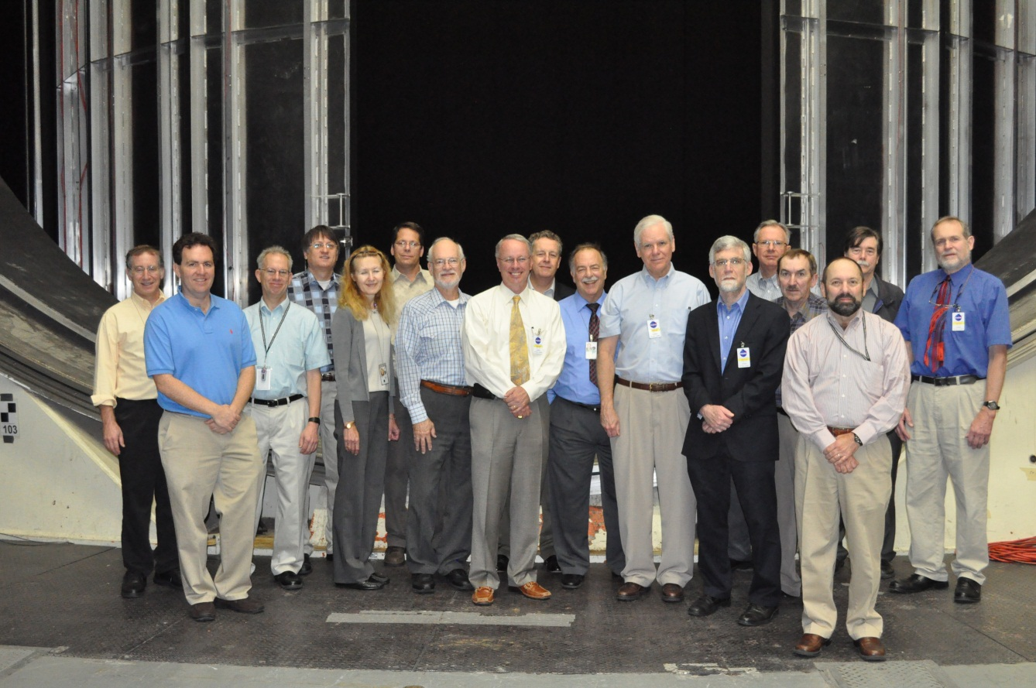
The JWST Product Integrity Team (PIT) Inspects JSFC Chamber A on October 8, 2012

Slide 36
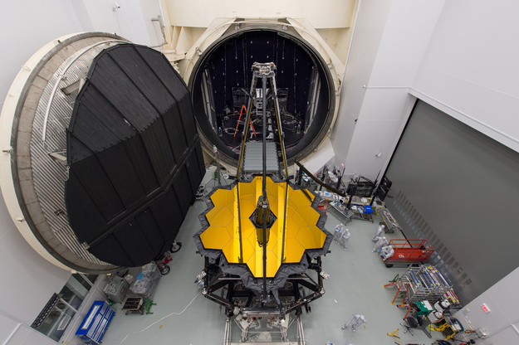
The OTIS Test
The JWST combined Optical Telescope element / Integrated Science instrument module (OTIS) \in front of the door the giant Chamber A thermal vacuum chamber at NASA's Johnson Space Center.

Slide 37

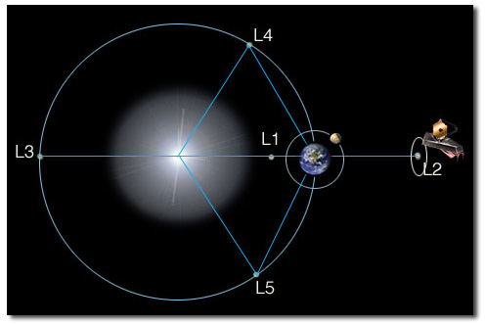
Launch and Deployment
Ariane 5 rocket launch
Orbits at L2, 1 million miles
from Earth
Notes:
RDG

Slide 38
Big Size and Infrared Eyes
Primary mirror made of 18 1.5-meter beryllium segments

Slide 39
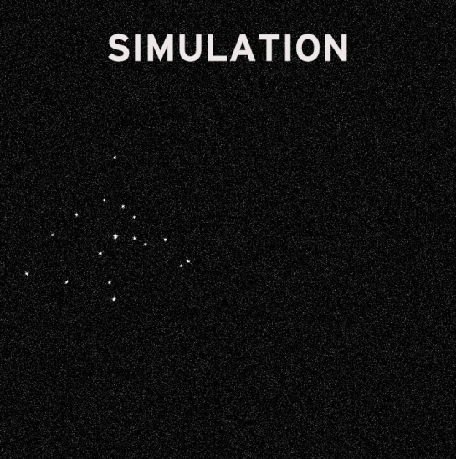
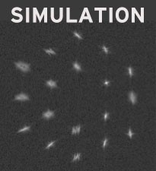
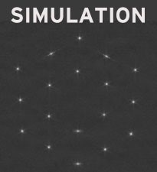
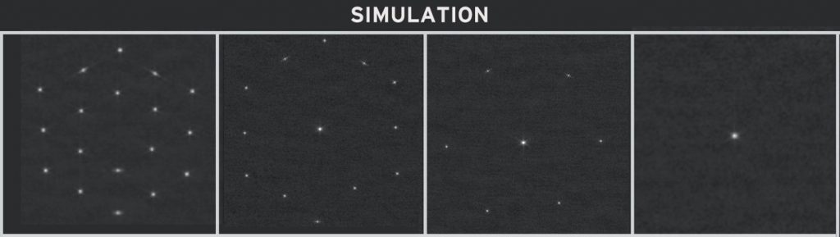
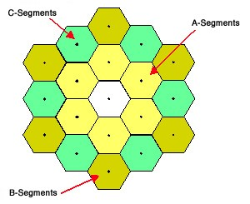
Alignment, Correction, and Stacking
Segment identification, alignment, and correction
Stacking sequence: A stacked, A+B stacked, A+B+C stacked

Slide 40
Initial Evaluationn Image

Slide 41
Initial Alighnment

Slide 42
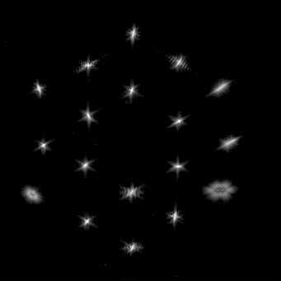
Focusing Bending the Segments
Notes:
RDG

Slide 43
Stacking the Eighteen Images
Stacking eighteen
separate images
produced by
eighteen separate
2-meter telescopes
Stacking sequence: A stacked, A+B stacked, A+B+C stacked

Slide 44
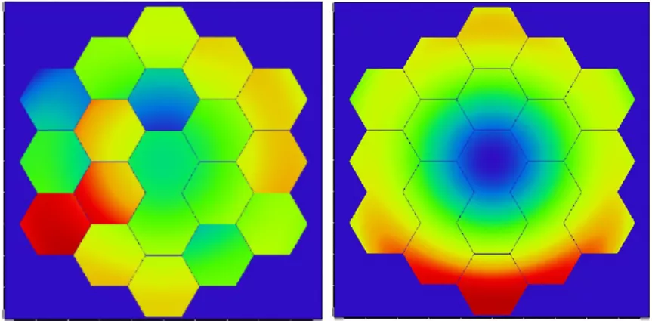
Phasing the Eighteen Segments to Look at the Same Wave-front Simultaneously (“Tuning the Orchestra”)

Slide 45
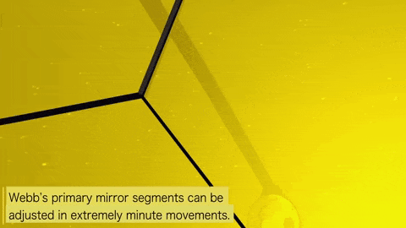
Phasing the Eighteen Segments to View the Same Wave-front Simultaneously

Slide 46

Fully Stacked and Phased First-light Image

Slide 47
Early Science Results from JWST

Slide 48

First JWST Deep Sky Image

Slide 49


How Gravitational Imaging Works
Light (photons) from the red star
falls toward the black star
Viewed in 3-D from
The point of view
of the observer, the
multiple images
form the Einstein Ring.

Slide 50
The Southern MAssive Cluster Survey (SMACS) 0723 images a galaxy 13.3 billion light years away

Slide 51


The Existence of Dark Matter is Indicated by the Way in which Galaxies Rotate
$$V= \sqrt{\frac{GM}{r}}$$

Slide 52

Gravitational Imaging of a Distant Galaxy by a Galaxy Cluster with Dark Matter

Slide 53

Gravitational Imaging of a Distant Galaxy by a Galaxy Cluster with Dark Matter

Slide 54

Multiple Galaxy Images
Multiple mages of three galaxies behind a foreground cluster

Slide 55


JWST Discovers the Most Distant Galaxy Yet
The galaxy is one of 50,000
sources in this JWST image
taken in the direction of
Pandora’s Cluster (Abell 2744)
It is 13.5 million light years away, seen 367 million years after the Big Bang

Slide 56




JWST’s Peek into the Eagle Nebula in Serpens
JWST
HST
Visible
JWST Infrared

Slide 57



JWST Reveals a Proto-star and its Preplanetary Disk
Artist’s
conceptions of how a
proto-stellar disc and its
bi-polar nebula wind are
related
The real thing in Dark Cloud L1527

Slide 58

JWST Reveals a Massive Star about to Explode as a Supernova
The Wolf-Rayet star
S124
undergoes episodes of mass loss as it evolves toward its catastrphic death
The real thing in Dark Cloud L1527

Slide 59



JWST NIRCam Images of SN1987A
The Wolf-Rayet star
S124
undergoes episodes of mass loss as it evolves toward its catastrphic death
The real thing in Dark Cloud L1527M
Matsuura, …Gehrz, …,Woodward, et al. 2023, ApJ, in press

Slide 60
The End for Now
More to Come

