Slide 1
Privacy-Preserving Location Services
Mohamed F. Mokbel
mokbel@cs.umn.edu
Department of Computer Science and Engineering
University of Minnesota

Slide 2
Tutorial Outline
PART I: Privacy Concerns of location-based Services
PART II: Realizing Location Privacy in Mobile Environments
PART III: Privacy Attack Models
PART IV: Privacy-aware Location-based Query Processing
PART V: Summary and Future Research Directions

Slide 3
Tutorial Outline
PART I: Privacy Concerns of location-based Services
  Location-based Services: Then, Now, What is Next
  Location Privacy: Why Now?
  User Perception of Location Privacy
  What is Special about Location Privacy
PART II: Realizing Location Privacy in Mobile Environments
PART III: Privacy Attack Models
PART IV: Privacy-aware Location-based Query Processing
PART V: Summary and Future Research Directions

Slide 4
Location-based Services: Definition
In an abstract way
A certain service that is offered to the users based on their locations

Slide 5
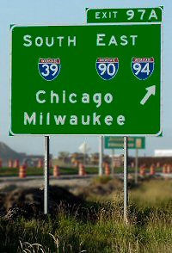
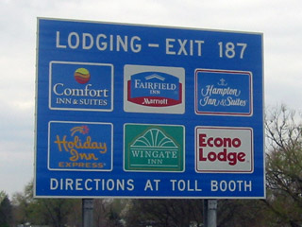
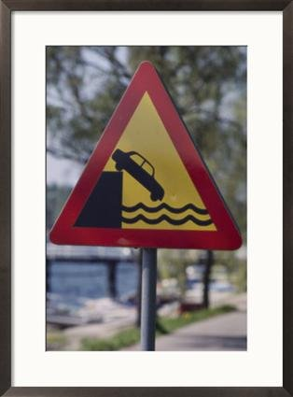
Location-based Services: Then
Limited to fixed traffic signs
How many years we have used these signs as the ONLY source for LBS

Slide 6
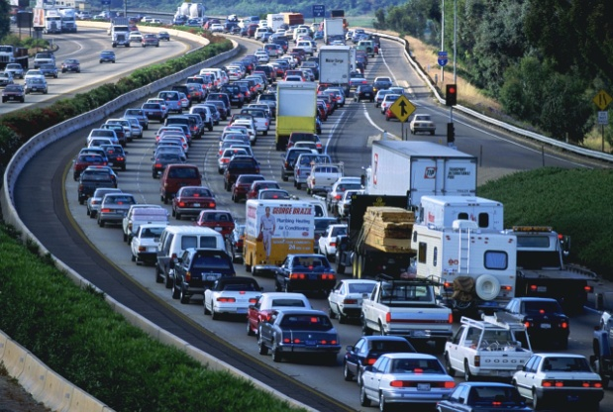
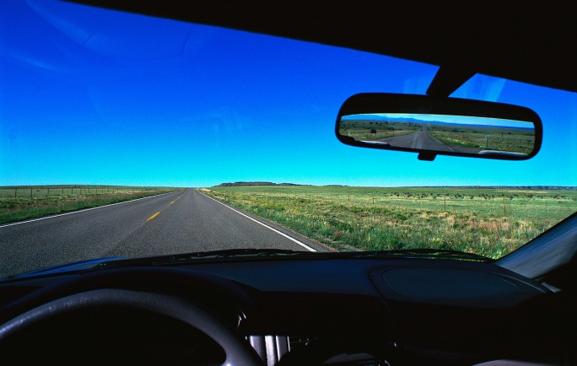
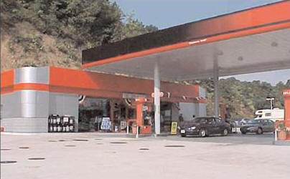
Location-based Services: Now
Location-based traffic reports:
  Range query: How many cars in the free way
  Shortest path query: What is the estimated travel time to reach my destination
Location-based store finder:
  Range query: What are the restaurants within five miles of my location
  Nearest-neighbor query: Where is my nearest fast (junk) food restaurant
Location-based advertisement:
  Range query: Send E-coupons to all customers within five miles of my store

Slide 7
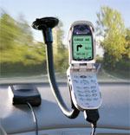
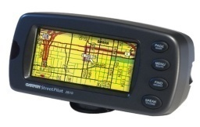
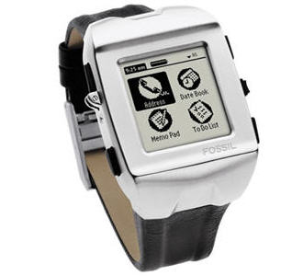
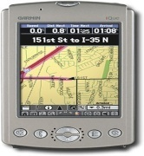

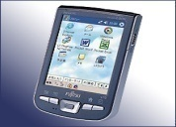

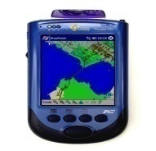
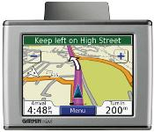
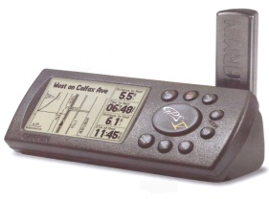
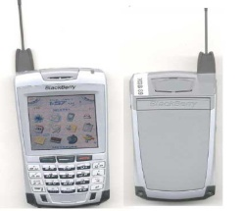
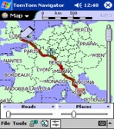
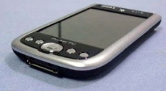

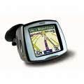
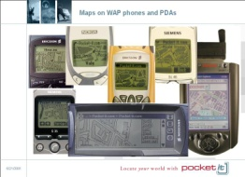
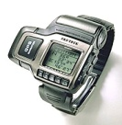

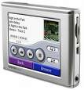
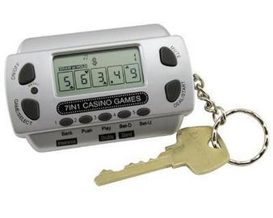

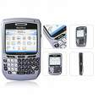

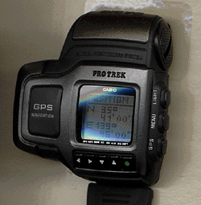
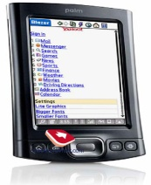
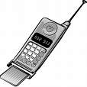
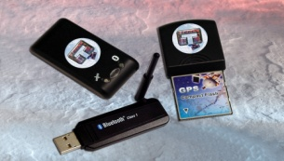
Location-based Services: Why Now ?

Slide 8
Location-based Services: Why Now ?
GIS/ Spatial Database
Web GIS
Mobile GIS
LBS
Mobile Devices
Internet
Mobile Internet
LBS is a convergence of technologies
Convergence of technologies to create LBS (Brimicombe, 2002)

Slide 9
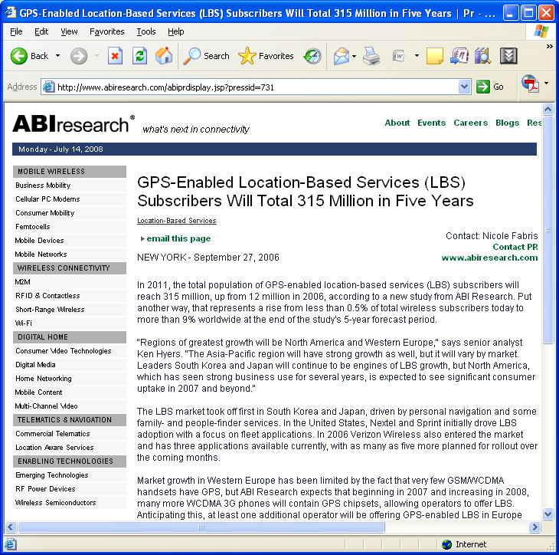
Location-based Services: What is Next
http://www.abiresearch.com/abiprdisplay.jsp?pressid=731

Slide 10
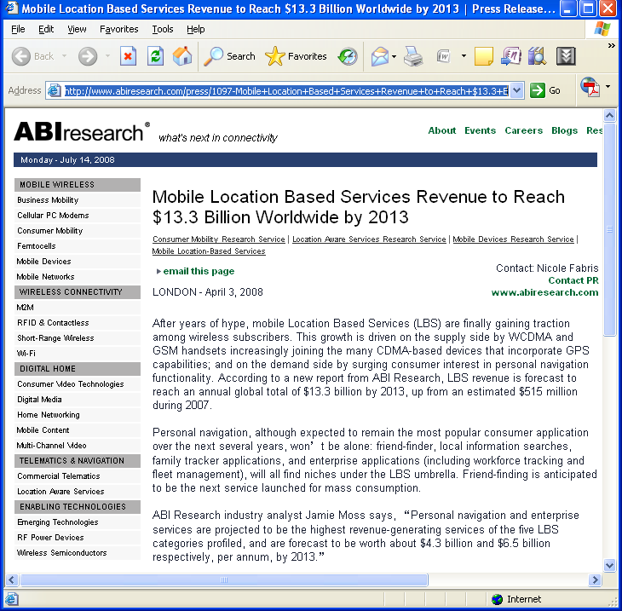
Location-based Services: What is Next
http://www.abiresearch.com/press/1097-Mobile+Location+Based+Services+Revenue+to+Reach+$13.3+Billion+Worldwide+by+2013

Slide 11
Tutorial Outline
PART I: Privacy Concerns of location-based Services
  Location-based Services: Then, Now, What is Next
  Location Privacy: Why Now?
  User Perception of Location Privacy
  What is Special about Location Privacy
PART II: Realizing Location Privacy in Mobile Environments
PART III: Privacy Attack Models
PART IV: Privacy-aware Location-based Query Processing
PART V: Summary and Future Research Directions

Slide 12
Location Privacy: Why Now ?
Do you use any of these devices ?
Do you ever feel that you are tracked?

Slide 13



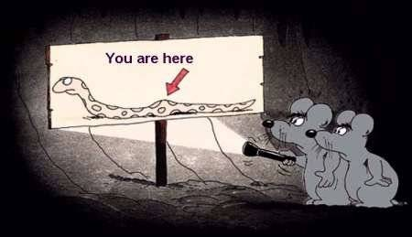
Major Privacy Threats
YOU ARE TRACKED…!!!!
“New technologies can pinpoint your location at any time and place. They promise safety and convenience but threaten privacy and security”
Cover story, IEEE Spectrum, July 2003

Slide 14
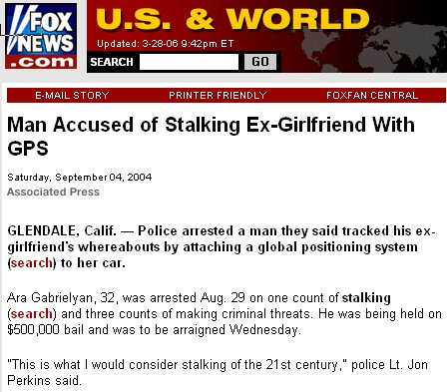
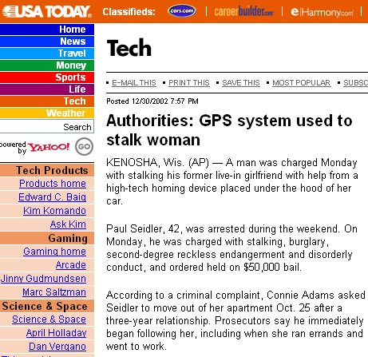
Major Privacy Threats
http://www.foxnews.com/story/0,2933,131487,00.html
http://www.usatoday.com/tech/news/2002-12-30-gps-stalker_x.htm

Slide 15

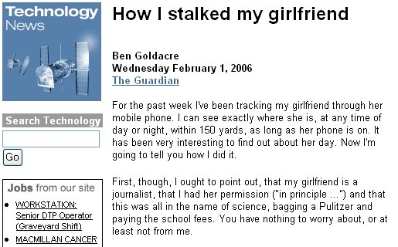
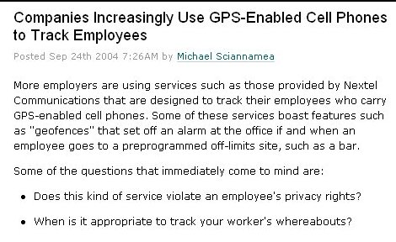
Major Privacy Threats
http://wifi.weblogsinc.com/2004/09/24/companies-increasingly-use-gps-enabled-cell-phones-to-track/
http://technology.guardian.co.uk/news/story/0,,1699156,00.html

Slide 16
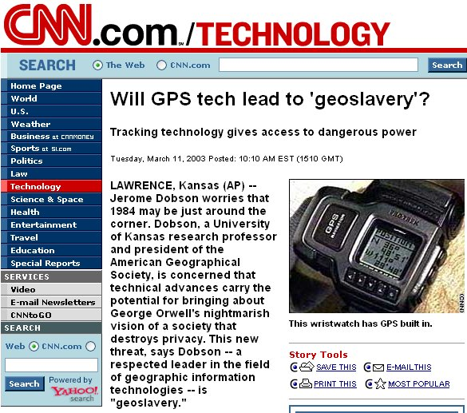
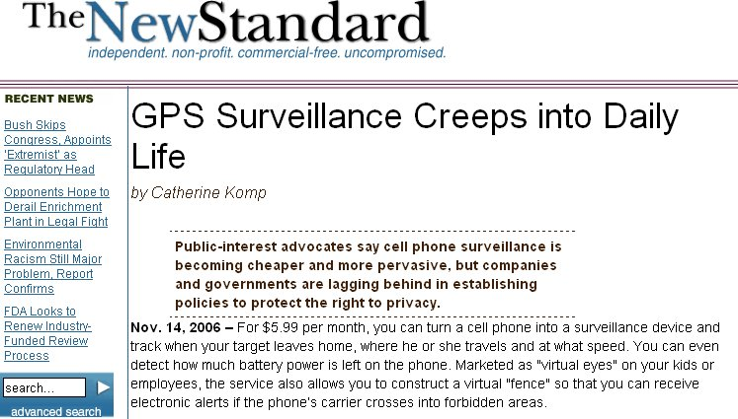
Major Privacy Threats
http://www.cnn.com/2003/TECH/ptech/03/11/geo.slavery.ap/
http://newstandardnews.net/content/?action=show_item&itemid=3886

Slide 17
Tutorial Outline
PART I: Privacy Concerns of location-based Services
  Location-based Services: Then, Now, What is Next
  Location Privacy: Why Now?
  User Perception of Location Privacy
  What is Special about Location Privacy
PART II: Realizing Location Privacy in Mobile Environments
PART III: Privacy Attack Models
PART IV: Privacy-aware Location-based Query Processing
PART V: Summary and Future Research Directions

Slide 18
User Perception of Location Privacy
One World – Two Views
Hey..!! We have a coupon for you
An advertisement where a shopper received a coupon for fifty cents off a double non-fat latte on his mobile device while walking by that coffee shop
LBS-Industry use this ad as a way to show how relevant location-based advertising could be
Privacy-Industry used the same ad to show how intrusive location-based advertising could be
We know that you prefer latte, we have a special for it
By the way, five of your colleagues and your boss are currently inside
Oh..! It seems that you were in Hawaii last week, so, you can afford our expensive breakfast today

Slide 19


User Perception of Location Privacy
One World – Two Views
A user signed a contract with the car rental that had the following two sentences highlighted in bold type as a disclaimer across the top:
“Vehicles driven in excess of posted speed limit will be charged $150 fee per occurrence. All our vehicles are GPS equipped”
In that case, the car rental company charged the user for $450 for three speed violations although the user had received no traffic tickets
The car rental company assumes that they have access to all user locations and driving habits
The user sues the car company as he “thinks” that he did not grant the company to follow his route

Slide 20
User Perception of Location Privacy
One World – Two Views
Location-based services rely on the implicit assumption that users agree on revealing their private user locations
Location-based services trade their services with privacy
  If a user wants to keep her location privacy, she has to turn off her location-detection device and (temporarily) unsubscribe from the service
Pseudonymity is not applicable as the user location can directly lead to its identity
Several social studies report that users become more aware about their privacy and may end up not using any of the location-based services

Slide 21
WHY location-detection devices?
With all its privacy threats, why do users still use location-detection devices?
Location-based Database Server
Wide spread of location-based services
Location-based store finders
  Where is my nearest gas station
Location-based traffic reports
  Let me know if there is congestion within 10 minutes of my route
Location-based advertisements
  Send e-coupons to all cars that are within two miles of my gas station

Slide 22
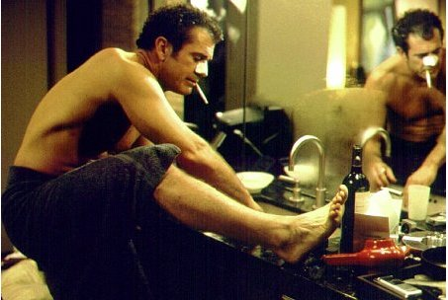
What Users Want
Entertain location-based services
without
revealing their private location information

Slide 23
Service-Privacy Trade-off
First extreme:
  A user reports her exact location ➔ 100% service
Second extreme:
  A user does NOT report her location ➔ 0% service
Desired Trade-off: A user reports a perturbed version of her location ➔ x% service

Slide 24

Service-Privacy Trade-off
Example:: What is my nearest gas station
100%
Service
0%
100%
Privacy
0%

Slide 25
Service-Privacy Trade-off
Case Study: Pay-per-Use Insurance
Policy 1. Only user cumulative data, not detailed location data, will be available to the insurance company
Policy 2. The insurance company has full access to the user location data without identifying information. Only cumulative data would have the identifying information. The insurance company is allowed to sell anonymized data to third parties. This policy is offered with five percent discount.
Telematics Service Provider

Slide 26
Service-Privacy Trade-off
Case Study: Pay-per-Use Insurance
Policy 3. The insurance company has full access to the user driving and personal information. The insurance company is not allowed to share this data with others. This policy is offered with ten percent discount.
Policy 4. The insurance company and third parties would have full access to the user driving and personal information. This policy is offered with fifteen percent discount.
Telematics Service Provider

Slide 27
Tutorial Outline
PART I: Privacy Concerns of location-based Services
  Location-based Services: Then, Now, What is Next
  Location Privacy: Why Now?
  User Perception of Location Privacy
  What is Special about Location Privacy
PART II: Realizing Location Privacy in Mobile Environments
PART III: Privacy Attack Models
PART IV: Privacy-aware Location-based Query Processing
PART V: Summary and Future Research Directions

Slide 28
What is Special About Location Privacy
There has been a lot of work on data privacy
Hippocratic databases
Access methods
K-anonymity
Can we use these techniques for location privacy ?

Slide 29
What is Special About Location Privacy
Database Privacy
Location Privacy
The goal is to keep the privacy of the stored data (e.g., medical data)
Queries are explicit (e.g., SQL queries for patient records)
Applicable for the current snapshot of data
Privacy requirements are set for the whole set of data
The goal is to keep the privacy of data that is not stored yet (e.g., received location data)
Queries need to be private (e.g., location-based queries)
Should tolerate the high frequency of location updates
Privacy requirements are personalized

Slide 30
Tutorial Outline
PART I: Privacy Concerns of location-based Services
PART II: Realizing Location Privacy in Mobile Environments
  Concepts for Hiding Location Information
  System Architectures for preserving location privacy
    Client-Server Architecture
    Third Trusted Party Architecture
    Peer-to-peer Architecture
PART III: Privacy Attack Models
PART IV: Privacy-aware Location-based Query Processing
PART V: Summary and Future Research Directions

Slide 31
Concepts for Location Privacy
Location Perturbation
The user location is represented with a wrong value
The privacy is achieved from the fact that the reported location is false
The accuracy and the amount of privacy mainly depends on how far the reported location form the exact location

Slide 32
Concepts for Location Privacy
Spatial Cloaking
Location cloaking, location blurring, location obfuscation
The user exact location is represented as a region that includes the exact user location
An adversary does know that the user is located in the cloaked region, but has no clue where the user is exactly located
The area of the cloaked region achieves a trade-off between the user privacy and the service

Slide 33
Concepts for Location Privacy
Spatio-temporal Cloaking
In addition to spatial cloaking the user information can be delayed a while to cloak the temporal dimension
Temporal cloaking could tolerate asking about stationary objects (e.g., gas stations)
Challenging to support querying moving objects, e.g., what is my nearest police car
Y
X
T

Slide 34
Concepts for Location Privacy
Data-Dependent Cloaking
Naïve cloaking
MBR cloaking

Slide 35
Concepts for Location Privacy
Space-Dependent Cloaking
Fixed grid cloaking
Adaptive grid cloaking

Slide 36
Concepts for Location Privacy k-anonymity
The cloaked region contains at least k users
The user is indistinguishable among other k users
The cloaked area largely depends on the surrounding environment.
A value of k =100 may result in a very small area if a user is located in the stadium or may result in a very large area if the user in the desert.
10-anonymity

Slide 37
Concepts for Location Privacy
Privacy Profile
Each mobile user will have her own privacy-profile that includes:
  K. A user wants to be k-anonymous
  A_{min}. The minimum required area of the blurred area
  A_{max}. The maximum required area of the blurred area
  Multiple instances of the above parameters to indicate different privacy profiles at different times
Time
k
A_{min}
A_{max}
8:00 AM -
1
___
___
5:00 PM -
100
1 mile
3 miles
10:00 PM -
5 miles
___
1000

Slide 38
Concepts for Location Privacy
Query Types
Private Queries over Public Data
  What is my nearest gas station
  The user location is private while the objects of interest are public
Public Queries over Private Data
  How many cars in the downtown area
  The query location is public while the objects of interest is private
Private Queries over Private Data
  Where is my nearest friend
  Both the query location and objects of interest are private

Slide 39
Concepts for Location Privacy
Modes of Privacy
User Location Privacy
  Users want to hide their location information and their query information
User Query Privacy
  Users do not mind or obligated to reveal their locations, however, users want to hide their queries
Trajectory Privacy
  Users do not mind to reveal few locations, however, they want to avoid linking these locations together to form a trajecotry

Slide 40
Concepts for Location Privacy
Requirements of the Location Anonymization Process
Accuracy.
  The anonymization process should satisfy and be as close as possible to the user requirements (expressed as privacy profile)
Quality.
  An adversary cannot infer any information about the exact user location from the reported location
Efficiency.
  Calculating the anonymized location should be computationally efficient and scalable
Flexibility.
  Each user has the ability to change her privacy profile at any time

Slide 41
Tutorial Outline
PART I: Privacy Concerns of location-based Services
PART II: Realizing Location Privacy in Mobile Environments
  Concepts for Hiding Location Information
  System Architectures for preserving location privacy
    Client-Server Architecture
    Third Trusted Party Architecture
    Peer-to-peer Architecture
PART III: Privacy Attack Models
PART IV: Privacy-aware Location-based Query Processing
PART V: Summary and Future Research Directions

Slide 42
System Architectures for Location Privacy
Client-Server architecture
  Users communicated directly with the sever to do the anonymization process. Possibly employing an offline phase with a trusted entity
Third trusted party architecture
  A centralized trusted entity is responsible for gathering information and providing the required privacy for each user
Peer-to-Peer cooperative architecture
  Users collaborate with each other without the interleaving of a centralized entity to provide customized privacy for each single user

Slide 43

Client-Server Architecture
Privacy-aware Query Processor
1: Query +
Scrambled Location Information
2: Candidate Answer
Scrambling the location

Slide 44
Client-Server Architecture
  Clients try to cheat the server using either fake locations or fake space
  Simple to implement, easy to integrate with existing technologies
  Lower quality of service
  Examples: Landmark objects, false dummies, and space transformation

Slide 45
Client-Server Architecture:
Landmark objects
Instead of reporting the exact location, report the location of a closest landmark
The query answer will be based on the landmark
Voronoi diagrams can be used to identify the closest landmark

Slide 46
Client-Server Architecture:
False Dummies
A user sends m locations, only one of them is true while m-1 are false dummies
The server replies with a service for each received location
The user is the only one who knows the true location, and hence the true answer
Generating false dummies should follow a certain pattern similar to a user pattern but with different locations
Server
A separate answer for each received location

Slide 47
Client-Server Architecture:
Location Obfuscation
All locations are represented as vertices in a graph with edges correspond to the distance between each two vertices
A user represents her location as an imprecise location (e.g., I am within the central park)
The imprecise location is abstracted as a set of vertices
The server evaluates the query based on the distance to each vertex of imprecise locations

Slide 48
Client-Server Architecture:
Space Transformation
Users transform their locations from the two-dimensional space to another space using a reversible transformation
The new space does not have to have the same dimensionality as the original space.
The database server answers location-based queries in the new space. This could result in an approximate answer
The user apply a reverse transformation to transform the answer to the original space
6
7
10
11
5
8
9
12
4
3
14
13
1
2
15
16

Slide 49
Third Trusted Party Architecture
Privacy-aware Query Processor
2: Query +
Cloaked Spatial Region
3: Candidate Answer
Location-based Database Server
Third trusted party that is responsible on blurring the exact location information.
Location Anonymizer
4: Candidate Answer
1: Query +
Location Information

Slide 50
Third Trusted Party Architecture
  A trusted third party receives the exact locations from clients, blurs the locations, and sends the blurred locations to the server
  Provide powerful privacy guarantees with high-quality services
  System bottleneck and sophisticated implementations
  Examples: Casper, CliqueCloak, and spatio-temporal cloaking

Slide 51
Third Trusted Party Architecture:
Mix Zones
A mix zone is defined as a connected spatial region of maximum size where users do not register for an application
Users can change their pseudonyms once they enter the mix zone
A user may refuse to send any location update if the mix zone has less than k users
Upon emerging from the mix zone, an adversary cannot know which one of the users has came out
App Zone
Mix Zone
App Zone
App Zone

Slide 52
Third Trusted Party Architecture: k-area cloaking
Sensitive areas are pre-defined
The space is divided into a set of zones where each zone has at least k sensitive area
All location updates for a user within a certain zone are buffered
Upon leaving a zone, user locations are revealed only if the users did not visit any of the sensitive areas

Slide 53
Third Trusted Party Architecture:
Quadtree Spatial Cloaking
Achieve k-anonymity, i.e., a user is indistinguishable from other k-1 users
Recursively divide the space into quadrants until a quadrant has less than k users.
The previous quadrant, which still meet the k-anonymity constraint, is returned
Achieve 5-anonmity for

Slide 54
Third Trusted Party Architecture:
CliqueCloak Algorithm
Each user requests:
  A level of k anonymity
  A maximum cloaked area
Build an undirected constraint graph. Two nodes are neighbors, if their maximum areas contain each other.
E (k=3)
B (k=4)
D (k=4)
F (k=5)
m (k=3)
H (k=4)
A (k=3)
C (k=2)
For a new user m, add m to the graph. Find the set of nodes that are neighbors to m in the graph and has level of anonymity <= m.k
The cloaked region is the MBR that includes the user and neighboring nodes. All users within an MBR use that MBR as their cloaked region

Slide 55
Third Trusted Party Architecture:
Bi-directional CliqueCloak
Each user requests:
  A level of k anonymity
  A maximum cloaked area
  A maximum cloaking latency
Build a directed constraint graph. An edge from node X to node Y exists if maximum area of X contains Y.
E (k=3)
B (k=4)
F (k=5)
m (k=3)
D (k=4)
H (k=4)
A (k=3)
C (k=2)
For a new user m, add m to the graph. Find the set of nodes that are outgoing neighbors to m in the graph
The cloaked region is the MBR that includes outgoing neighboring nodes. Users within an MBR are not tied to use the same MBR as their cloaked region

Slide 56
Third Trusted Party Architecture:
Hilbert k-Anonymizing
All user locations are sorted based on their Hilbert order
To anonymize a user, we compute start and end values as:
  start = rank_{u} - (rank_{u} mod k_{u})
  end = start + k_{u} – 1
A cloaked spatial region is an MBR of all users within the range (from start to end).
The main idea is that it is always the case that k_{u} users would have the sane [start,end] interval
I
F
G
H
J
E
C
D
K
A
B
L
 | A | B | C | D | E | F | G | H | I | J | K | L
k_{u} | 6 | 5 | 4 | 5 | 4 | 5 | 6 | 5 | 7 | 4 | 5 | 4
Rank_{u} | 0 | 1 | 2 | 3 | 4 | 5 | 6 | 7 | 8 | 9 | 10 | 11

Slide 57
Third Trusted Party Architecture:
Nearest-Neighbor k-Anonymizing
STEP 1: Determine a set S containing u and k - 1 u’s nearest neighbors.
STEP 2: Randomly select v from S.
STEP 3: Determine a set S’ containing v and v’s k - 1 nearest neighbors.
STEP 4: A cloaked spatial region is an MBR of all users in S’ and u.
S
S’
The main idea is that randomly selecting one of the k nearest neighbors achieves the k-anonymity

Slide 58
Third Trusted Party Architecture:
Privacy Grid
The system space is divided into grid cells where each cell maintains the number of users in the cell
3
2
1
0
4
0
3
4
4
5
To anonymize a user request, we start from the cell containing the user, then we expand the cell area to neighboring cells until the user privacy requirements is satisfied
2
4
3
3
4
6
2
3
4
5
0
2
4
5
6
Anonymity level = 20

Slide 59
Third Trusted Party Architecture:
Basic Pyramid Structure
The entire system area is represented as a complete pyramid structure divided into grids at different levels of various resolution
Each grid cell maintains the number of users in that cell
To anonymize a user request, we traverse the pyramid structure from the bottom level to the top level until a cell satisfying the user privacy profile is found.
Scalable. Simple to implement. Overhead in maintaining all grid cells

Slide 60
Third Trusted Party Architecture:
Adaptive Pyramid Structure
Instead of maintaining all pyramid cells, we maintain only those cells that are potential cloaked regions
Similar to the case of the basic pyramid structure, traverse the pyramid structure from the bottom level to the top level, until a cell satisfying the user privacy profile is found.
Most likely we will find the cloaked region in only one hit
Scalable. Less overhead in maintaining grid cells. Need maintenance algorithms

Slide 61
Third Trusted Party Architecture:
Adaptive Pyramid Structure: Maintenance
To guarantee its efficiency, the adaptive pyramid structure dynamically adjusts its maintained cells based on users’ mobility
Cell Splitting: Once one of the users in a certain cell expresses relaxed privacy profile, the cell is split into four lower cells
Cell Merging: Once all users within certain cells strength their privacy profiles, those cells can be merged together

Slide 62
Peer-to-Peer Architecture
Privacy-aware Query Processor
2: Candidate Answer
1: Query +
Cloaked Location Information

Slide 63
Peer-to-Peer Architecture
Peer users are collaborating with each others to keep their customized privacy information
A result of evolving mobile peer-to-peer communication technologies
No need for a third trusted party
A certificate could be applied to approve trustworthy users
Examples: Group Formation and PRIVE

Slide 64
Peer-to-Peer Architecture
Group Formation
The main idea is that whenever a user wants to issue a location-based query, the user broadcasts a request to its neighbors to form a group. Then, a random user of the group will act as the query sender.

Slide 65
Peer-to-Peer Cooperative Architecture
Group Formation
Phase 1: Peer Searching
  Broadcast a multi-hop request until at least k-1 peers are found
Phase 2: Location Adjustment
  Adjust the locations using velocity
Phase 3: Spatial Cloaking
  Blur user location into a region aligned to a grid that cover the k-1 nearest peers
Example: k = 5
On-demand mode
  A mobile user only forms an anonymous group when it needs it
Proactive mode
  Mobile users periodically execute the on-demand approach to maintain their anonymous groups

Slide 66
Peer-to-Peer Cooperative Architecture
Hierarchical Hilbert Peer-to-Peer
*
start = 6
end = 11
A
Users are sorted by their Hilbert values.
Users are grouped in a hierarchical way
Cluster heads are responsible for handling users’ requests
The root is responsible for calculating start and end values
  start = rank_{u} - (rank_{u} mod k_{u})
  end = start + k_{u} - 1
k = 6
F
I
*
E
G
H
*
J
A
H
*
D
*
K
*
C
*
A
L
M
B
 | A | B | C | D | E | F | G | H | I | J | K | L | M
k_{u} | 6 | 5 | 4 | 5 | 4 | 5 | 6 | 5 | 6 | 4 | 5 | 4 | 5
H(u) | 1 | 2 | 3 | 4 | 5 | 6 | 8 | 9 | 10 | 12 | 13 | 15 | 16
Rank_{u} | 0 | 1 | 2 | 3 | 4 | 5 | 6 | 7 | 8 | 9 | 10 | 11 | 12

Slide 67
Peer-to-Peer Cooperative Architecture
Non-Hierarchical Hilbert Peer-to-Peer
Instead of organizing users on a tree, users are organized as a ring
To get anonymized, a user generates a random offset
Send to all involved clusters that involve [offset,offset+k_{u}-1]
U₂
U₃
F
I
E
G
H
*
J
D
*
U₄
K
*
  offset = uniform(0, k_{u}-1)
C
G
U₃
U₂
F
H*
*
A
L
M
E
I
U₁
B
D*
J
k = 6, offset =4
K*
 | A | B | C | D | E | F | G | H | I | J | K | L | M
k_{u} | 6 | 5 | 4 | 5 | 4 | 5 | 6 | 5 | 6 | 4 | 5 | 4 | 5
H(u) | 1 | 2 | 3 | 4 | 5 | 6 | 8 | 9 | 10 | 12 | 13 | 15 | 16
Rank_{u} | 0 | 1 | 2 | 3 | 4 | 5 | 6 | 7 | 8 | 9 | 10 | 11 | 12
C
L
B
M
U₄
A*
U₁

Slide 68
Tutorial Outline
PART I: Privacy Concerns of location-based Services
PART II: Realizing Location Privacy in Mobile Environments
PART III: Privacy Attack Models
  Adversary Attempts
  Adversary Attack Models
  Solutions for Attack Models
PART IV: Privacy-aware Location-based Query Processing
PART V: Summary and Future Research Directions

Slide 69

Privacy Attack Models
Adversary Attempts: Knowing the User Location
If an adversary manages to get hold of users’ location information, the adversary may be able to link user locations to their queries. Two ways for knowing user locations:
  Users location may be public. For example, employees are in their cubes during daytime hours
  An adversary may hire someone to use the system and keep monitoring the actual user location with the given location or region

Slide 70
Privacy Attack Models
Adversary Attempts: Knowing the User Location
Two modes of privacy: Location Privacy and Query Privacy
Location Privacy:
  Users want to hide their location information and their query information
Query Privacy:
  Users do not mind to or obligated to reveal their locations. However, users want to hide their queries
  Examples: Employees at work.

Slide 71
Privacy Attack Models
Adversary Attempts: Location and Query Tracking
Location Tracking: An adversary may link data from several consecutive location instances that use the same pseudonym
Location tracking can be avoided by generating different pseudonym for each location update
Query Tracking: An adversary may monitor unusual continuous queries may reveal the user identity
Even with different pseudonyms, unusual queries could be linked together

Slide 72
Tutorial Outline
PART I: Privacy Concerns of location-based Services
PART II: Realizing Location Privacy in Mobile Environments
PART III: Privacy Attack Models
  Adversary Attempts
  Adversary Attack Models
  Solutions for Attack Models
PART IV: Privacy-aware Location-based Query Processing
PART V: Summary and Future Research Directions

Slide 73
Privacy Attack Models
Location Distribution Attack
Location distribution attack takes place when:
  User locations are known
  Some users have outlier locations
  The employed spatial cloaking algorithm tends to generate minimum areas
Given a cloaked spatial region covering a sparse area (user A) and a partial dense area (users B, C, and D), an adversary can easily figure out that the query issuer is an outlier.
F
E
D
B
C
A

Slide 74
Privacy Attack Models
Maximum Movement Boundary Attack
Maximum movement boundary attack takes place when:
  Continuous location updates or continuous queries are considered
  The same pseudonym is used for two consecutive updates
  The maximum possible speed is known
The maximum speed is used to get a maximum movement boundary (MBB)
The user is located at the intersection of MBB with the new cloaked region
I know you are here!
R_{i+1}
R_{i}

Slide 75
Privacy Attack Models
Query Tracking Attack
This attack takes place when:
  Continuous location updates or continuous queries are considered
  The same pseudonym is used for several consecutive updates
  User locations are known
Once a query is issued, all users in the query region are candidates to be the query issuer
If the query is reported again, the intersection of the candidates between the query instances reduces the user privacy
F
G
H
D
E
A
C
I
B
J
K
At time t_{i} {A,B,C,D,E}
At time t_{i+1}{A,B,F,G,H}
At time t_{i+2} {A,F,G,H,I}

Slide 76
Tutorial Outline
PART I: Privacy Concerns of location-based Services
PART II: Realizing Location Privacy in Mobile Environments
PART III: Privacy Attack Models
  Adversary Attempts
  Adversary Attack Models
  Solutions for Attack Models
PART IV: Privacy-aware Location-based Query Processing
PART V: Summary and Future Research Directions

Slide 77
Solution to Location Distribution Attack: k-Sharing Region Property
K-sharing Region Property: A cloaked spatial region not only contains at least k other users, but it is also shared by at least k of these users.
The same cloaked spatial region is produced from k users. An adversary cannot link the region to an outlier
F
E
D
B
C
A
May not result in the best cloaked region for each user, yet, it would result in an overall more privacy-aware environment
Examples of techniques that are free from this attack include CliqueCloak

Slide 78
Solution to Maximum Movement Boundary Attack
Safe Update Property
Two consecutive cloaked regions R_{i} and R_{i+1} from the same users are free from the maximum movement boundary attack if one of these three conditions hold:
  The overlapping area satisfies user requirements
  R_{i} totally covers R_{i+1}
  The MBB of R_{i} totally covers R_{i+1}
R_{i+1}
R_{i+1}
R_{i+1}
R_{i}
R_{i}
R_{i}
  The MMB of R_{i} totally covers R_{i+1}

Slide 79
Solution to Maximum Movement Boundary Attack
Patching and Delaying
Patching: Combine the current cloaked spatial region with the previous one
Delaying: Postpone the update until the MMB covers the current cloaked spatial region
R_{i+1}
R_{i+1}
R_{i}
R_{i}

Slide 80
Solution to Query Tracking Attack:
Memorization Property
Remember a set of users S that is contained in the cloaked spatial region when the query is initially registered with the database server
Adjust the subsequent cloaked spatial regions to contain at least k of these users.
F
G
H
D
E
A
C
I
B
J
K
If a user S is not contained in a subsequent cloaked spatial region, this user is immediately removed from S.
This may result in a very large cloaked spatial region. At some point, the server may decide to disconnect the query and restart it with a new identity.

Slide 81
Tutorial Outline
PART I: Privacy Concerns of location-based Services
PART II: Realizing Location Privacy in Mobile Environments
PART III: Privacy Attack Models
PART IV: Privacy-aware Location-based Query Processing
  Dealing with fake locations/space (Client-server architecture)
  Dealing with cloaked regions (Third trusted party and P2P architectures)
PART V: Summary and Future Research Directions

Slide 82
The Privacy-aware Query Processor
Dealing with Fake Locations/Space
Almost no changes at the query processor
The query processor answers the submitted query with a good faith regardless of whether the submitted location is right or not
Based on how fake is the submitted location/space, the query processor would give an approximate answer
Exact answers can be obtained with a higher cost
The user must transform the query answer back into its original location/space

Slide 83
Dealing with Fake Locations / Space
Perturbed Locations
Perturbed locations can be fake ones or landmark locations
The perturbed location is of distance d from the original location
  d is a user specified parameter that determines the amount of required privacy
Worst case analysis: Damage in Answer = 2d
Average case analysis: Damage in Answer= d
No change is required in the query processor
No more overhead to the query processor
d+X
d
X

Slide 84
Dealing with Fake Locations / Space
Dummy Locations
The query processor will evaluate a query for each individual dummy location
The user can single out her own answer based on the actual location
No change is required in the query processor
More overhead to the query processor as more redundant queries will be evaluate

Slide 85
Dealing with Fake Locations / Space
Space Twist: Anchor Points
For a nearest-neighbor query, a user located at q issues an “incremental” NN query from an arbitrarily fake point q`
For each object O returned from the server, the user computes:
  Supply region; a circle centered at q` with a radius dist(q’, O)
  Demand region; a circle centered at q with a radius dist(q, O_{nearest}), where O_{nearest} is the nearest object to q among the objects returned from the server so far
Terminate whenever the demand region is included in supply region
The exact answer is O_{nearest}
q'
1st NN of q'
2nd NN of q'
O_{nearest} to q
O_{nearest} to q
q
3rd NN of q'

Slide 86
Dealing with Fake Locations / Space
Hilbert Space Transformation
H(q)=50
q
Finding approximate nearest-neighbors using Hilbert order
The objects are sorted based on their Hilbert values H(O_{i})
For a k-NN query q, the answer is the k objects with the smallest Hilbert distance to H(q)
An offline anonymizer transforms all objects of interest using the Hilbert Order
I
F
G
H
J
E
C
D
K
A
L
B
 | A | D | C | B | L | K | H | J | I | G | E | F
H(O_{i}) | 3 | 5 | 10 | 15 | 22 | 25 | 36 | 38 | 48 | 55 | 58 | 62
The space transformation function is hidden from the server
The answer is approximate as it makes use of the locality preserving mapping of the Hilbert curve. The exact answer is F

Slide 87
Dealing with Fake Locations / Space
Private Information Retrieval: Hilbert Order
The main idea of Private Information Retrieval (PIR) is to allow users to privately retrieve information from a database, without the database server learning what particular information the user has requested
I
All points are clustered into buckets at the server based on Hilbert Order
When initiating a query, the user u determines its Hilbert order H(u), then the user performs O(log n) PIR “binary” search to retrieve the closest bucket
F
G
H
J
E
C
D
K
This is expensive in terms of number of PIRs.
A
L
B
The answer is approximate as it makes use of the locality preserving mapping of the Hilbert curve.

Slide 88
Dealing with Fake Locations / Space
Private Information Retrieval: kd-tree
Finding approximate nearest-neighbors using kd-tree
Partition the space into rectangular regions based on the kd-tree
For a NN query q, the user initiates a request to the server to get the kd-tree structure
Then, the user determines its tree cell C and uses PIR request to retrieve all objects of interest in C
F
I
G
J
E
C
H
D
q
K
A
B
L
That is an approximate approach as the user will get {C, H, K} as an answer while the exact answer is B

Slide 89
Dealing with Fake Locations / Space
Private Information Retrieval: R-tree
Finding approximate nearest-neighbors using R-tree
The server arranges objects of interest in minimum bounding rectangles (MBRs) as the leaf nodes of an R-tree
For a NN query q, the user initiates a request to get the R-tree structure
Then, the user determines its closest MBR and uses PIR request to retrieve all its objects of interest
F
I
G
J
E
H
D
C
K
q
A
B
L
That is an approximate approach as the user will get {K, L} as an answer while the exact answer is H

Slide 90
Dealing with Fake Locations / Space
Private Information Retrieval: Voroni Diagram + Grid
Finding exact nearest-neighbors using Voroni Diagram and Grid
The server partitions the space into Voronoi cell and regular grid cells
For each grid cell, we store the voronoi cells that it overlaps with
The user knows it cells, so, it imitates a PIR request to get objects of interest in voronoi cells that intersects with its cell
p₁
A
p₅
p₆
B
p₂
q
C
p₃
p₇
D
p₄
Cell | Objects
A1 | P1, P2
A2 | P1, P2, P5
A3 | P2, P5, P6
A4 | P5, P6
Cell | Objects
B1 | P1, P2,
B2 | P2, P3
B3 | P2, P3, P5, P6, P7
B4 | P6, P7
The answer set is {P₂, P₃, P₅, P₆, P₇} where it includes the exact answer

Slide 91
Tutorial Outline
PART I: Privacy Concerns of location-based Services
PART II: Realizing Location Privacy in Mobile Environments
PART III: Privacy Attack Models
PART IV: Privacy-aware Location-based Query Processing
  Dealing with fake locations/space (Client-server architecture)
  Dealing with cloaked regions (Third trusted party and P2P architectures)
    Range Queries
    Aggregate Queries
    Nearest-Neighbor Queries
PART V: Summary and Future Research Directions

Slide 92
The Privacy-aware Query Processor
Dealing with Cloaked Regions
A new privacy-aware query processor will be embedded inside the location-based database server to deal with spatial cloaked areas rather than exact location information
Traditional Query:
  What is my nearest gas station given that I am in this location
New Query:
  What is my nearest gas station given that I am somewhere in this region

Slide 93
The Privacy-aware Query Processor
Dealing with Cloaked Regions
Two types of data:
  Public data. Gas stations, restaurants, police cars
  Private data. Personal data records
Three types of queries:
  Private queries over public data
    What is my nearest gas station
  Public queries over private data
    How many cars in the downtown area
  Private queries over private data
    Where is my nearest friend

Slide 94
Tutorial Outline
PART I: Privacy Concerns of location-based Services
PART II: Realizing Location Privacy in Mobile Environments
PART III: Privacy Attack Models
PART IV: Privacy-aware Location-based Query Processing
  Dealing with fake locations/space (Client-server architecture)
  Dealing with cloaked regions (Third trusted party and P2P architectures)
    Range Queries
    Aggregate Queries
    Nearest-Neighbor Queries
PART V: Summary and Future Research Directions

Slide 95

Range Queries
Private Queries over Public Data
Example: Find all gas stations within x miles from my location where my location is somewhere in the cloaked spatial region
The basic idea is to extend the cloaked region by distance x in all directions
Every gas station in the extended region is a candidate answer
Range query

Slide 96
Range Queries
Private Queries over Public Data
Extend the cloaked area in all directions by the required distance
Three ways for answer representation:
All possible answer
Answer per area
Probabilistic Answer
0.4
0.25
0.4
0.05
0.1

Slide 97
Range Queries
Public Queries over Private Data
Example: Find all cars within a certain area
Objects of interest are represented as cloaked spatial regions in which the objects of interest can be anywhere
Any cloaked region that overlaps with the query region is a candidate answer
Range query

Slide 98
Range Queries
Public Queries over Private Data
Range Queries: What are the objects that are within the area of Interest
  Any object that has a privacy region overlaps with the area of interest: C, D, E, F, H
A
B
C
Probabilistic Range Queries: With each object, report the probability of being part of the answer
  (C, 0.3), (D, 0.2), (E, 1), (F, 0.6), (H, 0.4)
  Can be computed by the ratio of the overlapping area between the cloaked region and the query region
  Easy to compute for uniform distribution
  Challenging in case of non-uniform distributions
D
E
F
G
H
I
J

Slide 99
Range Queries
Public Queries over Private Data
Threshold Probabilistic Range Queries: What are the objects within area of interest with at least 50% probability: E, F
More practical version and much easier to compute
The threshold value is used for answer pruning to avoid extensive computation for exact probabilities
A
B
C
D
E
F
G
H
I
J

Slide 100
Range Queries
Private Queries over Private Data
Example: Find my friends within x miles of my location where my location is somewhere within the cloaked spatial region
Both the querying user and objects of interest are represented as cloaked regions
Solution approaches will be a mix of the techniques used at “private queries over public objects” and “public queries over private objects”
Range query

Slide 101
Range Queries
Private Queries over Private Data
Candidate Answer:
  C, D, E, F, G, H
Resolve Queries First. Divide the user cloaked area into regions where each region has a certain set of candidate answers. Apply the uniform distribution model to get the probability of each object
Extensive computations are required. Need for heuristic solutions
Threshold range queries are much easier to compute
A
B
C
D
E
F
G
H
I
J

Slide 102
Tutorial Outline
PART I: Privacy Concerns of location-based Services
PART II: Realizing Location Privacy in Mobile Environments
PART III: Privacy Attack Models
PART IV: Privacy-aware Location-based Query Processing
  Dealing with fake locations/space (Client-server architecture)
  Dealing with cloaked regions (Third trusted party and P2P architectures)
    Range Queries
    Aggregate Queries
    Nearest-Neighbor Queries
PART V: Summary and Future Research Directions

Slide 103
Aggregate Queries
Private Queries over Public Data
How many gas stations within x miles of my location
Answer per area
Minimum = 0, Maximum = 2
Prob (0) = 0.2, Prob(1) = 0.25 + 0.2 + 0.5 = 0.5, Prob(2) = 0.3
Average = 1.1
Alternatively, each area can be represented by an answer

Slide 104
Aggregate Queries
Public Queries over Private Data
Aggregate Queries: How many objects within area of interest
  Minimum: 1, Maximum: 5
  Average: 0.3 + 0.2 + 1 + 0.6 + 0.4 = 2.5
A
B
C
Probabilistic Aggregate Queries: How many objects (with probabilities) within area of interest
  Prob(1)=(0.7)(0.8)(0.4)(0.6)=0.1344
  ….
  [1, 0.1344], [2, 0.3824], [3,0.3464], [4, 0.1244], [5,0.0144]
  More statistics can be computed
D
E
F
G
H
I
J

Slide 105
Aggregate Queries
Private Queries over Private Data
A
Private Queries over Private Data: To be able to compute the aggregates, we would have to go through the same procedure for range queries to either compute the probabilities of each object or divide the query region into partial regions with an answer for each region
B
C
D
E
F
G
H
I
J

Slide 106
Tutorial Outline
PART I: Privacy Concerns of location-based Services
PART II: Realizing Location Privacy in Mobile Environments
PART III: Privacy Attack Models
PART IV: Privacy-aware Location-based Query Processing
  Dealing with fake locations/space (Client-server architecture)
  Dealing with cloaked regions (Third trusted party and P2P architectures)
    Range Queries
    Aggregate Queries
    Nearest-Neighbor Queries
PART V: Summary and Future Research Directions

Slide 107
Nearest-Neighbor Queries
Private Queries over Public Data
Example: Find my nearest gas station given that I am somewhere in the cloaked spatial region
The basic idea is to find all candidate answers
There is a trade-off between the area of the cloaked spatial region (privacy) and the size of the candidate answer (quality of service)
NN query

Slide 108
Nearest-Neighbor Queries
Private Queries over Public Data: Optimal Answer
The Optimal answer can be defined as the answer with only exact candidates, i.e., each returned candidate has the potential to be part of the answer.
  Too cumbersome to compute
A heuristic to get the optimal answer is to find the minimum possible range that include all potential candidate answers
  False positives will take place

Slide 109
Nearest-Neighbor Queries
Private Queries over Public Data: Optimal Answer (1-D)
Given a one-dimensional line L = [start, end], a set of objects O= {o₁, o₂,…,o_{n}}, find an answer as tuples <o_{i} ,T> where o_{i} Є O and T ⊂ L such that o_{i} is the nearest object to any point in L
Developed for continuous nearest-neighbor queries
Optimal answer in terms of only providing all possible answers. No redundant answers are returned
Answer can be represented as all objects, probability, or by area

Slide 110
Nearest-Neighbor Queries
Private Queries over Public Data: Optimal Answer (1-D)
Scan objects by plane-sweep way
Maintain two vicinity circles centered a the start and end points
If an object lies within the two vicinity circles, remove the previous object
If an object lies within only one vicinity circle, then the previous object is part of the answer
  Draw a bisector to get part of the answer
  Update the start point
Ignore objects that are outside the vicinity circle
A
G
B
D
s
e
F
C
E

Slide 111
Nearest-Neighbor Queries
Private Queries over Public Data: Optimal Answer (2-D)
For each edge for the cloaked region, scan objects with plane-sweep
For each two consecutive points, get the intersection between their bisector and the current edge
Based on the set of bisectors, we decide the point that could be nearest neighbors to any point on that edge
All objects of interest that are within the query range are returned also in the answer
p₅
p₂
p₇
p₁
s
s₁
s₂
s₂
e
p₃
p₈
p₆
p₄

Slide 112
Nearest-Neighbor Queries
Private Queries over Public Data: Finding a Range
Step 1: Locate four filters. The NN target object for each vertex
Step 2 : Find the middle points. The furthest point on the edge to the two filters
Step 3: Extend the query range
Step 4: Candidate answer
v
m₃₄
v
3
4
T
m₂₄
m₁₃
3
T
4
T
T
1
2
v
m₁₂
v
1
2

Slide 113
Nearest-Neighbor Queries
Private Queries over Public Data: Finding an Optimal Range
Same as the previous heuristic with the exception that an edge can be divided into two segments if one of these two conditions hold:
  the distance between the middle point and the filter is the maximum, and
  the NN target object for the middle point is a new filter
Line segments are recursively divided until no more divisions are possible
v
m₃₄
v
3
4
m₁₃
m₂₄
v
m₁₂
v
1
2

Slide 114
Nearest-Neighbor Queries
Private Queries over Public Data: Answer Representation
Regardless of the underlying method to compute candidate answers, we have three alternatives:
  Return the list of the candidate answers to the user
  Employ a Voronoi diagram for all the objects in the candidate answer list to determine the probability that each object is an answer.
  Voronoi diagrams can provide the answer in terms of areas
v
v
3
4
v
v
1
2

Slide 115
Nearest-Neighbor Queries
Public Queries over Private Data
Example: Find my nearest car
Several objects may be candidate to be my nearest-neighbor
The accuracy of the query highly depends on the size of the cloaked regions
Very challenging to generalize for k-nearest-neighbor queries
NN query

Slide 116
Nearest-Neighbor Queries
Public Queries over Private Data
Nearest-Neighbor Queries: Where is my nearest friend
Filter Step:
  Compute the maximum distance for each object
  MinMax = the “minimum” “maximum distance”
  Filter out objects that are outside the circle of radius MinMax
Compute the minimum distance MinDist to each possible object for further analysis
A
B
C
D
E
F
G
H
I

Slide 117
Nearest-Neighbor Queries
Public Queries over Private Data
D
H
F
C
B
G
All possible answers: (ordered by MinDist)
  D, H, F, C, B, G
Probabilistic Answer:
  Compute the exact probability of each answer to be a nearest-neighbor
  The probability distribution of an object within a range is NOT uniform
A much easier version (and more practical) is to find those objects that can be nearest-neighbor with at leaset certain probability

Slide 118
Nearest-Neighbor Queries
Private Queries over Private Data
NN query

Slide 119
Nearest-Neighbor Queries
Private Queries over Private Data
Step 1: Locate four filters
  The NN target object for each vertex
Step 2: Find the middle points
  The furthest point on the edge to the two filters
Step 3: Extend the query range
Step 4: Candidate answer
v
m₃₄
4
v
m₂₄
3
m₁₃
v
m₁₂
v
1
2

Slide 120
Tutorial Outline
PART I: Privacy Concerns of location-based Services
PART II: Realizing Location Privacy in Mobile Environments
PART III: Privacy Attack Models
PART IV: Privacy-aware Location-based Query Processing
PART V: Summary and Future Research Directions
  Topics Not Covered in this Tutorial
  Putting Things Together
  Research Directions

Slide 121
Topics Not Covered
Privacy-Preserving Trajectory Publications
The idea is to be able to publish trajectory data without revealing the identity of its users
Main References:
    O. Abul, F. Bonchi, M. Nanni: Never Walk Alone: Uncertainty for Anonymity in Moving Objects Databases. ICDE 2008
    A. Gkoulalas-Divanis, V. Verykios, M. Mokbel . Identifying Unsafe Routes for Network-Based Trajectory Privacy. SDM 2009
    E. Nergiz, M. Atzori, Y. Saygin. Towards Trajectory Anonymization: a Generalization-Based Approach. Proceedings of ACM SIGSPATIAL GIS Workshop on Security and Privacy in GIS and LBS, 2008
    M. Terrovitis, N. Mamoulis: Privacy Preservation in the Publication of Trajectories. MDM 2008
    T. Xu and Y. Cai. Exploring Historical Location Data for Anonymity Preservation in Location-based Services. IEEE Infocom 2008.

Slide 122
Topics Not Covered
Location Privacy in Road Networks
Road networks provide a background knowledge that can be used by an adversary to infer the user location
As an example, consider a cloaked region that includes only one road segment
Main References:
    B. Hoh, M. Gruteser, R. Herring, J. Ban, D. Work, J. Herrera, A. Bayen, M. Annavaram, Q. Jacobson: Virtual trip lines for distributed privacy-preserving traffic monitoring. MobiSys 2008
    W-S Ku, R. Zimmermann, W-C Peng, S. Shroff. Privacy Protected Query Processing on Spatial Networks. ICDE Workshops 2007
    P-Y Li, W-C Peng, T-W Wang, W-S Ku, J. Xu, J. Hamilton . A Cloaking Algorithm Based on Spatial Networks for Location Privacy. SUTC 2008
    T-H You, W-C Peng, W-C Lee. Protecting Moving Trajectories with Dummies. MDM Workshops 2007

Slide 123
Topics Not Covered
Location Privacy in Sensor Networks
Sensor network environment has its own constraints in terms of power consumption and bandwidth communication
A location privacy paradigm for sensor network should respect the sensor network environment properties
Main References:
    C-Y. Chow, M. Mokbel, T. He: Tinycasper: a privacy-preserving aggregate location monitoring system in wireless sensor networks (Demo). SIGMOD 2008
    R. Ganti, N. Pham, Y-E. Tsai, T. Abdelzaher: PoolView: stream privacy for grassroots participatory sensing. SenSys 2008
    M. Gruteser and B. Hoh. On the Anonymity of Periodic Location Samples. In Proceeding of the International Conference on Security in Pervasive Computing, 2005.

Slide 124
Tutorial Outline
PART I: Privacy Concerns of location-based Services
PART II: Realizing Location Privacy in Mobile Environments
PART III: Privacy Attack Models
PART IV: Privacy-aware Location-based Query Processing
PART V: Summary and Future Research Directions
  Topics Not Covered in this Tutorial
  Putting Things Together
  Research Directions

Slide 125
Summary (1)
Putting Things Together
Social Science
Data Mining
HCI
Network
Security
Database
Privacy Profile
Anonymization Process
Location-based Server
Feedback

Slide 126
Summary (2)
Location privacy is a major obstacle in ubiquitous deployment of location-based services
Major privacy threats with real life scenarios are currently taking place due to the use of location-detection devices
Several social studies indicate that users become more aware about their privacy
Location privacy is significantly different from database privacy as the aim to protect incoming data and queries not the stored data
Three main architectures for location anonymization: client-server architecture, third trusted party architecture, and peer-to-peer architecture

Slide 127
Summary (3)
Adversary attacks may aim to obtain data about user location information or linking location/query updates
Three attack models are discussed: location distribution attack, maximum movement boundary attack, and query tracking attacks
Three novel types of queries are discussed: private queries over public data, public queries over public data, and private queries over private data
Probabilistic query processors and querying uncertain data approaches can be utilized to support privacy-aware query processors

Slide 128
Tutorial Outline
PART I: Privacy Concerns of location-based Services
PART II: Realizing Location Privacy in Mobile Environments
PART III: Privacy Attack Models
PART IV: Privacy-aware Location-based Query Processing
PART V: Summary and Future Research Directions
  Topics Not Covered in this Tutorial
  Putting Things Together
  Research Directions

Slide 129
Open Research Issues
Social Science / HCI
Realistic ways that users can utilize to express their privacy
Casual users really do not get the ideas of anonymization, cloaking, and blurring
Providing models like strict privacy, medium privacy, low privacy, and custom privacy
Mapping from such predefined models to the technical terms (e.g., k-anonymity)
Adjusting user privacy requirements based on the received service

Slide 130
Open Research Issues
Location Anonymization
A formal definition for the optimal spatial cloaked regions
Developing workload benchmark to be used for comparison of various anonymization techniques. Measures of comparison would be scalability, efficiency in terms of time, close-to-optimal cloaked regions
Developing new algorithms that support various user requirements
Making the anonymization process ubiquitous within the user device by utilizing cached data at the user side

Slide 131
Open Research Issues
Adversary Attacks
Formal proofs that the anonymization process is free of certain adversary attacks
Defining levels of anonymization based on the sustainability of adversary attacks
Formal quantization of privacy leakage of location-based services
Developing new adversary attacks that may use aprioiri knowledge of user locations/habits
Developing adversary attacks for each location-based query
Developing adversary attacks that are based on data mining techniques

Slide 132
Open Research Issues
Query Processing
Utilizing existing query processors without any changes
Supporting various kinds of location-based queries beyond range, aggregate and nearest-neighbor queries
Privacy-preserving data mining techniques for location data
Scalable and efficient heuristics for privacy-aware queries
There is no meaning to return an object with a probability 0.0005 of being part of the answer

Slide 133
References
[ABI06] | ABI Research. GPS-Enabled Location-Based Services (LBS) Subscribers Will Total 315 Million in Five Years. http://www.abiresearch.com/abiprdisplay.jsp?pressid=731 September, 27, 2006.
[ABN08] | Osman Abul, Francesco Bonchi, Mirco Nanni: Never Walk Alone: Uncertainty for Anonymity in Moving Objects Databases. ICDE 2008: 376-385
[AKM03] | Linda Ackerman, James Kempf, and Toshio Miki. Wireless location privacy: A report on law and policy in the united states, the europrean union, and japan. Technical Report DCL-TR2003-001, DoCoMo Commuinication Laboratories, USA, 2003.
[AF04] | Mikhail J. Atallah and Keith B. Frikken. Privacy-Preserving Location-Dependent Query Processing. In Proceeding of the IEEE/ACS International Conference on Pervasive Services, ICPS, pages 9–17, Beirut, Lebanon, July 2004.
[BLP08] | Bhuvan Bamba, Ling Liu, Péter Pesti, Ting Wang: Supporting anonymous location queries in mobile environments with privacy grid. WWW 2008: 237-246
[BK03] | Louise Barkhuus and Anind K. Dey. Location-Based Services for Mobile Telephony: a Study of Users’ Privacy Concerns. In Proceeding of the IFIP Conference on Human-Computer Interaction, INTERACT, pages 709–712, 2003.
[Ber05] | Alastair R. Beresford. Location Privacy in Ubiquitous Computing. PhD thesis, University of Cambridge, Cambridge, UK, January 2005.
[BS03] | Alastair R. Beresford and Frank Stajano. Location Privacy in Pervasive Computing. IEEE Pervasive Computing, 2(1):46–55, 2003.
[Bet02] | A. Bethell. Evaluating Conflicts in the Development and Use of Geographic Information Systems. Master’s thesis, Department of Spatial Information Science and Engineering, University of Maine, Orono, ME, 2002.
[BWJ05] | Claudio Bettini, Xiaoyang Sean Wang, and Sushil Jajodia. Protecting Privacy Against Location-Based Personal Identification. In Proceeding of the VLDB Workshop on Secure Data Management, SDM, pages 185–199, 2005.

Slide 134
References
[Bha03] | Anuket Bhaduri. User Controlled Privacy Protection in Location-based Services. Master’s thesis, Department of Spatial Information Science and Engineering, University of Maine, Orono, ME, 2003.
[BO02] | Anuket Bhaduri and Harlan J. Onsrud. User Controlled Privacy Protection in Location-based Services. In International Conference on Geographic Information Science, GIScience, 2002
[Bri02] | Allan J. Brimicombe. GIS: Where are the frontiers now? In Proceedings of GIS 2002, pages 33–45, 2002.
[CKP03] | Reynold Cheng, Dmitri V. Kalashnikov, and Sunil Prabhakar. Evaluating Probabilistic Queries over Imprecise Data. In Proceedings of the ACM International Conference on Management of Data, SIGMOD, pages 551–562, San Diego, CA, June 2003.
[CKP04] | Reynold Cheng, Dmitri V. Kalashnikov, and Sunil Prabhakar. Querying Imprecise Data in Moving Object Environments. IEEE Transactions on Knowledge and Data Engineering, TKDE, 16(9):1112–1127, September 2004.
[CZB06] | Reynold Cheng, Yu Zhang, Elisa Bertino, and Sunil Prabhakar. Preserving User Location Privacy in Mobile Data Management Infrastructures. In Proceedings of Privacy Enhancing Technology Workshop, PET, 2006.
[CM07] | Chi-Yin Chow and Mohamed Mokbel. Enabling Private Continuous Queries For Revealed User Locations. In Proceedings of the International Symposium on Advances in Spatial and Temporal Databases, SSTD, 2007.
[CML06] | Chi-Yin Chow, Mohamed F. Mokbel, and Xuan Liu. A Peer-to-Peer Spatial Cloaking Algorithm for Anonymous Location-based Services. In Proceedings of the ACM Symposium on Advances in Geographic Information Systems, ACM GIS, Arlington, VA, November 2006.
[CNN03] | CNN. Will GPS tech lead to ’geoslavery’? http://www.cnn.com/2003/TECH/ptech/03/11/geo.slavery.ap/ March, 11, 2003.
[CSM05] | Sunny Consolvo, Ian E. Smith, Tara Matthews, Anthony LaMarca, Jason Tabert, and Pauline Powledge. Location Disclosure to Social Relations: Why, When, and What people Want to Share. In Proc of the International Conference on Human Factors in Computing Systems, CHI, 81–90, 2005.

Slide 135
References
[DYM05] | Xiangyuan Dai, Man Lung Yiu, Nikos Mamoulis, Yufei Tao, and Michail Vaitis. Probabilistic Spatial Queries on Existentially Uncertain Data. In Proceedings of the International Symposium on Advances in Spatial and Temporal Databases, SSTD, pages 400–417, Angra dos Reis, Brazil, August 2005.
[DLA05] | George Danezis, Stephen Lewis, and Ross Anderson. How Much is Location Privacy Worth? In Fourth Workshop on the Economics of Information Security, WEIS, 2005.
[DG05] | Victor Teixeira de Almeida and Ralf Hartmut G¨uting. Supporting Uncertainty in Moving Objects in Network Databases. In Proceedings of the ACM Symposium on Advances in Geographic Information Systems, ACM GIS, pages 31–40, Bremen, Germany, November 2005.
[DXT07] | Jing Du, Jianliang Xu, Xueyan Tang, and Haibo Hu. iPDA: Enabling Privacy-Preserving Location-Based Services. In Proceeding of the International Conference on Mobile Data Management, MDM, 2007.
[DK05] | Matt Duckham and Lars Kulik. A Formal Model of Obfuscation and Negotiation for Location Privacy. In Pervasive, pages 152–170, 2005.
[DEG04] | Sastry Duri, Jeffrey Elliott, Marco Gruteser, Xuan Liu, Paul Moskowitz, Ronald Perez, Moninder Singh, and Jung-Mu Tang. Data Protection and Data Sharing in Telematics. Mobile Networks and Applications, 9(6):693–701, 2004.
[DGL02] | Sastry Duri, Marco Gruteser, Xuan Liu, Paul Moskowitz, Ronald Perez, Moninder Singh, and Jung-Mu Tang. Framework for Security and Privacy in Automotive Telematics. In Proceeding of the International Workshop on Mobile Commerce, WMC, pages 25–32, September 2002.
[ELM06] | Ian Elcoate, Jim Longstaff, and Paul Massey. Location Privacy in Multiple Social Contexts. In Workshop on Privacy, Trust and Identity Issues for Ambient Intelligence, May 2006.
[FOX04] | Foxs News.Man Accused of Stalking Ex-GirlfriendWith GPS. http://www.foxnews.com/story/0,2933,131487,00.html. September, 04, 2004.
[GL05] | Bugra Gedik and Ling Liu. Location Privacy in Mobile Systems: A Personalized Anonymization Model. In Proceeding of the International Conference on Distributed Computing Systems, ICDCS, pages 620–629, 2005.

Slide 136
References
[GL08] | Bugra Gedik, Ling Liu: Protecting Location Privacy with Personalized k-Anonymity: Architecture and Algorithms. IEEE Trans. Mob. Comput. 7(1): 1-18 (2008)
[GKA08] | Gabriel Ghinita, Panos Kalnis, Ali Khoshgozaran, Cyrus Shahabi, Kian-Lee Tan: Private Queries in Location based Services: Anonymizers are not Aecessary. In Proceedings of the ACM International Conference on Management of Data, SIGMOD, pages 121-132, Vancouver, Canada, June 2008.
[GKS07a] | Gabriel Ghinita, Panos Kalnis, and Spiros Skiadopoulos. MOBIHIDE: A Mobile Peer-to-Peer System for Anonymous Location-Based Queries. In Proceedings of the International Symposium on Advances in Spatial and Temporal Databases, SSTD, 2007.
[GKS07b] | Gabriel Ghinita, Panos Kalnis, and Spiros Skiadopoulos. PRIVE: Anonymous Location based Queries in Distributed Mobile Systems. In International Conference on World Wide Web, WWW, pages 1–10, 2007.
[GHT04] | Andreas Gorlach, Andreas Heinemann, and Wesley W. Terpstra. Survey on Location Privacy in Pervasive Computing. In Workshop on Security and Privacy in Pervasive Computing, April 2004.
[GVM09] | Aris Gkoulalas-Divanis, Vassilis S. Verykios, Mohamed F. Mokbel . Identifying Unsafe Routes for Network-Based Trajectory Privacy. In Proceeding of the SIAM International Conference on Data Mining, SDM, Sparks, Nevada, Apr 2009
[GG03a] | Marco Gruteser and Dirk Grunwald. A Methodological Assessment of Location Privacy Risks in Wireless Hotspot Networks. In Proceedings of the International Conference on Security in Pervasive Computing, SPC, pages 10–24, 2003.
[GG03b] | Marco Gruteser and Dirk Grunwald. Anonymous Usage of Location-Based Services Through Spatial and Temporal Cloaking. In Proceedings of the International Conference on Mobile Systems, Applications, and Services, MobiSys, pages 163–168, 2003.
[GH05] | Marco Gruteser and Baik Hoh. On the Anonymity of Periodic Location Samples. In Proceeding of the International Conference on Security in Pervasive Computing, 2005.
[GL04] | Marco Gruteser and Xuan Liu. Protecting Privacy in Continuous Location-Tracking Applications. IEEE Security and Privacy, 2(2):28–34, March 2004.

Slide 137
References
[GSJ03] | Marco Gruteser, Graham Schelle, Ashish Jain, Rick Han, and Dirk Grunwald. Privacy-Aware Location Sensor Networks. In Proceedings of the Workshop on Hot Topics in Operating Systems, HotOS, pages 163–168, 2003.
[Gua06] | The Guardian Unlimited. How I stalked my girlfriend. http://technology.guardian.co.uk/news/story/0,,1699156,00.html February, 1, 2006.
[GMS04] | Carl A. Gunter, Michael J. May, and Stuart G. Stubblebine. A Formal Privacy System and Its Application to Location Based Services. In Proceedings of Privacy Enhancing Technology Workshop, PET, pages 256–282, 2004.
[HS03a] | Urs Hengartner and Peter Steenkiste. Access Control to Information in Pervasive Computing Environments. In Proceeding of the Workshop on Hot Topics in Operating Systems, pages 157–162, 2003.
[HS03b] | Urs Hengartner and Peter Steenkiste. Protecting Access to People Location Information. In Proceeding of the International Conference on Security in Pervasive Computing, SPC, pages 25–38, 2003.
[HGH08] | Baik Hoh, Marco Gruteser, Ryan Herring, Jeff Ban, Daniel Work, Juan Carlos Herrera, Alexandre M. Bayen, Murali Annavaram, Quinn Jacobson: Virtual trip lines for distributed privacy-preserving traffic monitoring. MobiSys 2008: 15-28
[HGX06] | Baik Hoh, Marco Gruteser, Hui Xiong, and Ansaf Alrabady. Enhancing Security and Privacy in Traffc-Monitoring Systems. IEEE Pervasive Computing Magazine (Special Issue on Intelligent Transportation Systems), 5(34):38–46, 2006.
[HL04] | Jason I. Hong and James A. Landay. An Architecture for Privacy-Sensitive Ubiquitous Computing. In Proceedings of The International Conference on Mobile Systems, Applications, and Services, MobiSys, pages 177–189, 2004.
[HL06] | Haibo Hu and Dik Lun Lee. Range Nearest-Neighbor Query. IEEE Transactions on Knowledge and Data Engineering, TKDE, 18(1):78–91, 2006.
[IDraft] | Internet Draft. Geolocation Policy: A Document Format for Expressing Privacy Preferences for Location Information. http://www.ietf.org/internet-drafts/draft-ietf-geopriv-policy-11.txt, February 2007.

Slide 138
References
[IETF] | Internet Engineering Task Force (IETF). Geographic Location/Privacy (geopriv) Workgroup. http://www.ietf.org/html.charters/geopriv-charter.html.
[JS05] | Iris A. Junglas and Christiane Spitzmuller. A Research Model for Studying Privacy Concerns Pertaining to Location-Based Services. In Proceeding of the Hawaii International Conference on System Sciences, HICSS, January 2005.
[Kaa03] | Eija Kaasinen. User needs for location-aware mobile services. Personal and Ubiquitous Computing, 7(1):70–79, 2003.
[KGM06] | Panos Kalnis, Gabriel Ghinita, Kyriakos Mouratidis, and Dimitris Papadias. Preserving Anonymity in Location Based Services. Technical Report TRB6/06, Department of Computer Science, National University of Singapore, 2006.
[KS07] | Ali Khoshgozaran, Cyrus Shahabi: Blind Evaluation of Nearest Neighbor Queries Using Space Transformation to Preserve Location Privacy. In Proceedings of the International Symposium on Advances in Spatial and Temporal Databases, SSTD, pages 239-257, Boston, MA, July 2007
[Kid06] | Hidetoshi Kido. Location Anonymization for Protecting User Privacy in Location-based Services. Master’s thesis, School of Information Science and Technology, Osaka University, Japan, 2006.
[KYS05] | Hidetoshi Kido, Yutaka Yanagisawa, and Tetsuji Satoh. An Anonymous Communication Technique using Dummies for Location-based Services. In Proceedings of IEEE International Conference on Pervasive Services, ICPS, pages 88–97, 2005.
[KFK05] | Tobias Kolsch, Lothar Fritsch, Markulf Kohlweiss, and Dogan Kesdogan. Privacy for Profitable Location Based Services. In Proceeding of the International Conference on Security in Pervasive Computing, SPC, pages 164–178, 2005.
[KHS05] | Jiejun Kong, Xiaoyan Hong, M. Y. Sanadidi, and Mario Gerla. Mobility Changes Anonymity: Mobile Ad Hoc Networks Need Efficient Anonymous Routing. In Proceedings of the IEEE Symposium on Computers and Communications, ISCC, pages 57–62, 2005.
[LM04] | Iosif Lazaridis and Sharad Mehrotra. Approximate Selection Queries over Imprecise Data. In Proc of the International Conference on Data Engineering, ICDE, pages 140–152, Boston, MA, 2004.

Slide 139
References
[LMD03] | Scott Lederer, Jennifer Mankoff, and Anind K. Dey. Who Wants to Know What When? Privacy Preference Determinants in Ubiquitous Computing. In Proceeding of the Extended abstracts of the Conference on Human Factors in Computing Systems, CHI Extended Abstracts, pages 724–725, 2003.
[LPP01] | Location privacy protection act of 2001. us congress, sponsor: Sen. john edwards(d-nc), http://www.techlawjournal.com/cong107/privacy/location/s1164is.asp, 2001.
[Mok06] | Mohamed F. Mokbel. Towards Privacy-Aware Location-Based Database Servers. In Proceedings of the International Workshop on Privacy Data Management, PDM 2006, April 2006.
[MC06] | Mohamed F. Mokbel and Chi-Yin Chow. Challenges in Preserving Location Privacy in Peer-to-Peer Environments. In Proceedings of the International Workshop on Information Processing over Evolving Networks, WINPEN, Hong Kong, June 2006.
[MCA06] | Mohamed F. Mokbel, Chi-Yin Chow, and Walid G. Aref. The New Casper: Query Processing for Location Services without Compromising Privacy. In Proceedings of the International Conference on Very Large Data Bases, VLDB, pages 763–774, Seoul, Korea, September 2006.
[MCA07] | Mohamed F. Mokbel, Chi-Yin Chow, and Walid G. Aref. The New Casper: A Privacy-Aware Location-based Database Server. In Proceedings of the International Conference on Data Engineering, ICDE, Istanbul, Turkey, April 2007.
[MFD03] | G. Myles, A. Friday, and N. Davies. Preserving Privacy in Environments with Location-Based Applications. IEEE Pervasive Computing, 2(1):56–64, 2003.
[NAS08] | Ercan Nergiz, Maurizio Atzori, Yucel Saygin. Towards Trajectory Anonymization: a Generalization-Based Approach. Proceedings of ACM GIS Workshop on Security and Privacy in GIS and LBS, November, 2008, Irvine, CA, USA
[NRB03] | Jinfeng Ni, Chinya V. Ravishankar, and Bir Bhanu. Probabilistic Spatial Database Operations. In Proceedings of the International Symposium on Advances in Spatial and Temporal Databases, SSTD, pages 140–158, Santorini Island, Greece, July 2003.

Slide 140
References
[Oin02] | Kari Oinonen. Privacy guidlines. Technical Report LIF TR-101, Location Inter-operability Forum (LIF) -Currently known as Open Mobile Alliance, http://www.openmobilealliance.org/tech/affiliates/lif/lifindex.html, September 2002.
[PK00] | Andreas Pfitzmann and Marit Kohntopp. Anonymity, Unobservability, and Pseudonymity - A Proposal for Terminology. In Proceedings of the Workshop on Design Issues in Anonymity and Unobservability, pages 1–9, 2000.
[PJ99] | Dieter Pfoser and Christian S. Jensen. Capturing the Uncertainty of Moving-Object Representations. In Proceedings of the International Symposium on Advances in Spatial Databases, SSD, pages 111–132, Hong Kong, July 1999.
[PTJ05] | Dieter Pfoser, Nectaria Tryfona, and Christian S. Jensen. Indeterminacy and Spatiotemporal Data: Basic Definitions and Case Study. GeoInformatica, 9(3):211–236, September 2005.
[RKW98] | J. Reed, K. Krizman, B. Woerner, and T. Rappaport. An Overview of the Challenges and Progress in Meeting the E-911 Requirement for Location Service. IEEE Personal Communications Magazine, 5(3):30–37, April 1998.
[RFC04a] | RFC 3693. Geopriv Requirements. http://www.ietf.org/rfc/rfc3693.txt, February 2004.
[RFC04b] | RFC 3694. Threat Analysis of the Geopriv Protocol. http://www.ietf.org/rfc/rfc3694.txt, February 2004.
[SK02] | Asim Smailagic and David Kogan. Location Sensing and Privacy in a Context-aware Computing Environment. IEEE Wireless Communication, 9(5):10–17, 2002.
[SLC04] | Ian Smith, Anthony LaMarca, Sunny Consolvo, and Paul Dourish. A Social Approach to Privacy in Location-Enhanced Computing. In Proceeding of the Workshop on Security and Privacy in Pervasive Computing, 2004.
[Sne01] | Einar Snekkenes. Concepts for Personal Location Privacy Policies. In Proceedings of the ACM Conference on Electronic Commerce, pages 48–57, 2001.

Slide 141
References
[TNS06] | The New Standard. GPS Surveillance Creeps into Daily Life. http://newstandardnews.net/content/?action=show item&itemid=3886 November, 14, 2006.
[TPS02] | Yufei Tao, Dimitris Papadias, and Qiongmao Shen. Continuous Nearest Neighbor Search. In Proceedings of the International Conference on Very Large Data Bases, VLDB, pages 287–298, Hong Kong, August 2002.
[TM08] | Manolis Terrovitis, Nikos Mamoulis: Privacy Preservation in the Publication of Trajectories. In Proceeding of the International Conference on Mobile Data Management, MDM, page 65-72, Beijing, China, April 2008
[TWH04] | Goce Trajcevski, OuriWolfson, Klaus Hinrichs, and Sam Chamberlain. Managing Uncertainty in Moving Objects Databases. ACM Transactions on Database Systems , TODS, 29(3):463–507, September 2004.
[TWZ02] | Goce Trajcevski, Ouri Wolfson, Fengli Zhang, and Sam Chamberlain. The Geometry of Uncertainty in Moving Objects Databases. In Proceedings of the International Conference on Extending Database Technology, EDBT, pages 233–250, Prague, Czech Republic, March 2002.
[USA02] | USAToday. Authorities: GPS system used to stalk woman. http://www.usatoday.com/tech/news/2002-12-30-gps-stalker x.htm. December, 30, 2002.
[Voe06] | John Voelcker. Stalked by Satellite. IEEE Spectrum, 43(7):15–16, 2006.
[War03] | Jay Warrior, Eric McHenry, and Kenneth McGee. They Know Where You Are . IEEE Spectrum, 40(7):20–25, 2003.
[Whi06] | AJames C. White. People, Not Places: A Policy Framework for Analyzing Location Privacy Issues. Master’s thesis, Terry Sanford Institute of Public Policy, Duke University, Durham, NC, 2006.
[Web04] | The Wifi Weblog. Companies Increasingly Use GPS-Enabled Cell Phones to Track Employees. http://wifi.weblogsinc.com/2004/09/24/companies-increasingly-use-gps-enabled-cell-phones-to-track/ September, 24, 2004.

Slide 142
References
[WY03] | Ouri Wolfson and Huabei Yin. Accuracy and Resource Concumption in Tracking and Location Prediction. In Proceedings of the International Symposium on Advances in Spatial and Temporal Databases, SSTD, pages 325–343, Santorini Island, Greece, July 2003.
[XC07] | Toby Xu, Ying Cai: Location anonymity in continuous location-based services. InProceeding of the ACM Conference on Geographic Information Systems, ACM GIS, Seattle, WA, Nov 2007.
[XC08] | Toby Xu and Ying Cai. Exploring Historical Location Data for Anonymity Preservation in Location-based Services. IEEE Infocom, Phoenix, Arizona, April 2008.
[XMX07] | Zhen Xiao, Xiaofeng Meng and Jianliang Xu. Quality-Aware Privacy Protection for Location-Based Services. In Proceedings of the International Conference on Database Systems for Advanced Applications, DASFAA, Bangkok, Thailand, April 2007.
[YAA05] | Mahmoud Youssef, Vijayalakshmi Atluri, and Nabil R. Adam. Preserving Mobile Customer Privacy: An Access Control System for Moving Objects and Customer Profiles. In Proceedings of the International Conference on Mobile Data Management, MDM, pages 67–76, 2005.
[YJH05] | Man Lung Yiu, Christian S. Jensen, Xuegang Huang, Hua Lu: SpaceTwist: Managing the Trade-Offs Among Location Privacy, Query Performance, and Query Accuracy in Mobile Services. In Proceeding of the IEEE International Conference on Data Engineering, ICDE, pp 366-375, Cancun, Mexico, April 2008
[ZD01] | ZDNet. Car spy pushes privacy limit. http://news.zdnet.com/2100-9595 22-530115.html. June, 19, 2001.

Slide 143
Thank you

