Slide 1
Personalization, Socialization, and Recommendations in Location-based Services 2.0
Mohamed F. Mokbel
Department of Computer Science and Engineering
University of Minnesota
www.cs.umn.edu/~mokbel
mokbel@cs.umn.edu

Slide 2
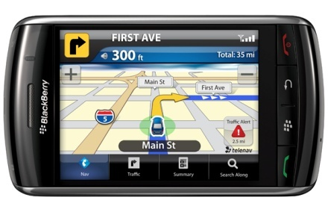
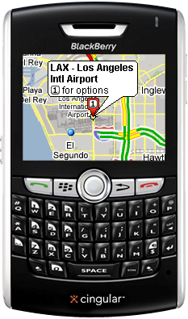
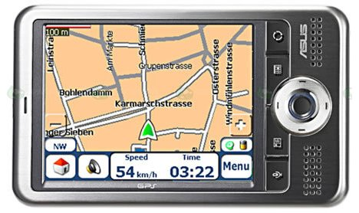
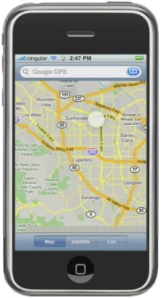
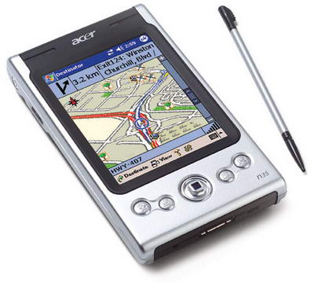
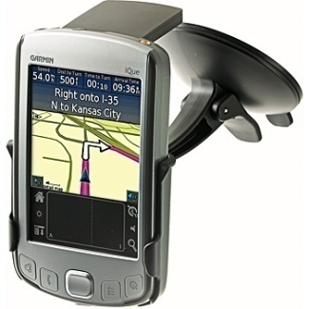
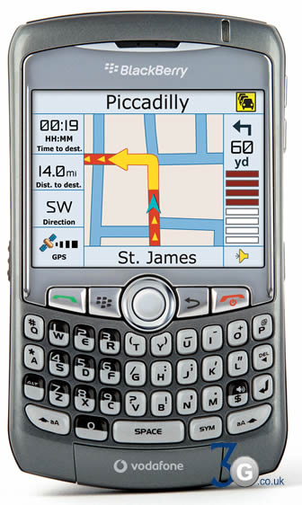
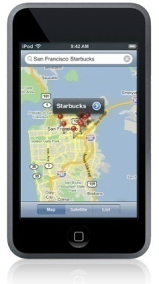
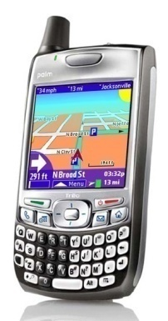
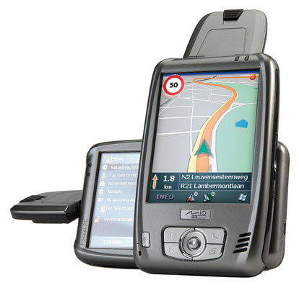
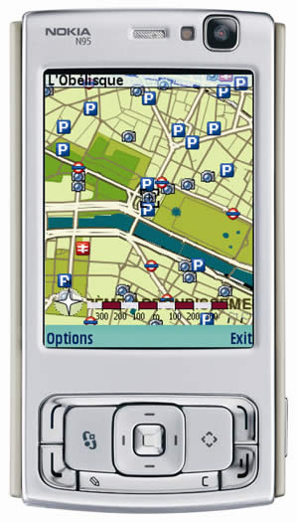
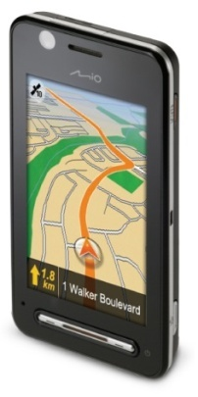
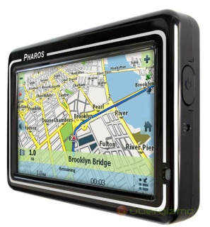
Location-based Services
Many people like to use these advanced technologies and devices

Slide 3
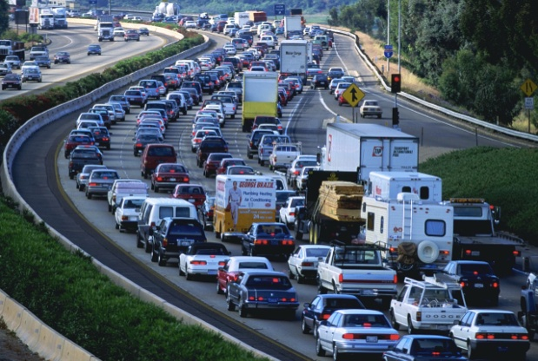
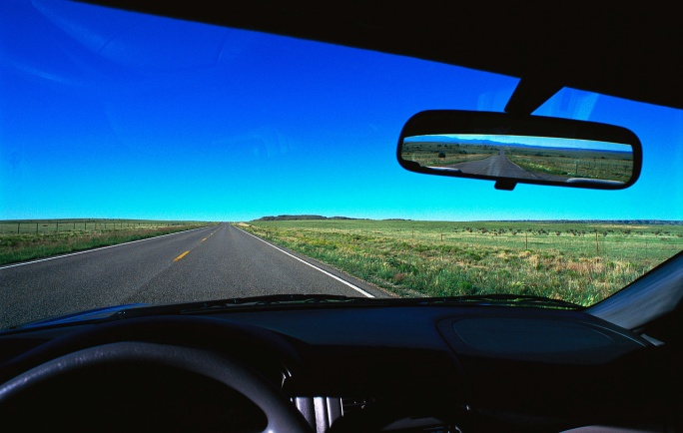
Location-based Services
Range Query: Give me all gas stations within one mile
K-Nearest-Neighbor Queries: Where is my nearest restaurant
Shortest Path Queries: What is the fastest/shortest route from here to the airport
RNN Queries, Group NN Queries, Trip Planning Queries, etc.
Aggregate Queries
Continuous (Monitoring) Queries
Moving Queries
Do not we feel old fashion with these queries..!!!

Slide 4
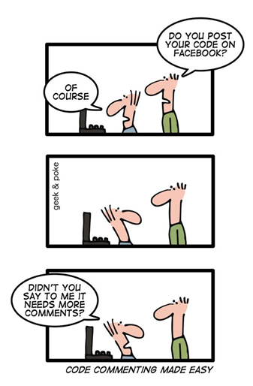
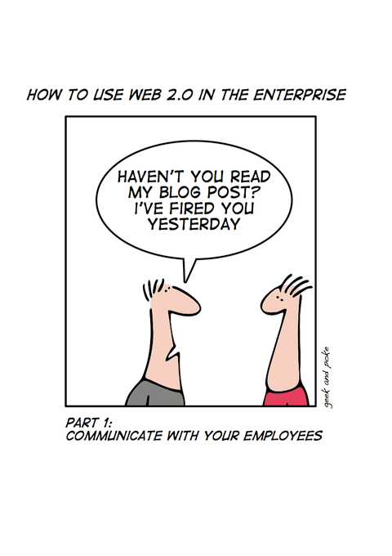
Web 2.0

Slide 5
Web 2.0
The Web is no longer a collection of static pages that describe something in the world.
Crowdsourcing and user-generated contents, i.e., a large group of people can create a collective work whose value far exceeds that provided by any of the individual participants.
Gets better when more users are involved
The main concept is that “You are not alone….”

Slide 6
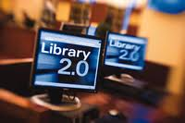
The World of 2.0
Travel 2.0
From expedia, travelocity, Kayak, to a more interactive websites and contests with photo sharing, comments, and personal experience.
Library 2.0
Feedback, review, and discussion about books and services
Government 2.0, Classroom 2.0, Movies 2.0, etc
Revolution 2.0

Slide 7
When LBS meets Web 2.0
Instead of asking about restaurants in a certain area or closest to me, I can:
Ask what are the K-best restaurants according to my profile and context (Personalization)
Ask for comments/suggestions from my friends (Socialization)
Ask a recommender system to suggest few restaurants for me, i.e., predict what I could like (Recommendations)
LBS
Web 2.0
Is it going to be a romantic meeting..!!

Slide 8
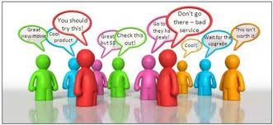
Three Pillars of LBS 2.0
Personalization
Query answer should be personalized to the user profile and context
Socialization
The location aspect deserves to be more than an attribute
Location-based social networks
Recommendations
Recommender systems are among the most successful applications in Web 2.0
However, they completely ignore the “locations”

Slide 9
Personalization in LBS 2.0

Slide 10
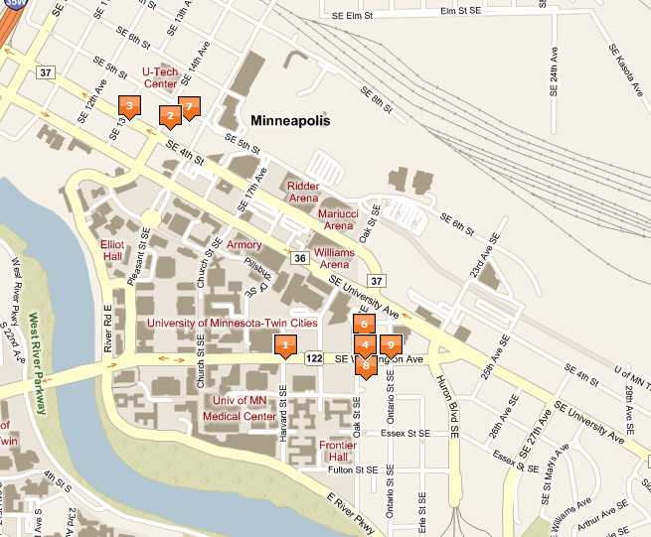
Motivation: Find a Restaurant for Dinner
Existing applications return the K closest restaurants
Consider five closest restaurants for dinner
Restaurant 1:
Hour and a half wait
Restaurant 2:
Does not meet my dietary
Restaurant 3:
Way too expensive
Restaurant 4:
Closed for remodeling
Restaurant 5:
30 minute drive-time, bad traffic accident along the route
The five restaurants are NOT useful as database systems are detached from:
Personal preferences (dietary restrictions, budget)
Extra contextual data (time of day, traffic, waiting times)

Slide 11
CareDB
A database that is aware of
user preferences and
surrounding contextual information,
and uses this information to give personalized query answers to the user.

Slide 12
CareDB Architecture
User₁
User₂
. . .
User_{n}
Environment
Context
User Context/Preference
CareDB
Preference/Context-Aware
Query Processing and Optimization
Query
Building
User
Queries
Query
Answer
CareDB
Data Context
Data₁
Data₂
. . .
Data_{n}
User Context/Preference
User location
User health Status
User salary
User distance
……
Environmental Context
Traffic
Weather
Road Network
Transportation
……
Database Context
Restaurant waiting time
Restaurant location
Restaurant rating
Restaurant price
……

Slide 13
CareDB: Query Builder
SELECT *
FROM Restaurants R
What is the Query Answer?
Query Building
What preference
method evaluates the
PREFERRING clause?
SELECT *
FROM Restaurants R
PREFERRING MIN R.Price,
MAX R.Rating,
MIN R.WaitTime,
MIN TravelTime(R.Location)
Notes:
Stored user preferences and context information
-Not claiming any novel solution
-Much work has been done on modeling user context and preference
-Would be happy to talk about the best model that would fit our system assumptions
Wait time (local or third party, e.g. opentable.com that exposes seating/waits as web service)
-not exact, will likely be reported as range or with error (couple at table 2)

Slide 14
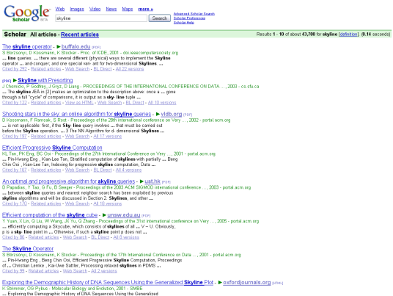
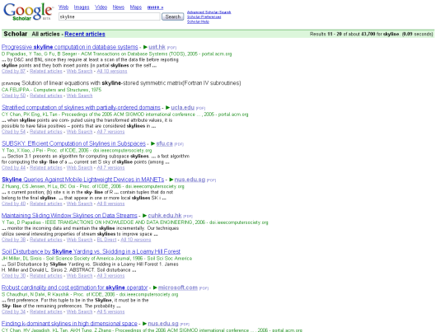
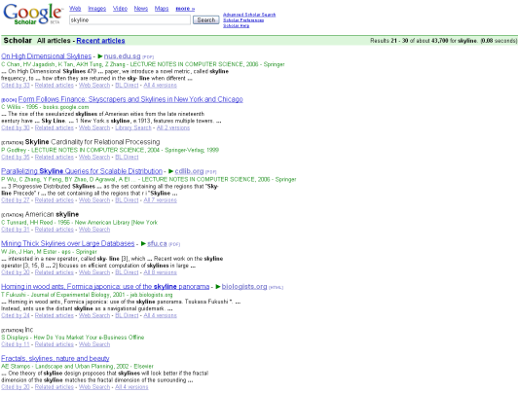
Preference Evaluation Methods
Quick Exercise
Go to scholar.google.com
Search for papers on preference evaluation methods
How many results do you get back?
The list goes on and on and on…
Top-k [VLDB 99]
Skyline [ICDE 01]
K-Dominance [SIGMOD 06]
K-Frequency [EDBT 06]
Top-k domination [VLDB 07]

Slide 15
Preference Evaluation in DBMS: The Good, the Bad, and the Ugly
Layered Approach
(The Bad)
Built-in Approach
(The Ugly)
Extensible Approach
(The Good)
DBMS
DBMS
Query Processing and Optimization
Preference Evaluation
Preference Query Processing and Optimization
FlexPref
Top-k
Skyline
K-Dom
Top-k
Top-k
K-Freq
Skyline
Skyline
Top-k Dom
K-Dom
K-Dom
K-Freq
K-Freq
Top-k Dom
Top-k Dom
DBMS
Skyline implementation:
~200 code lines (selection)
Bad Performance
Skyline implementation:
~8000 code lines (selection)
Good Performance
Skyline implementation:
~300 code lines (selection & join)
Good Performance

Slide 16
Adding a New Preference Method to FlexPref
Adding a preference evaluation method “MyPref” to FlexPref requires the implementation of three functions and two macros in a separate file “MyPref.c” outside the DB engine.
Once implemented, the preference method is registered using a DefinePreference command
DBMS
Query Processing and Optimization
DefinePreference MyPref with MyPref.c
FlexPref
MyPref.c
(Function Definitions)
Top-k
Skyline
K-Dom
K-Freq
MyPref

Slide 17
Querying FlexPref
SELECT * FROM Restaurants R
WHERE [Where_clause]
PREFERRING [Attribute List]
USING MyPref Objectives [Preference Objectives]
Query signature
SELECT * FROM Restaurants R
WHERE …
PREFERRING Price P, Distance D, Rating R
USING Skyline OBJECTIVES MIN P, D, MAX R
SELECT * FROM Restaurants R
WHERE …
PREFERRING Price P, Distance D, Rating R
USING TopKDom WITH K=5 OBJECTIVES MIN P, D, MAX R
SELECT * FROM Restaurants R
WHERE …
PREFERRING Price P, Distance D, Rating R
USING TopK WITH K=5 OBJECTIVES MIN Func(P,D,R)

Slide 18
FlexPref Generic Functions and Macros
FlexPref Macros
#define DefaultScore Default score assigned to each object
#define IsTransitive Whether preference function is transitive or not
PairwiseCompare(Object P, Object Q)
INPUT: Two objects P and Q
ACTION: Update the score of P
RETURN: 1 if Q can never be a preferred object
-1 if P can never be a preferred object
0 otherwise
IsPreferredObject(Object P, PreferenceSet S)
INPUT: A data object P and a set of preferred objects S
RETURN: True if P is a preferred object and can be added to S
False otherwise
AddPreferredToSet(Object P, PreferenceSet S)
INPUT: A data object P and a set of preferred objects S
ACTION: Add P to S and remove or rearrange objects from S

Slide 19
Single-Table Access in FlexPref
The algorithm is written in terms of the three generic functions and two macros
SELECT * FROM Restaurants
PREFERRING P, D, R
USING Skyline OBJECTIVES MIN P, MIN D, MAX R
Input: Single Table T
Output Preference set S
Preference Set S ← NULL
For each object P in T
P.score = #DefaultScore
for each Object Q in T
cmp ← PairwiseCompare(P,Q)
if (cmp ==1)
if Q is in S then remove Q
if #isTransitive
then discard Q from T
if (cmp == -1)
if #isTransitive
then discard P from T
read next object P
if (IsPreferredObject(P,S))
then AddToPreferredSet(P,S)
Return S
FlexPref_Select
R

Slide 20
Expensive (Spatial) Attributes in CareDB
“Find me a restaurant for dinner”
Attributes taken from 3rd party sources (expensive to derive)
CareDB
Driving time
Reviews
Restaurant attributes stored inside CareDB
(Name, location, etc)
Weather Data
Cost model changes slightly
Local data cheap to process relative to third-party data
Optimize to request the least amount data from third-party

Slide 21
CareDB/FlexPref System Prototype Demos: VLDB 2010 / SIGMOD 2010
15-minutes video for demonstrating the CareDB/FlexPref prototype is available online:
http://www.cs.umn.edu/~mokbel/demos.htm

Slide 22
Socialization in LBS 2.0

Slide 23
Social Networking Services
Social Networking
Services
(e.g., Facebook & Twitter)
Have become one of the most important Web services!!!

Slide 24
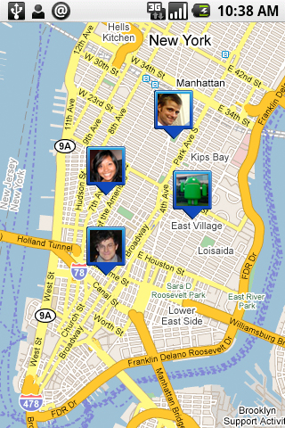
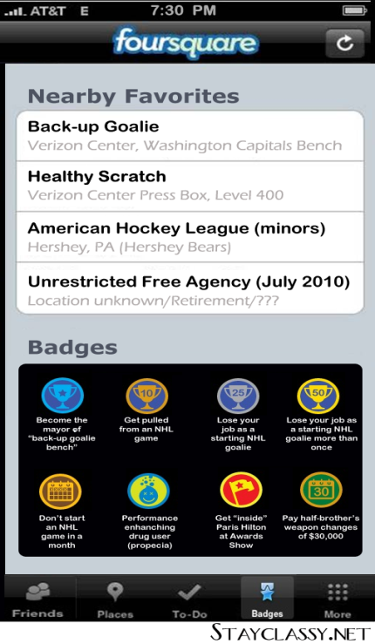
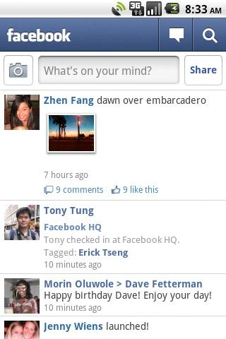
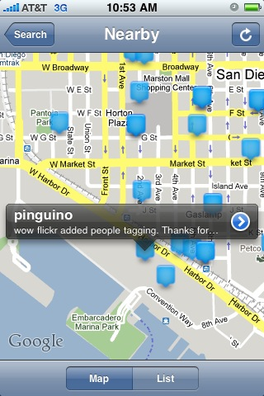
“Locations” in Social Networks
Google Latitude
Foursquare
Facebook Places
Twitter Nearby
Strictly built for mobile devices
Only cares about whereabouts of user friends (check-in functionality)
Isolated from the main social networking functionality
Location is dealt with as just an additional attribute

Slide 25
What would be a “Location-based” Social Network
Instead of redefining a new term, we can just start from existing social networks and make them “location-aware”
Location-based Facebook
Location-based Twitter
…..
This should be different from adding Check-in procedure, or just tracking the whereabouts of your friends
“Location” should be ubiquitous in every functionality of social networks rather than just an additional attribute

Slide 26
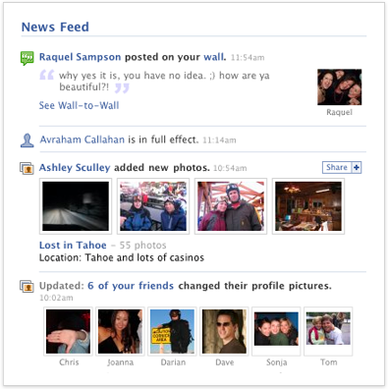
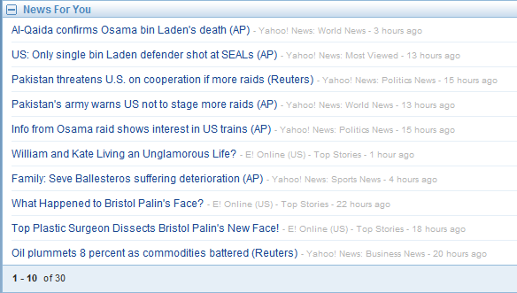
Social Networks: The News Feed Functionality
Display a set of message/news from user friends / subscribed news aggregators.
Examples
Social networking system, i.e., Facebook, Twitter
News Aggregators, i.e., My Yahoo!, iGoogle

Slide 27
The Need for “Location-based” News Feed
Traditional News Feed
Organized by either message issuing time, e.g., Twitter, or some diversity requirements, e.g., Facebook
Spatial relevance is overlooked, users get the same news feed from different log on locations
Motivating Scenarios
Travelling user is more interested in the news/messages that are close to her current location to explore the new place
Stationary users may not be interested in the news/messages that are issued very far from their locations
If the news feed functionality is aware of the inherent locations of users and messages, more relevant news feed will be delivered

Slide 28
GeoFeed: A location-Aware News Feed System
Location-based Messages
Each posted message has a spatial extent that indicates the relevance range of the message, i.e., only users located in this spatial extent may be interested of this message
System users
Have a friend list
Can post location-based messages to their friends
Receive those messages that are:
posted from their friends, and
overlap with either their current locations or a specified area of interest
For a user U with N friends, the news feed functionality is abstracted to a set of N location-based queries, such that:
The N queries are fired upon U logging on to the system
Each query retrieves the set of relevant messages from one friend

Slide 29
The Spatial Pull Approach in GeoFeed
Spatial Pull approach
Do nothing when the user offline
Once the user logs on, compute al the queries for the user
Bob (Producer)
location-based news feed query
Alice
(consumer)
Messages
3. Get cell
2. Alice’s
location
Spatial
Filter
Grid Index
5. location-aware
news feed
4. Messages in the cell
Advantages: No extra overhead during offline period
Disadvantages: High user response time, not efficient for the user with short offline time

Slide 30
The Spatial Push Approach in GeoFeed
Spatial Push approach
Maintain materialized view for each query
Once the user logs on, the answer is ready
1. location-aware
news feed query
Bob (Producer)
Alice
(consumer)
Materialized
view
3. Range
query
4.Update
New
message
Other Users
(consumers)
Other
Materialized
views
2. location-aware
news feeds
Grid Index
Advantages: Users are very happy with very low response time
Disadvantages: System is overwhelmed with maintaining large number of views that may no be necessary

Slide 31
The Shard Push Approach in GeoFeed
Shared Push approach
Share some views among queries for the same producer
Once the user logs on, the answer is ready
1. location-aware
news feed query
Bob (Producer)
Alice
(consumer)
3. Range
query
Shared
materialized
view
Filter
New
message
Other Users
(consumers)
2. location-aware
news feeds
4.Update
Grid Index
Advantages: Users are still very happy with very low response time, and system overhead could be significantly lower
Disadvantages: Need to continuously check if views can be shared

Slide 32
GeoFeed Decision Model
GeoFeed employs a decision model that decides upon the best approach to evaluate each query such that:
The system computational overhead is minimized; hence scalability is increased
Each use U will get the required news feed in T_{U} time units; set based on the user priority

Slide 33
Recommendations in LBS 2.0

Slide 34
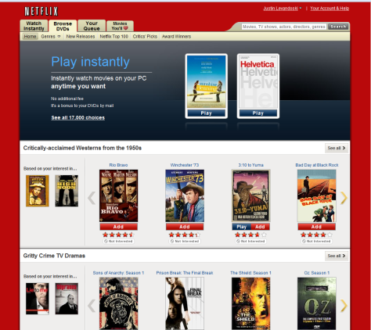
The Functionality of Recommender Systems
Analyze user behavior to recommend personalized and interesting things to do/read/see
Similar
Users
Movie
Ratings
rate movies
build recommendation
model
Similar Items
recommendation
query
Offline
Online
“Recommend user A five movies”
Collaborative filtering process is the most commonly used one in Recommender Systems
Notes:
First, we should ask the question what do Recommender systems do ?
Let’s take the Netflix example (which is a company for online video rental).
In Netflix, users watch movies and then give a rating to this movies.
All users ratings to different items are then used to build the recommendation model Offline.
We can then issue a recommendation query to the model to recommend user A five movies.
So, as we notice we have two phases: Offline model building phase, and Online recommendation generation phase.
Other examples of recommender system include amazon, and others…

Slide 35
“Locations” and “Recommendations”
Recommender systems rely on the input triple (user, item, rating)
Recommender systems completely ignore the spatial aspects of both users and items
The locations of users and/or items have significant impact on the result of recommendations
All heavy work in Recommender Systems is done offline.
This is acceptable when the model changes slowly, i.e., movies, music, clothes, books, etc.
Considering the “location” aspect call for online changes in the model

Slide 36
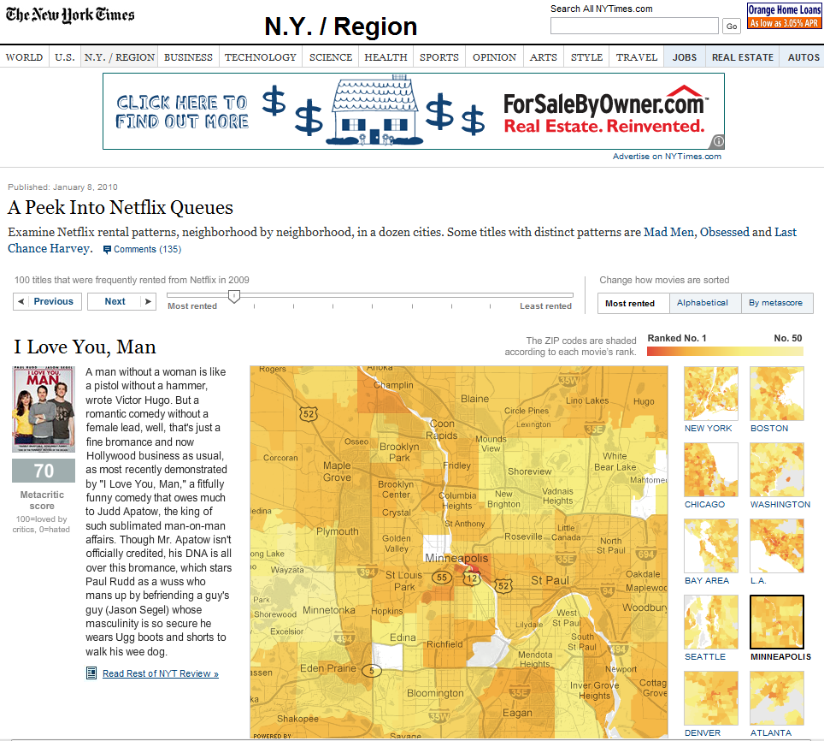
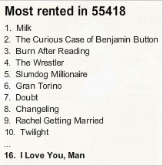
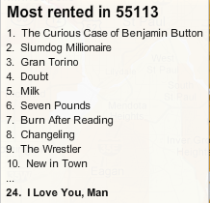
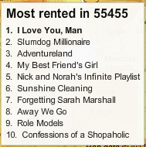
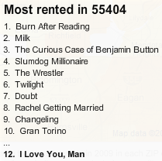
Location Matters: Netflix Rental Patterns
Movie preferences differ based on the user location (zip code)

Slide 37
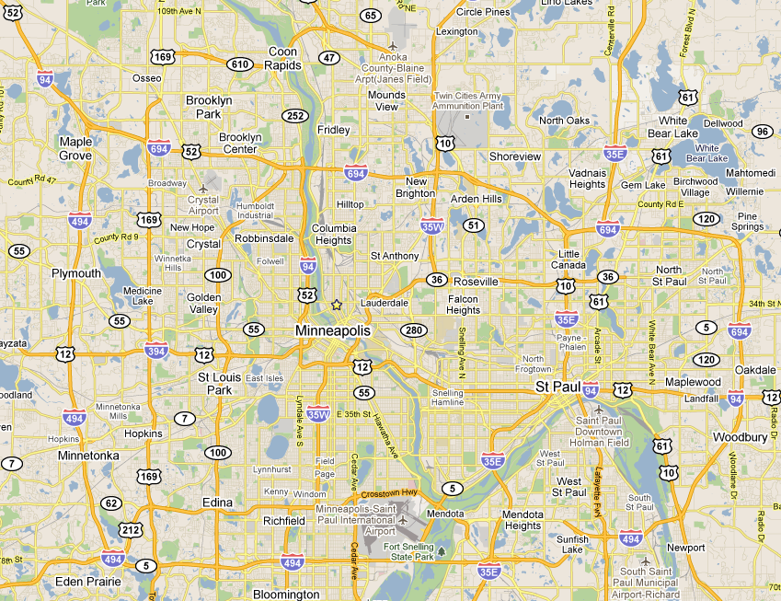
Location Matters: Top-3 Check-In Destinations in Foursquare
Destination preferences differ based on the user location (zip code) and the destination location
Fousquare users from Robbinsdale tend to visit venues in …
City | % of check-ins
Brooklyn Park | 32%
Robbinsdale | 20%
Minneapolis | 15%
Fousquare users from Falcon Heights tend to visit venues in …
City | % of check-ins
St. Paul | 17%
Minneapolis | 13
Roseville | 10%
Fousquare users from Edina tend to visit venues in …
City | % of check-ins
Edina | 59%
Minneapolis | 37%
Edin Prarie | 5%

Slide 38
Location-based Ratings in LARS (Location-Aware Recommender System)
We need to go beyond the traditional rating triple (user, item, rating) to include the following taxonomy:
Spatial Rating for Non-spatial Items
(user_location, user, item, rating)
Example: A user with a certain location is rating a movie
Recommendation: Recommend me a movie that users within the same vicinity have liked
Non-spatial Rating for Spatial Items
(user, item_location, item, rating)
Example: A user with unknown location is rating a restaurant
Recommendation: Recommend a restaurant within a close vicinity
Spatial Rating for Spatial Items
(user_location, location, item_location, item, rating)
Example: A user with a certain location is rating a restuarant
Notes:
First, we should ask the question what do Recommender systems do ?
Let’s take the Netflix example (which is a company for online video rental).
In Netflix, users watch movies and then give a rating to this movies.
All users ratings to different items are then used to build the recommendation model Offline.
We can then issue a recommendation query to the model to recommend user A five movies.
So, as we notice we have two phases: Offline model building phase, and Online recommendation generation phase.
Other examples of recommender system include amazon, and others…

Slide 39
Dealing with Spatial Ratings in LARS
A collaborative filtering model is built for each grid cell
Allows querying user to select influence level
Query is evaluated using grid at given level
Regular Collaborative Filtering
Influence Levels
Smaller cells → more “localized” answers

Slide 40
Dealing with Spatial Items in LARS
Penalize each item, with a travel penalty, based on its distance from the user.
Use a ranking function that combines the recommendation score and travel penalty
Incrementally, retrieve items based on travel penalty, and calculate the ranking score on an ad-hoc basis
Employ an early stopping condition to minimize the list of accessed items to get the K recommended items

Slide 41
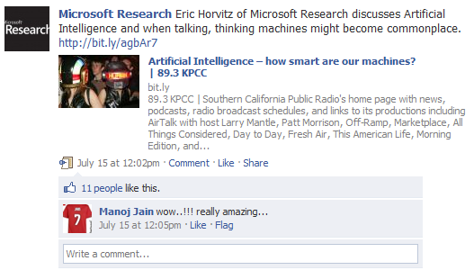
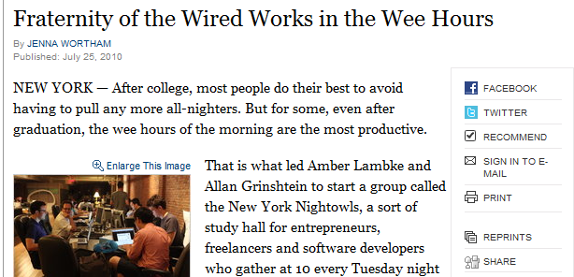
Offline Proces:Things have changed…
We live in an increasingly social and “real-time” world
Number of things to recommend is growing exponentially
Users expressing opinions faster than ever
Recommendations change second-to-second
Facebook Posts
Blog/News Items
NY Times “Recommend” button
“Like” button
“Offline” step can no longer be tolerated

Slide 42
Recommender Systems in DBMS ?
Incoming stream of rating data: (user, item, rating)
Ratings are used to build a recommendation model as:
Item-based collaborative filtering: (item, item, similarity)
User-based collaborative filtering: (user, user, similarity)
Recommendation query:
Item-based collaborative filtering:
Given a user u, find the top-k items that are most similar to the items that u has liked before
User-based collaborative filtering:
Given a user u, find the top-k items that the users who are similar to u have liked
“Online” recommendation environments have all the pieces of a data management problem

Slide 43
GoeScoialDB
GeoScoialDB is a social networking system that injects the location-awareness into the core functionally of social networks. Each decision in GeoSocialDB is taken while consulting the locations of both users and messages

Slide 44
Architecture of GeoSocialDB
GeoSocialDB
GeoFeed
GeoRank
Location-Aware News Feed
News Feed
Log-on Spatial Query
Location-Aware News Ranking
Recommendation
Geo-tagged Message
User Profiles
Suggestions
Messages
User Updates
Profile Update
User Suggestion
LARS
Spatial Recommendation Query
Location-Aware Recommendation

Slide 45
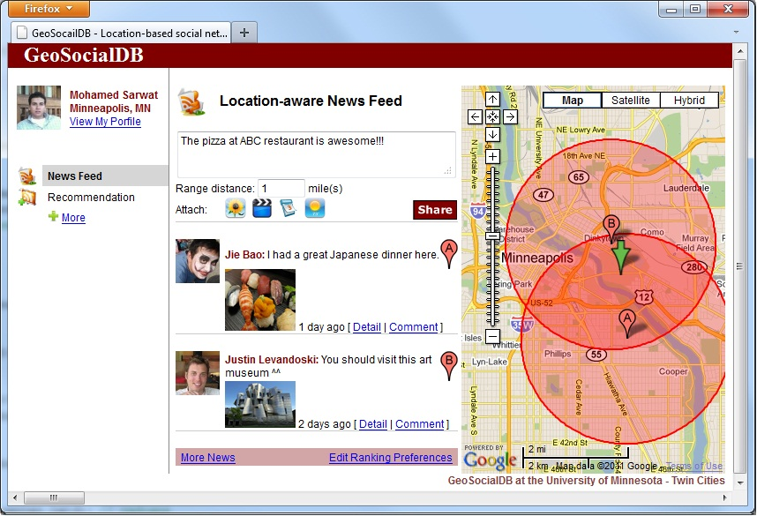
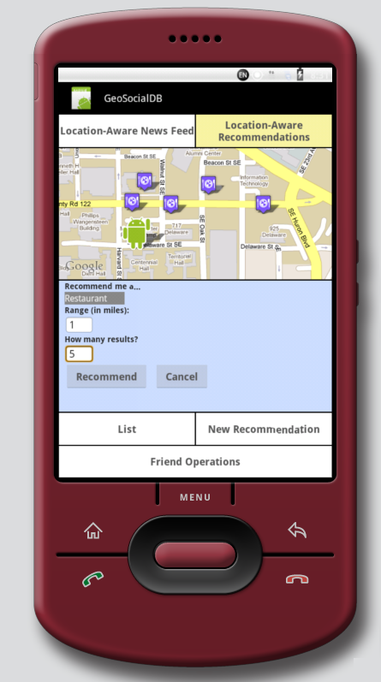
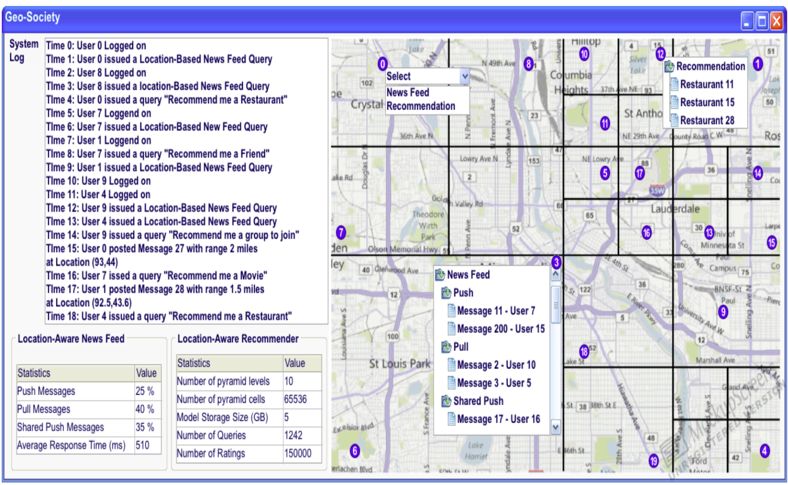
GeoSocialDB System Prototype

Slide 46
Summary
When LBS Meets Web 2.0
Personalization in LBS 2.0
The CareDB/FlexPref Project
A unified framework for supporting the location attribute within preference functions
Socialization in LBS 2.0
Location-based Social Networks
The GeoFeed Project as a Location-Aware News Feed System
Recommendations in LBS 2.0
A taxonomy of spatial ratings
The LARS project as a Location-Aware Recommender System
The GeoSocialDB Project as an LBS 2.0 System

Slide 47
Conclusion
Privacy
LBS
Web 2.0
… And, they lived happily ever after

Slide 48
DMLab Team Members
PhD Alumni
PhD Students
Joe Naps
(2008 – )
Summer intern:
LANL 2010 and 2011
M.S. Students
Prof. Chi-Yin Chow
(2005 – 2010)
Tenure-track Assistant Professor at City University of Hong Kong
Steven Yackel
(2009 – )
Jie Bao
(2009 – )
Summer intern:
MSR Asia 2011
Dr. Biplob Debnath
(2005 – 2010)
DataDomain
Main advisor: David Lilja, ECE
Undergrad Students
A. Hendawi
(2009 – )
Four-year PhD Scholarship
Jim Avery
(2010 – )
Dr. Justin Levandoski
(2006 – 2011)
Microsoft Research (MSR)
Mohamed Sarwat
(2009 – )
Summer interns:
MSR 2010, NEC 2011
Faculty
Mohamed Mokbel
(2005 – )
Prof. Mohamed Khalefa
(2006 – 2011)
Tenure-track Assistant Professor, Alexandria University, Egypt
Ahmed Eldawy
(2010 – )
Summer intern:
IBM Watson Lab 2011

Slide 49
Acknowledgments: Funding
Microsoft Research. Microsoft Unrestricted Gift, October, 2010
NSF- CAREER: Extensible Personalization of Spatial and Spatio-temporal Database Management Systems. 2010 -2015
Microsoft Research. Microsoft Unrestricted Gift, January, 2010
Microsoft Research. Microsoft Unrestricted Gift, April, 2009
NSF- IIS: Towards Ubiquitous Location Services: Scalability and Privacy of Location-based Continuous Queries. 2008 -2011
NSF- IIS: Preference- And Context-Aware Query Processing for Location-based Data-based servers. 2008 -2011
NSF- CNS: Infrastructure for Research in Spatio-Temporal and Context-Aware Systems and Applications. 2007 - 2011

Slide 50
Thanks

