Slide 1
CONIA: Content (Provider)-Oriented Namespace-Independent Architecture for Multimedia Information Delivery
Eman Ramadan, Arvind Narayanan, Zhi-Li Zhang
Department of Computer Science & Engineering
University of Minnesota, Minneapolis, USA
July 3, 2015
MuSIC (co-located with ICME) 2015, Torino, Italy

Slide 2
Outline
Introduction & Motivation
Architecture
Hints on Design & Implementation
Use Cases
Conclusion

Slide 3
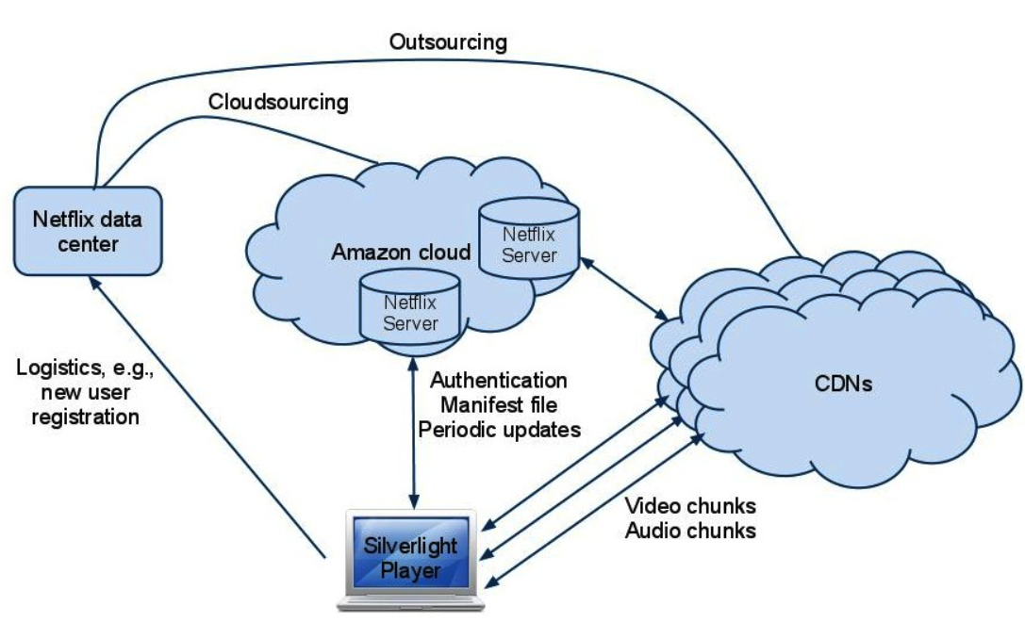
Limitation of Today’s Internet
Streaming services have expanded the role of Content Distribution Networks (CDNs) to a new level
For example, Netflix consumed almost a third of North America’s downstream traffic in 2014^{[1]}
Netflix designed OpenConnect to have more control in content distribution ^{[3]}
Netflix Architecture ^{[2]}

Slide 4
Future Internet Architecture Design Requirements
Better handling the diversity and complexity associated with multimedia content
For example, video object is composite
no single namespace can fit it all
Need for Content providers (CPs) to have a larger say in provisioning and dynamically distributing content
e.g., deploy their own load balancing/cache management policies
Take into account the network economics of content delivery to make the ICN design economically viable

Slide 5
CONIA: A New ICN Architecture
Two basic tenets underlying all ICN designs:
Content is the first-class object
Content storage should be part of the network substrate
But, we put forth a third tenet:
One must not dictate how the namespace for content is designed for all content providers
so as to enable a scalable, robust, economically viable, and evolvable ICN architecture

Slide 6
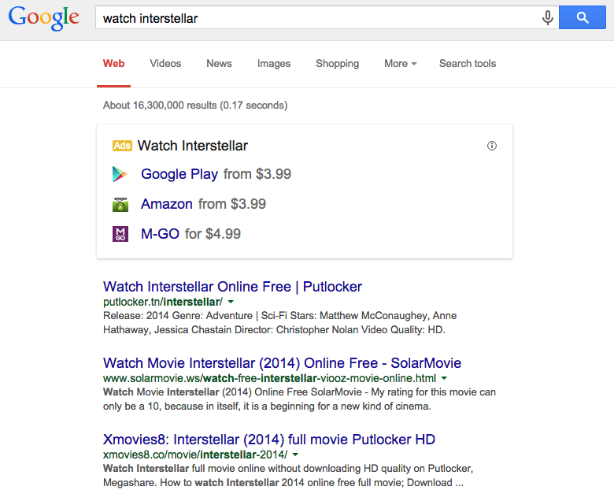
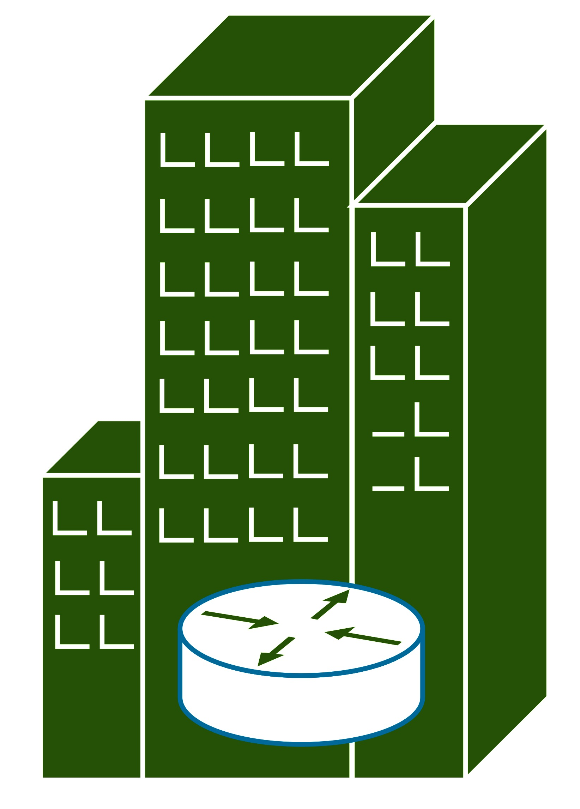
Two Dimensions of CONIA
Content Discovery
- Mapping user’s search query to actual content name
Content Delivery
- The process of requesting and delivering content
We separate the two …
Content Discovery
Generic Search Engine
Enter keywords here
Search <movie name>
List of Content Providers
User
Content Provider 1
Content Provider 2
Fetch cp_1.movie_name
Content Provider 3
movie
Content Delivery

Slide 7
CONIA: Content Delivery Architecture
Three key components
Content Store and Routing elements (CSR)
Generic, programmable, and shared resources
Offered by third party entities
CP Controller
Content-provider (CP) specific
Provision & manage CSRs
Client Content Player
Generic or CP-specific software
Allows users to interact with CP Controller and CSRs
CSR
CSR
CP Controller B
CP Controller A
CP A’s CSR
CP B’s CSR
Unused CSR
Client Content Player
An open and standardized control framework API used for interaction between the components.

Slide 8
Content Store and Routing (CSR)
Functions
Shared resource
Caches content; routes requests and data
Provides basic functions required for resource management & content delivery
Stores CP-specific control logic specifying how to handle requests & data
CSR → CP Controller Interactions
Reports statistics
CSR → CSR Interactions
Reports health information
Content offloading
CSR → Client Content Player Interactions
Responds to client requests with data

Slide 9
CP Controller
Functions
Provisions CSRs
Defines its own namespace
Decides “what to cache”, “where to cache”
Defines the control logic used to handle and forward requests and data
Maps client requests to CSRs
CP Controller → CSR Interactions
Pushes the namespace and content to CSRs
Installs the control logic into CSRs
CP Controller → Client Content Player Interactions
Responds to client requests with content map (such as MPD)
Dynamically generates content map using the global view and the collected statistics

Slide 10
Client Content Player
Functions
Interprets the Content Map
Renders and displays the content
e.g., web browser, video player
Client Content Player → CP Controller Interactions
Sends user request to CP controller and gets Content Map in return
Reports statistics
Client Content Player → CSR Interactions
Fetches content

Slide 11
CSR Design and Implementation
Current Research
A programmable “open” box
A logical view of CSR
Basic shared functions/libraries/services used by all the containers
e.g., web server, socket functions, I/O functions, etc.
Every Content Provider (CP) has full control over its container
Every container has
a storage device used to cache content, meta-data, statistics, etc.
a Content Control Logic Table (CCLT) used to control the content delivery plan
Container
Container
Container
CP₁
CP₂
CP₃
Basic functions (bins/shared libraries)
Container Engine
Operating System
Hardware

Slide 12
CCLT Design
Object ID | Statistics | Control Logic
… | … | …
Content Control Logic Table (CCLT) Structure
An entry in CCLT is composed of three fields
object ID – content name or identifier (granularity of object decided by CP)
statistics – counters, etc.
control logic – how to handle the object
The control logic in CCLT is expressed using a declarative language and defined in terms of two categories of context
Content-related context – the state of an object e.g., cached or not-cached, etc.
System-related context – the state of CSR/network condition e.g., load on CSR, etc.

Slide 13
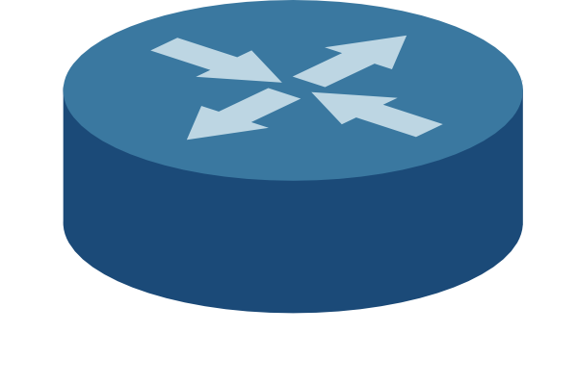
Use Cases: A Simple Example
CP Controller
video v₁
…
link to
CSRs
B1
B2
CDS v₁
step 1 - interest for v₁
step 2 - reply with Content Map of v₁
A1
A2
A3
step 3 – request s₁
c₂
…..
c_{n}
c₁
Content Map of v₁

Slide 14
Use Cases: Load-aware Forwarding
CP Controller
load on CSR A1
video v₁
…
link to
CSRs
A1
A2
step 4 – forward
request s₁
CDS v₁
step 5 – s₁ data
step 1 - interest for v₁
step 2 - reply with Content Map of v₁
B1
B2
B3
step 3 – request s₁
s1: [‘NOT_CACHED’] -> forward ( select ( [ A1, A2 ] ) )
s1: [‘NOT_CACHED’] -> forward ( select ( [ A1, A2 ], ‘LOAD’ ) )
c₂
…..
c_{n}
c₁
Content Map of v₁

Slide 15
Use Cases: Dynamic Adaptation
CP Controller
load on CSR A1
video v₁
…
link to
CSRs
A1
A2
step 4 – forward
request s₁
CDS v₁
step 5 – s₁ data
step 1 - interest for v₁
step 2 - reply with Content Map of v₁
B1
B2
B3
step 3 – request s₁
step 6 – transcoded s₁ data
s1: [‘CACHED’] -> r=select_rate(‘BW’) ^ r not cached : trcode(r), reply
c₂
…..
c_{n}
c₁
Content Map of v₁

Slide 16
Use Cases: Flash Crowds & Load Management
CP Controller
load on CSR A1
video v₁
…
link to
CSRs
A1
A2
step 9 – Expand v₁’s CDS
step 8 – Push v₁
step 4 – forward
request s₁
CDS v₁
A3
step 5 – s₁ data
step 1 - interest for v₁
step 2 - reply with Content Map of v₁
⌃
CDS v₁
B1
B2
B3
B4
c_{n+1}
step 3 – request s₁
step 6 – transcoded s₁ data
…..
c_{n}
c_{n+m}
c₂
c₁
step 7 – Many users show interest in
v₁ and request its chunks
Content Map of v₁

Slide 17
Conclusion
CONIA: a straw-man proposal to argue for
The need for namespace independence for complex information delivery
The importance of providing larger control to content providers and considering the network economics for better content delivery
Overview of CONIA's content delivery architecture
Basic functions of the key components
Communications between components
Several use cases illustrated how CONIA allows content providers to dynamically adapt to user demands and optimize content delivery to meet user QoE expectations

Slide 18
References
Global Internet Phenomena Report - 2H2014 Sandvine
Unreeling Netflix: Understanding and Improving Multi-CDN Movie Delivery Vijay K. Adhikari, Yang Guo, Fang Hao, Matteo Varvello, Volker Hilt, Moritz Steiner, and Zhi-Li Zhang In INFOCOM, 2012
Netflix OpenConnect https://openconnect.netflix.com/

Slide 19
Thank you
Questions?

