Slide 1

Cache Network Management Using
BIG Cache Abstraction
Pariya Babaie, Eman Ramadan, Zhi-Li Zhang
Department of Computer Science & Engineering
University of Minnesota, Minneapolis, USA
April 30, 2019
INFOCOM 2019, Paris, France

Slide 2
Outline
Motivations
Network-wide Cache Management via BIG Cache Abstraction
Optimization Decomposition Framework for Cache Networks
Cache Allotment vs. Object Placement Sub-Problems
Evaluation

Slide 3










Content is the King!
Content or information delivery (either “static” or “dynamic”): a major function of today’s Internet
  static: e.g., video, which can be cached
  dynamic: e.g., search responses, generated dynamically
Content (esp. video) delivery places significant burden on the Internet infrastructure
Distributed network caches, or content distribution networks, play a critical role in scaling out large-scale content (esp. video) delivery over the Internet

Slide 4


Content Distribution Ecosystems
Three Key Players
Content Providers (CPs)
  Providing better QoE for its users
  Reducing origin server loads
  Minimizing network bandwidth costs
Users
  Low startup latency & smooth delivery
Cache Network Operators (CNOs)
  Efficient utilization of all cache capacities in the network
Origin Servers
Requests
Intermediate
Servers
Edge Servers
Users

Slide 5
Existing Caching Policy & Cache Network Studies
Traditionally, caching policies are designed for a single cache
  e.g., LRU, FIFO, k-HIT, k-LRU, LRU(m), …
Spurred by ICNs, a flurry of recent studies on a network of caches, e.g.,
  performance analysis of a cache network, where each node employs LRU, …
  new caching strategies along a request path: leave copy everywhere, leave copy down, leave copy probabilistically
  joint optimization of routing & cache (object placement), and so forth
  …
Nonetheless, most studies assume that caching policies such as LRU are employed independently at each node of a cache network

Slide 6



Cache Networks: New Innovation Needed!
Problems with treating each cache node independently
Technical difficulties: arrival processes at intermediate nodes are filtered (“cache misses” from previous nodes)
  no longer Poisson even if original user requests are
More importantly, performance issues!
  Problem of Thrashing:
  Cache utilization at intermediate layers is poor
  (again due to “filtered” arrival processes)
Origin Content Servers
Cache Nodes/Servers
Content Requests
User Bases

Slide 7



Problem of Thrashing: LCE (leave copy everywhere) - LRU
See Our IEEE ICDCS’17 paper for more details
LRU
L4
Request
L3
Object
cache hit
L2
Intermediate layers are useless!
(led to the argument of edge caching only)
cache miss
A tandem line of four caches
Origin server serves a collection of 100 objects
Object access probabilities follows Zipf. dist. with α = 1
Size of all cache servers = 10
L1
…. ..... ..... .....

Slide 8
Cache Networks: New Innovation Needed !
Problems with treating each node independently
Technical difficulties: arrival processes at intermediate nodes are filtered (“cache misses” from previous nodes)
  no longer Poisson even if original user requests are
More importantly, performance issues!
  Problem of Thrashing: cache utilization at intermediate layers is poor (again due to “filtered” arrival processes)
Origin Content Servers
Cache Nodes/Servers
Content Requests
Q: How can we fully utilize all of the caches?
Further, how can we meet different perspectives of the three key players (CPs, CNOs & Users)?
User Bases

Slide 9
BIG Cache Abstraction
Treating the entire cache network as a ”BIG” cache pool, forming a collection of (virtual) “BIG Caches”, one per edge server
Origin Content Servers
Cache
Nodes
Content Requests
User Bases

Slide 10
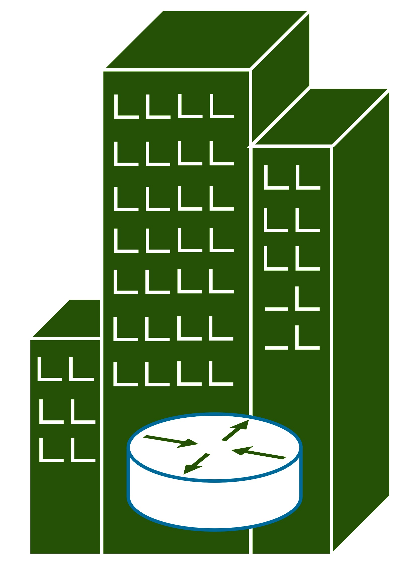
BIG Cache Abstraction
Treating the entire cache network as a ”BIG Cache” pool, forming a collection of (virtual) “BIG Caches”, one per edge server
BIG cache abstraction
Each intermediate cache allots a portion of its capacity to serve requests from each edge server sharing it
Cache pieces at different layers are “glued” together to form one virtual “BIG” cache
Objects are placed in the BIG virtual cache under one consistent cache replacement policy
Enables higher-level abstractions and frameworks
for network-wide cache management!
BIG Cache Controller
See Our IEEE ICDCS’17 paper for more details

Slide 11
Network-wide Cache Management
Decouples caching policies (“what objects to cache”) from object placement (“where to place an object or multiple copies of it”) across multiple distributed caches
  e.g., in terms of server loads, it doesn’t matter where objects are placed; it matters to user access latency
Allows cache network operators to efficiently and fully utilize the available cache resources
  e.g., controlled “placement” & movement” of objects from one cache node to another node
Enables development of more effective, efficient, and manageable network-wide cache management policies
  e.g., by accommodating different objectives of CPs, COs and users
Objects
Origin Servers
Intermediate Servers
“software-defined” cache networks
User Bases
Notes:
For example, when an object is evicted (or expired) from one cache, should it simply be discarded, or should it be inserted into the next (intermediate) cache (i.e., considered as a “new arrival” to this next cache) along the content request path to an origin content server? When an object is returned from an upstream cache (or the origin content server) back down along the request path, should the object be cached along the way – also known as “leave- copy-everywhere” (LCE), as advocated by [1, 30], or selectively e.g., “leave-copy-down” (LCD) or with some probability e.g., “leave-copy-probabilistically” (LCP) [38], at some intermediate caches? Or should it be cached only at the edge caches, e.g., as advocated by [20]? Most of classical studies on caching policies (e.g., object replacement/eviction using LRU or timer expiration) are focused on a single cache system. When the caches are coupled together to form, say, a tandem caching system (e.g., L1/L2 caches in computer architecture) or a network of caches (e.g., a content distribution network or a cooperative proxy cache system), caching policies such as LRU are nonetheless applied to individual caches independently.

Slide 12
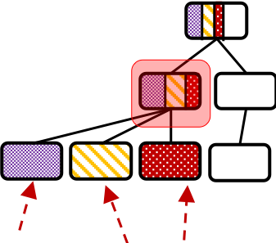




Network-wide Performance Optimization
Origin Server
BIG Cache Ce
Theoretical Modeling
Goal
  Maximizing network utilization
    Which objects to cache?
    Where to place them?
    Cache allotments
Constraints
  The summation of allotments within an intermediate cache must not exceed its physical capacity
  The total size of the objects in any BIG cache must not exceed its capacity
C_{H}
$$C_{H}^{e}$$
…..
…..
…..
…..
Intermediate Servers
C₃
…..
$$C_{3}^{e}$$
C₂
$$C_{2}^{e}$$
C₁
…..
$$C_{1}^{e}$$
Requests
Edge Servers

Slide 13

Network-wide Performance Optimization
  Ce BIG cache from $C_{e}$ to $C_{o}$
  C_{h} , 1<h<H+1 , Intermediate Server at level h
  $C_{h}^{e}$ portion of C_{h} allotted to Ce
  $U^{e}$ utility function
  $u_{n}^{e}$ stationary occupancy probability of $O_{n}^{e}$
  C_{e} receives N^{e} object requests
  Ɛ set of edge servers
  $N^{e}$ size of collection of Ce
  $R^{e}$ path from $C_{e}$ to $C_{o}$
  $H$ Hierarchy level

Slide 14
Decomposition Framework
We decompose this global (centralized) optimization problem into a set of distributed optimization problems that can be solved separately in an iterative and distributed fashion
We use an optimization decomposition framework that allows us to decompose it into sub-problems of cache allotment and object placement
We can also separately optimize the performance objectives from the content providers, cache network operators, and user perspectives

Slide 15
Advantages of Decomposition Framework
Different Utility Functions
  Overall hit-rate
  User perceived latency
Different Inter-Arrivals Processes
  Pareto and Poisson inter-arrival processes
  Zipf distribution for popularity
Different Caching Policies
  Supporting different caching policies given their hit rate can be formulated as a function of occupancy probability
Notes:
Different arrivals
We handle different pattern of request arrival

Slide 16
Decomposition Framework
Object Placement
Cache Allotment

Slide 17
Object Placement vs. Cache Allotment
Object placement problem
  Given: cache allotments & BIG cache capacity
  Computes: the optimal occupancy probability of content objects
Cache allotment problem
  Computes: the allotment pieces of intermediate caches assigned to each BIG cache considering the request characteristics of each edge cache

Slide 18

Optimal Object Placement Problem
Single BIG cache utilization
  The utility function is strictly concave, increasing, and continuously differentiable
  Lagranian $L(u_{n}^{e}$, $μ^{e}$)
  Lagrange multipliers ($μ^{e})$ are passed to the master problem
Dual Problem
Notes:
We solve the occupancy problem via it’s dual problem
We form the lagrangian function first
u_n^e* is the occupancy that maximizes the lagrangian function
Since U is stricty concave the duality gap is zero and the dual problem actually gives the optimal primal values
Then we solve the dual problem by finding the optimal lagrange multipliers and these values are unique as well
The lagrange multipliers are passed to the master problem

Slide 19
Optimal Cache Allotment Problem
Allotment gradient update
Feasibility
is the the optimal value for the given cache allotments
Notes:
The optimal allotment problem is also solved with sub-gradient method! The sub-gradients are the lagrange multipliers of sub-problems
After updating the allotment values the feasibility check is done which makes sure the constraints are satisfied

Slide 20
Solution Abstraction – Primal Dual Algorithm
terminate
Pass cache allotments to each BIG cache
Pass occupancy probabilities to master problem
Yes
Is this the optimal utilization?
Initialize cache allotment
Find optimal occupancy values
Update cache allotments
No
Pass cache allotments to each BIG cache
Notes:
For each big cache we solve the optimal occupancy values and we pass the occupancy probabilities and the lagrange multiplier to the master problem which is the allotment problem

Slide 21




Evaluation Setting
4 tandem line of caches, 4 BIG caches
  4 Edge server, 3 intermediate servers, and an origin server
Origin server has a permanent copy of 4 object collections
  $N^{e}=${300,500,1000,1000}
  Object access probabilities follows Zipf. dist. with α = {0.2,0.2,0.5,0.5}
Size of cache servers at each level
  $C_{1}=30$, $C_{2}=60$, $C_{3}=120$
Inter-arrival distributions
  Pareto (d), decreasing hazard rate
  Poisson (c), constant hazard rate
Allotment strategies
  Optimal Allotment
  Equal Allotment
  Heuristic Allotment
Caching policies:
  Timer-base (TTL)
  LRU
  Static
Origin Server
BIG Cache C⁴
C₃
$$C_{3}^{4}$$
C₂
$$C_{2}^{4}$$
C₁
$$C_{1}^{4}$$
Equal Allotment
  The capacity of each intermediate cache is divided equally among the edge caches sharing it
Heuristic Allotment
  The capacity of each intermediate cache is divided proportionally among the edge caches sharing it with respect to the access rate of the competing content objects

Slide 22
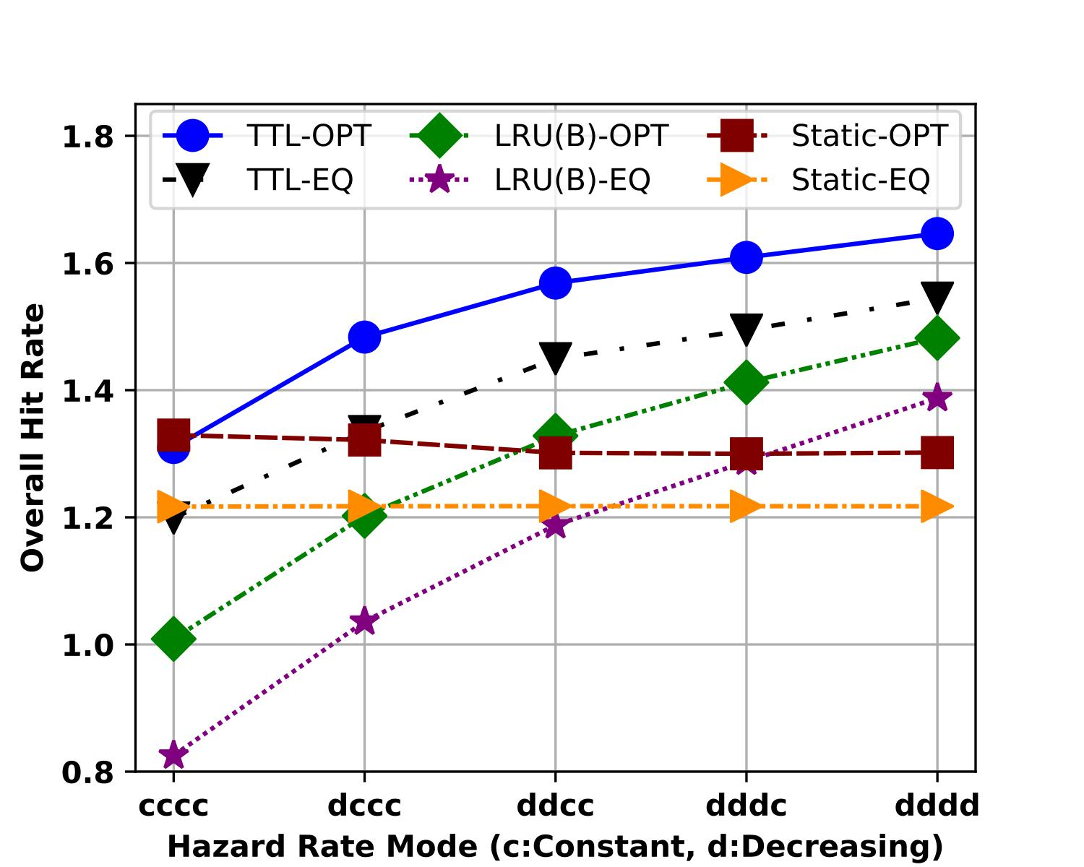
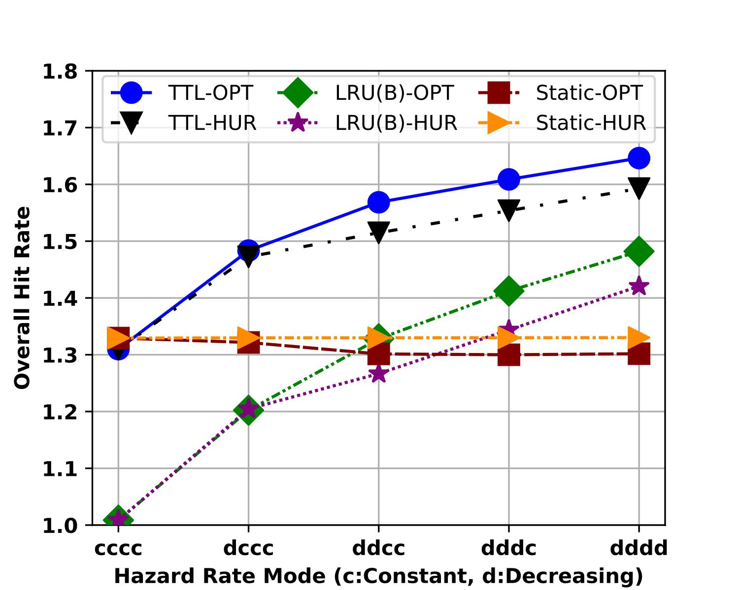
Overall Hit Rate Comparison
Optimal vs Equal
Optimal vs Heuristic
The optimal allotment leads to a higher overall hit rate than equal and heuristic allotments, regardless of caching policy and request inter-arrival distribution

Slide 23
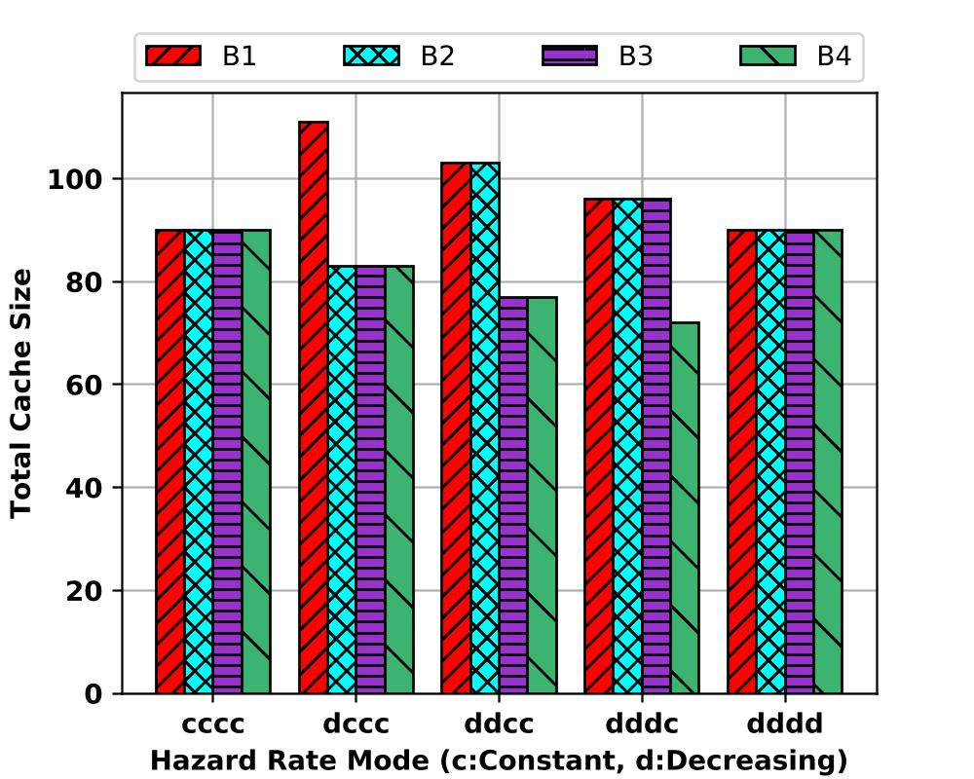
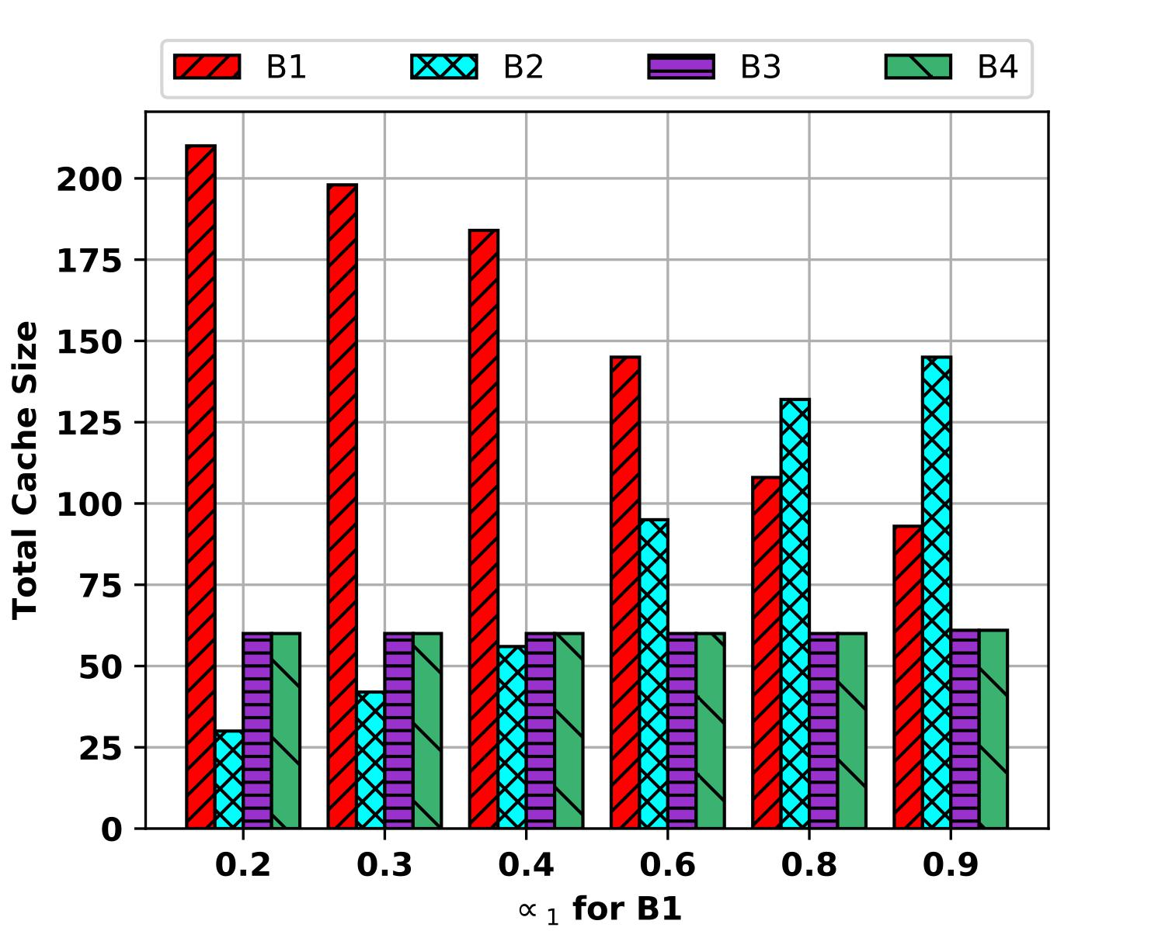
Impact of Key Factors
Impact of Hazard Rate Function
Impact of Content Access Rate
N = 1000
Zipf α = 0.5
B₂, B₃, B₄ Zipf α = 0.5
Inter-arrival distr. = Poisson
Branches with decreasing hazard rate receive more capacity
Branches with smaller ⍺ receive more capacity
Notes:
Hazard rate:
Access rate: Thus, “BIG” caches with smaller value of α receive more capacity as their less popular objects have larger access rate than the corresponding objects from other branches. Fig. 4c shows the total cache capacity allotted to each “BIG” cache under optimal allotment.

Slide 24
Discussion
Non-unit object size
  Can be formulated as a constraint
Request received at intermediate caches
Multiple origin servers
  Logically centralized
Unknown object access rate
  Can be predicted using ML/DL algorithms
  see, e.g., DeepCache (SIGCOMM NetAI’18 Workshop)
Notes:
Topology constraints can be all formulated!

Slide 25
Questions?

