Slide 1

When Raft Meets SDN: How to Elect a Leader and Reach Consensus in an Unruly Network
Yang Zhang, Eman Ramadan, Hesham Mekky, Zhi-Li Zhang
University of Minnesota

Slide 2
Introduction
Consensus Algorithm

Slide 3
Introduction
Software Defined Network
Consensus Algorithm
Application Layer
Applications
API
API
API
Network Operating Systems
Control Plane
Control to Data Plane Interface
Data Plane
Network Device
Network Device
Network Device
Network Device
Consensus algorithm is essential for SDN distributed control plane

Slide 4
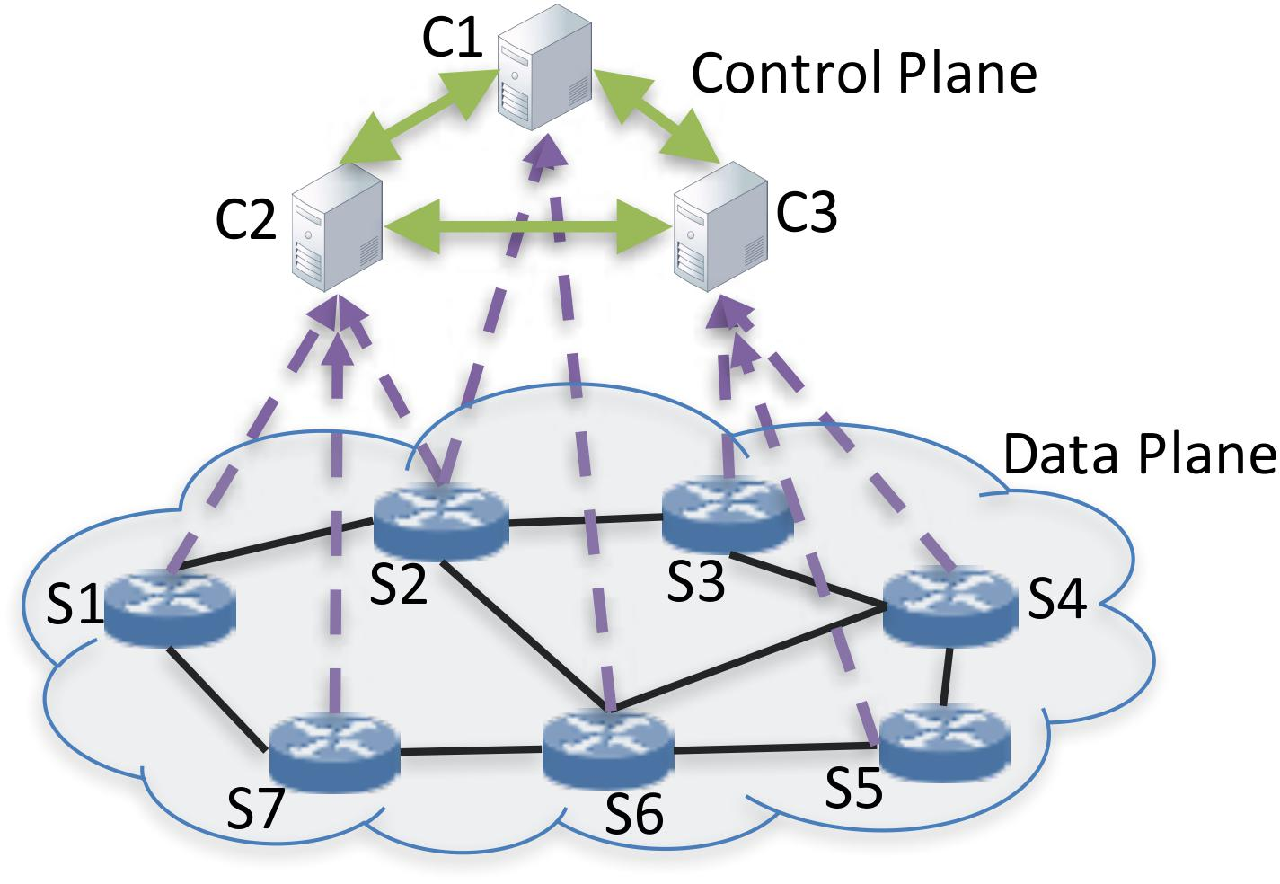
Problems in SDN Distributed Control Plane
SDN control plane setup
Cyclic dependencies
control network connectivity
consensus algorithm
control logic managing the network
In consensus algorithm
server failure has been studied for decades
full mesh connectivity is assumed
what if network fails?
new failure scenarios arise in SDN

Slide 5
RAFT: a representative consensus algorithm
At any given time, each server is either:
  – Leader: handles all client interactions, log replication, etc.
  – Follower: completely passive
  – Candidate: used to elect a new leader
• Normal operation: 1 leader, N-1 followers
Follower
Candidate
Leader

Slide 6
RAFT Leader Election
times out,
new election
times out,
start election
receives votes
from majority
start
Follower
Candidate
Leader
discovers current leader
or a higher term
discovers server with
higher term
Vote criteria: 1) highest term, 2) latest log
*Term is defined as virtual time period in Raft

Slide 7
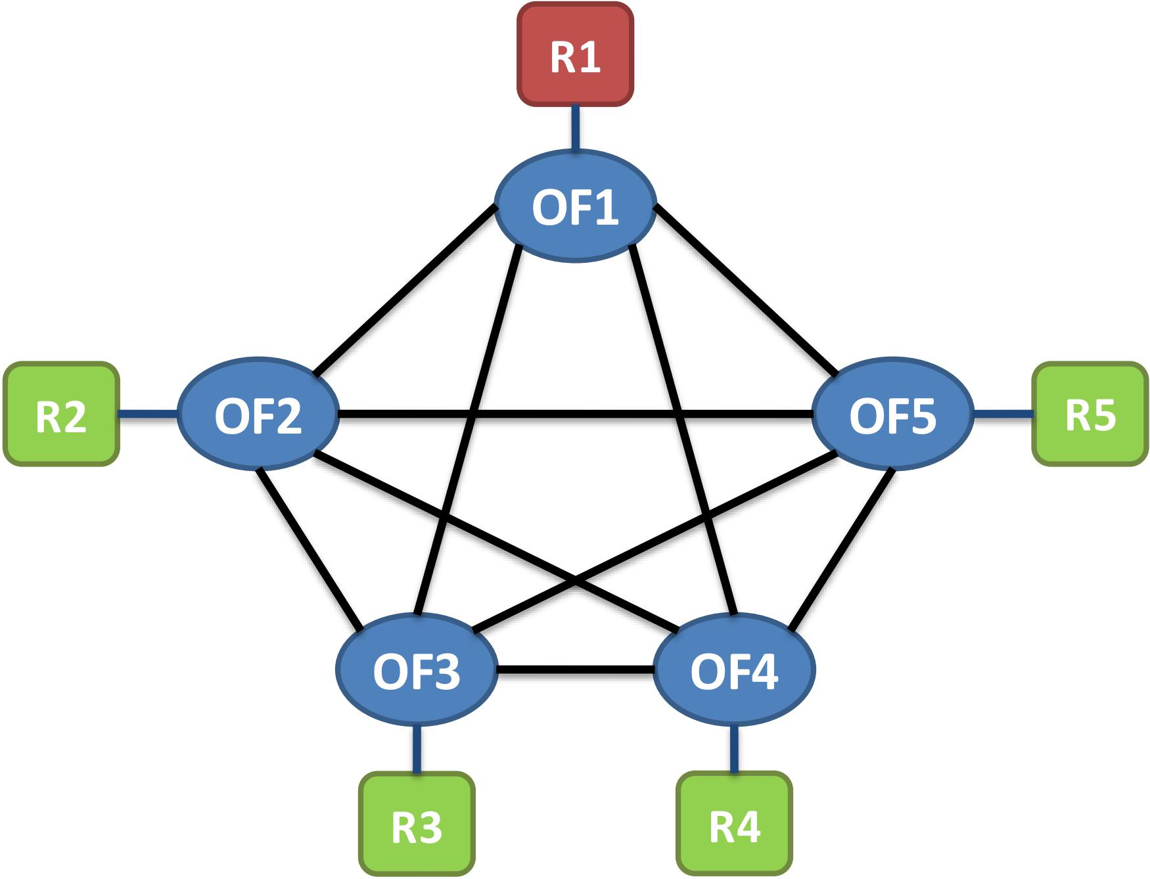
RAFT MEETS SDN
R1
R2
R5
R3
R4
Control Cluster under Normal Operations.

Slide 8
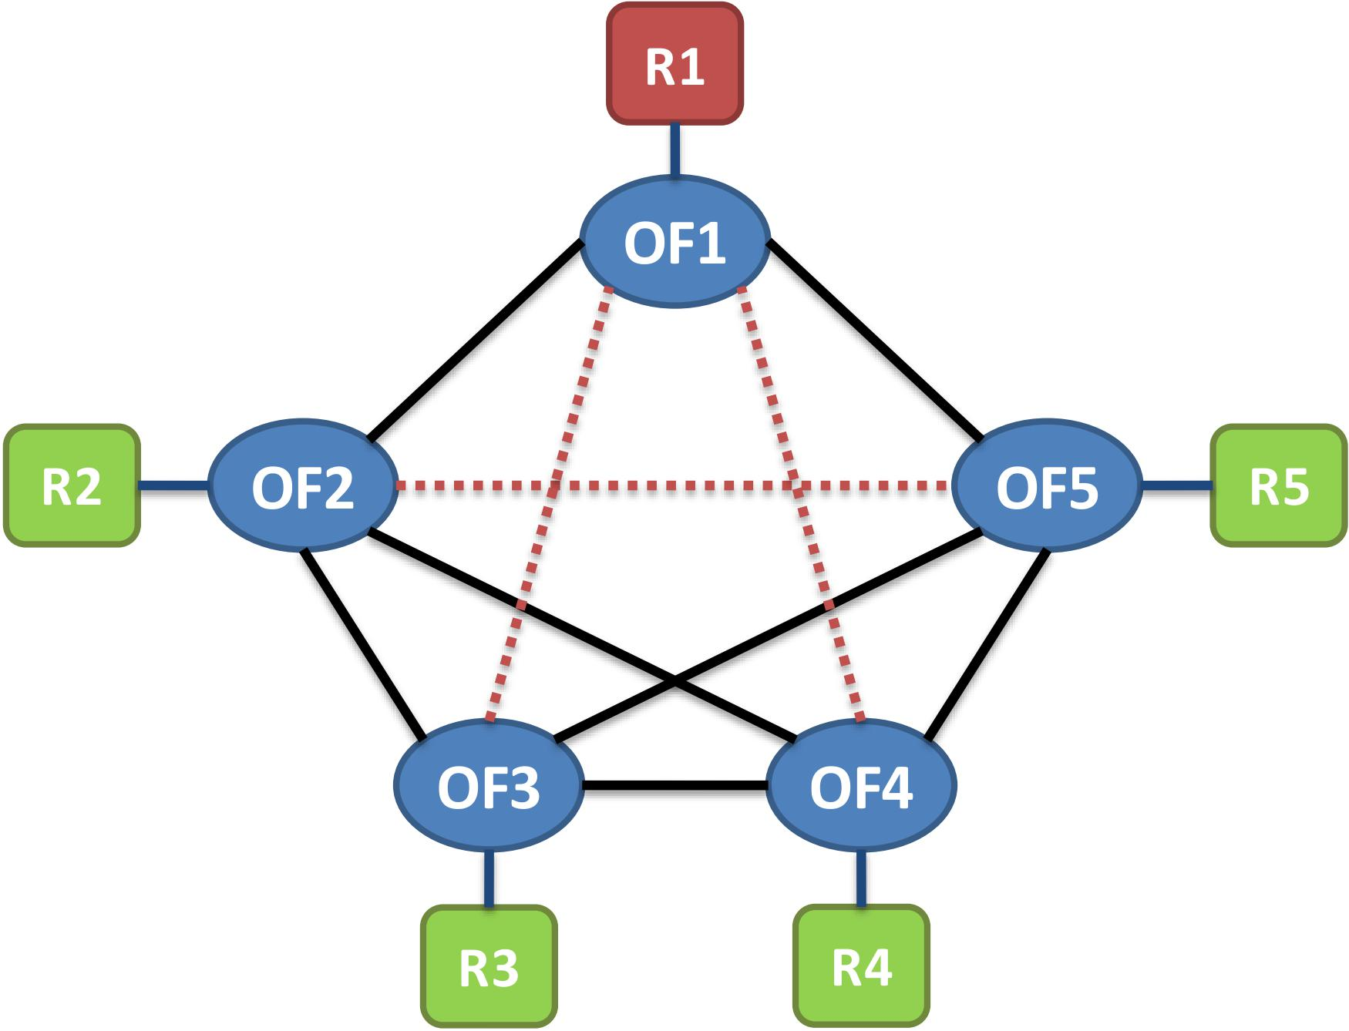
RAFT MEETS SDN
R1
R1
R1
R1
R1
R2
R5
R2
R5
R3
R4
R3
R4
R3
R3
R3
Control Cluster under Normal Operations.
Oscillating Leadership.
Condition. Up-to-date servers have a quorum, but they cannot communicate with each other.

Slide 9
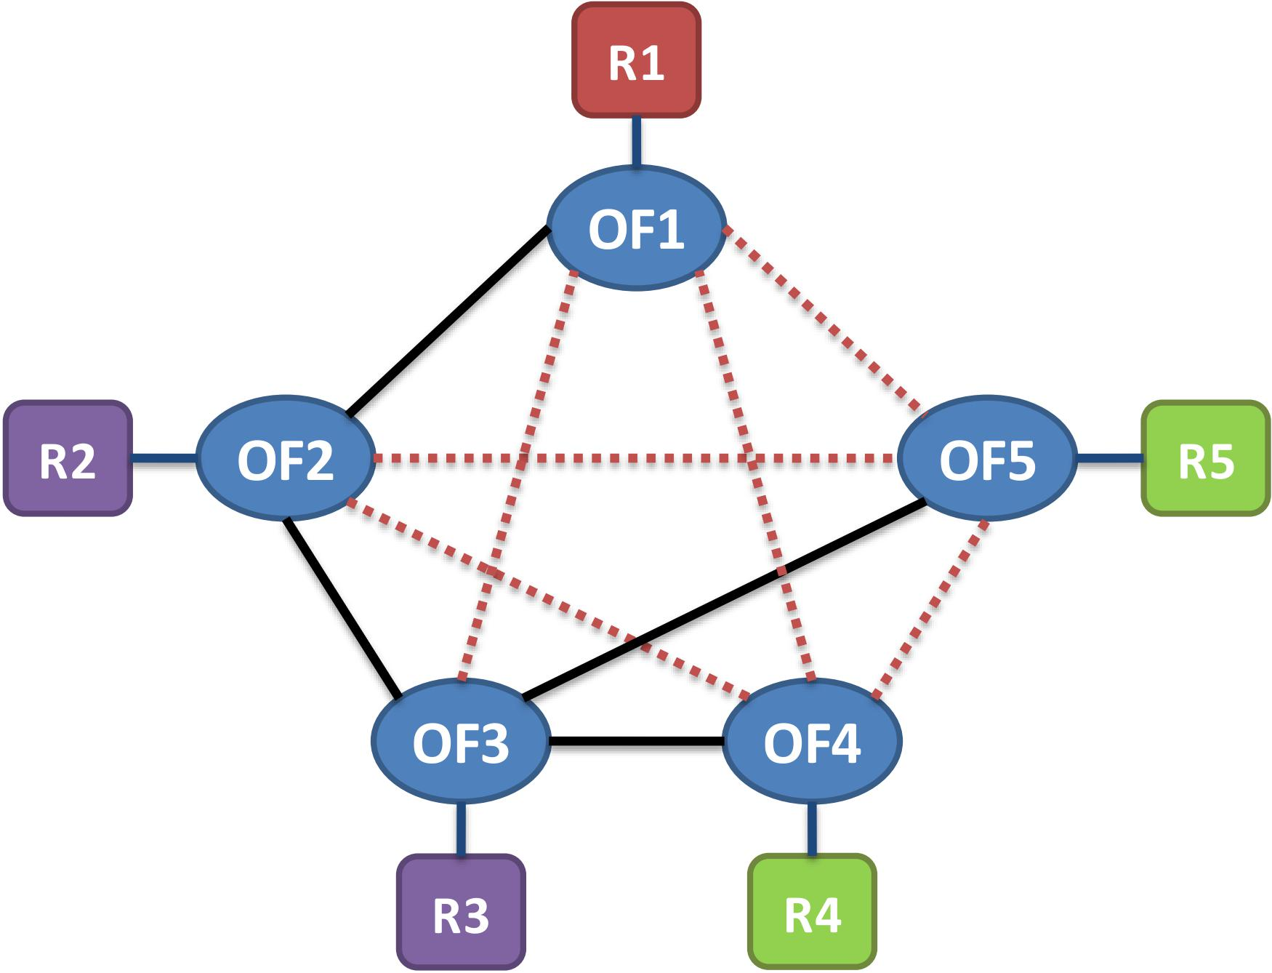
RAFT MEETS SDN
R1
R1
R2
R5
R3
R4
No Leader Exists.
Condition. Some servers have a quorum, but they have obsolete logs, and servers having up-to-date logs, do not have a quorum.

Slide 10
POSSIBLE SOLUTIONS
Solution Expectation
  all-to-all connectivity among cluster members as long as the network is not partitioned.
Gossiping (overlay network)
  Pros: easy to implement
  Cons: no guarantee to work in all scenarios; heavy overhead
Routing via Preorders
  Pros: built-in resiliency in control plane; no modification to consensus algorithm
  Cons: requires path calculation ahead of time

Slide 11

Routing via Preorder: Failure Handling
Failure Handling Process:
  Upon failures, use alternative outgoing links if exist
  Group table is used for implementing all possible alternative paths
C
B
E
s = A
d = G
F
D
proved
It guarantees a network where two nodes are always reachable as long as there is no partition.

Slide 12
PRELIMINARY RESULTS
Experiment Setup
Raft Implementation: Raft C++ implementation in LogCabin
Six Docker containers: 5 servers and 1 client
Five Software switches: Open vSwitch
Simulating the two failure scenarios:
  Oscillating Leadership
  No Existing Leader

Slide 13
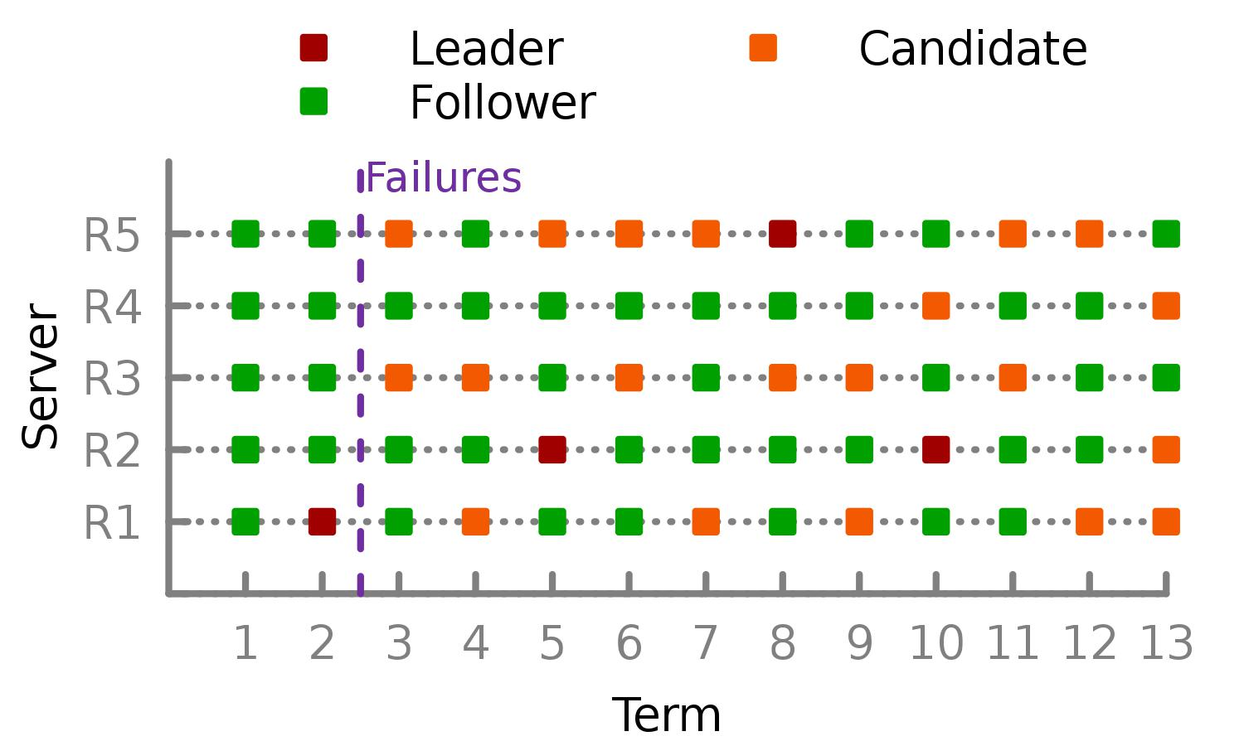
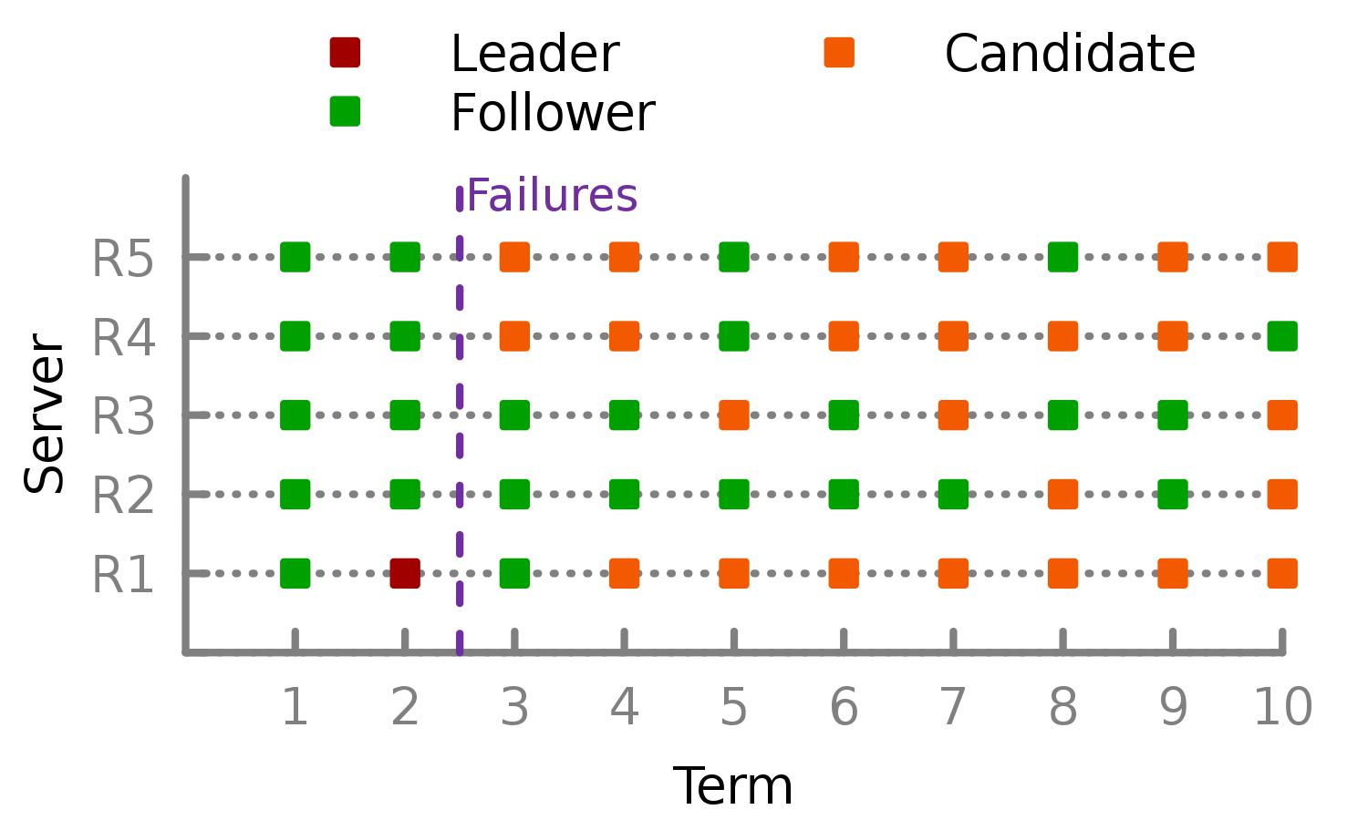
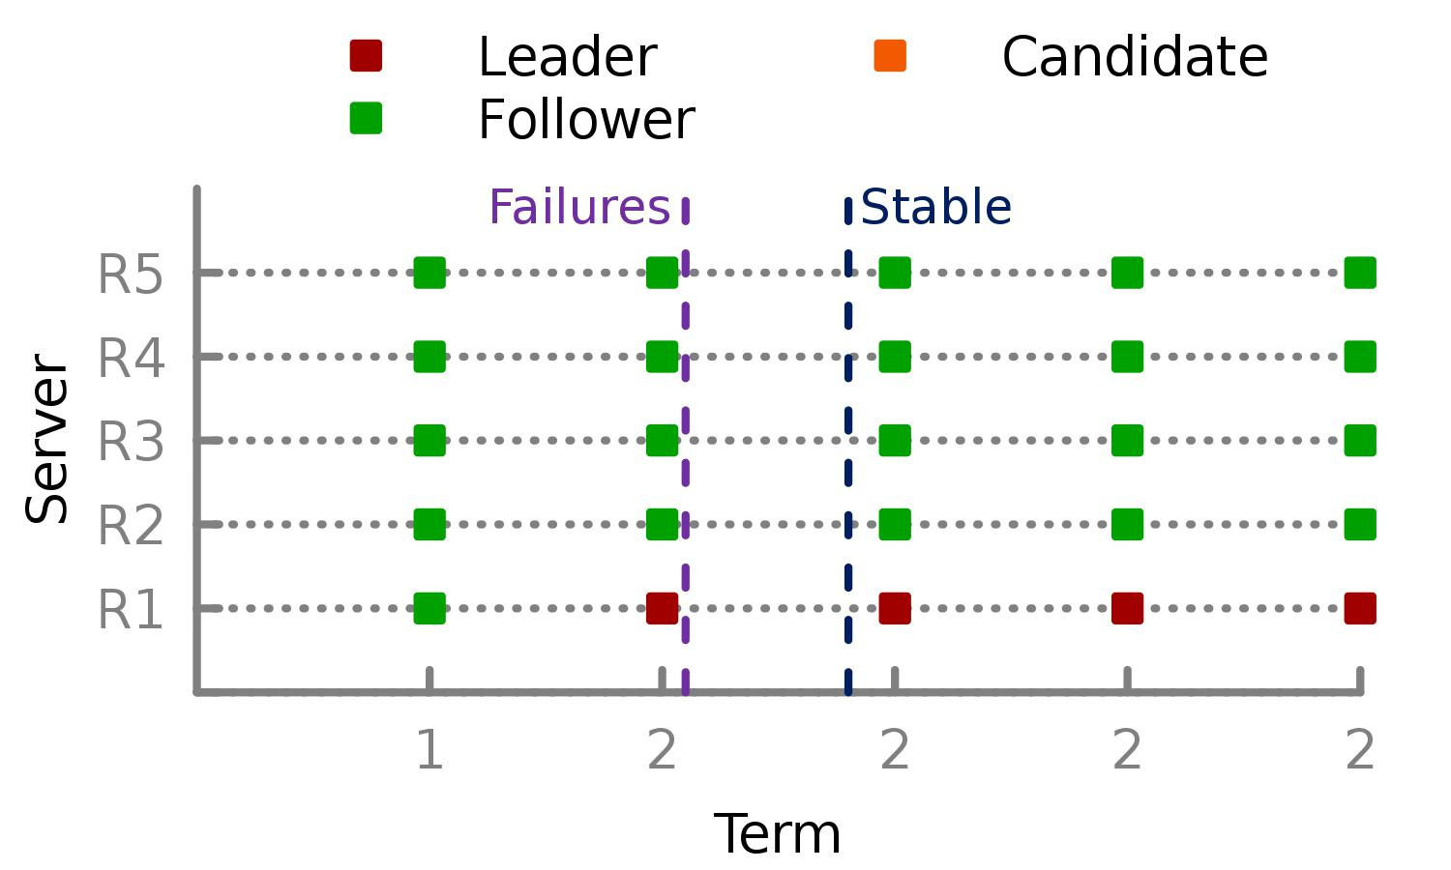
PRELIMINARY RESULTS
Raft: leadership keeps oscillating among servers (unstable).
Raft: no viable leader (liveness lost).
PrOG: leadership is stable.
Vanilla Raft is not stable under failure scenarios, while PrOG-assisted Raft is stable.

Slide 14
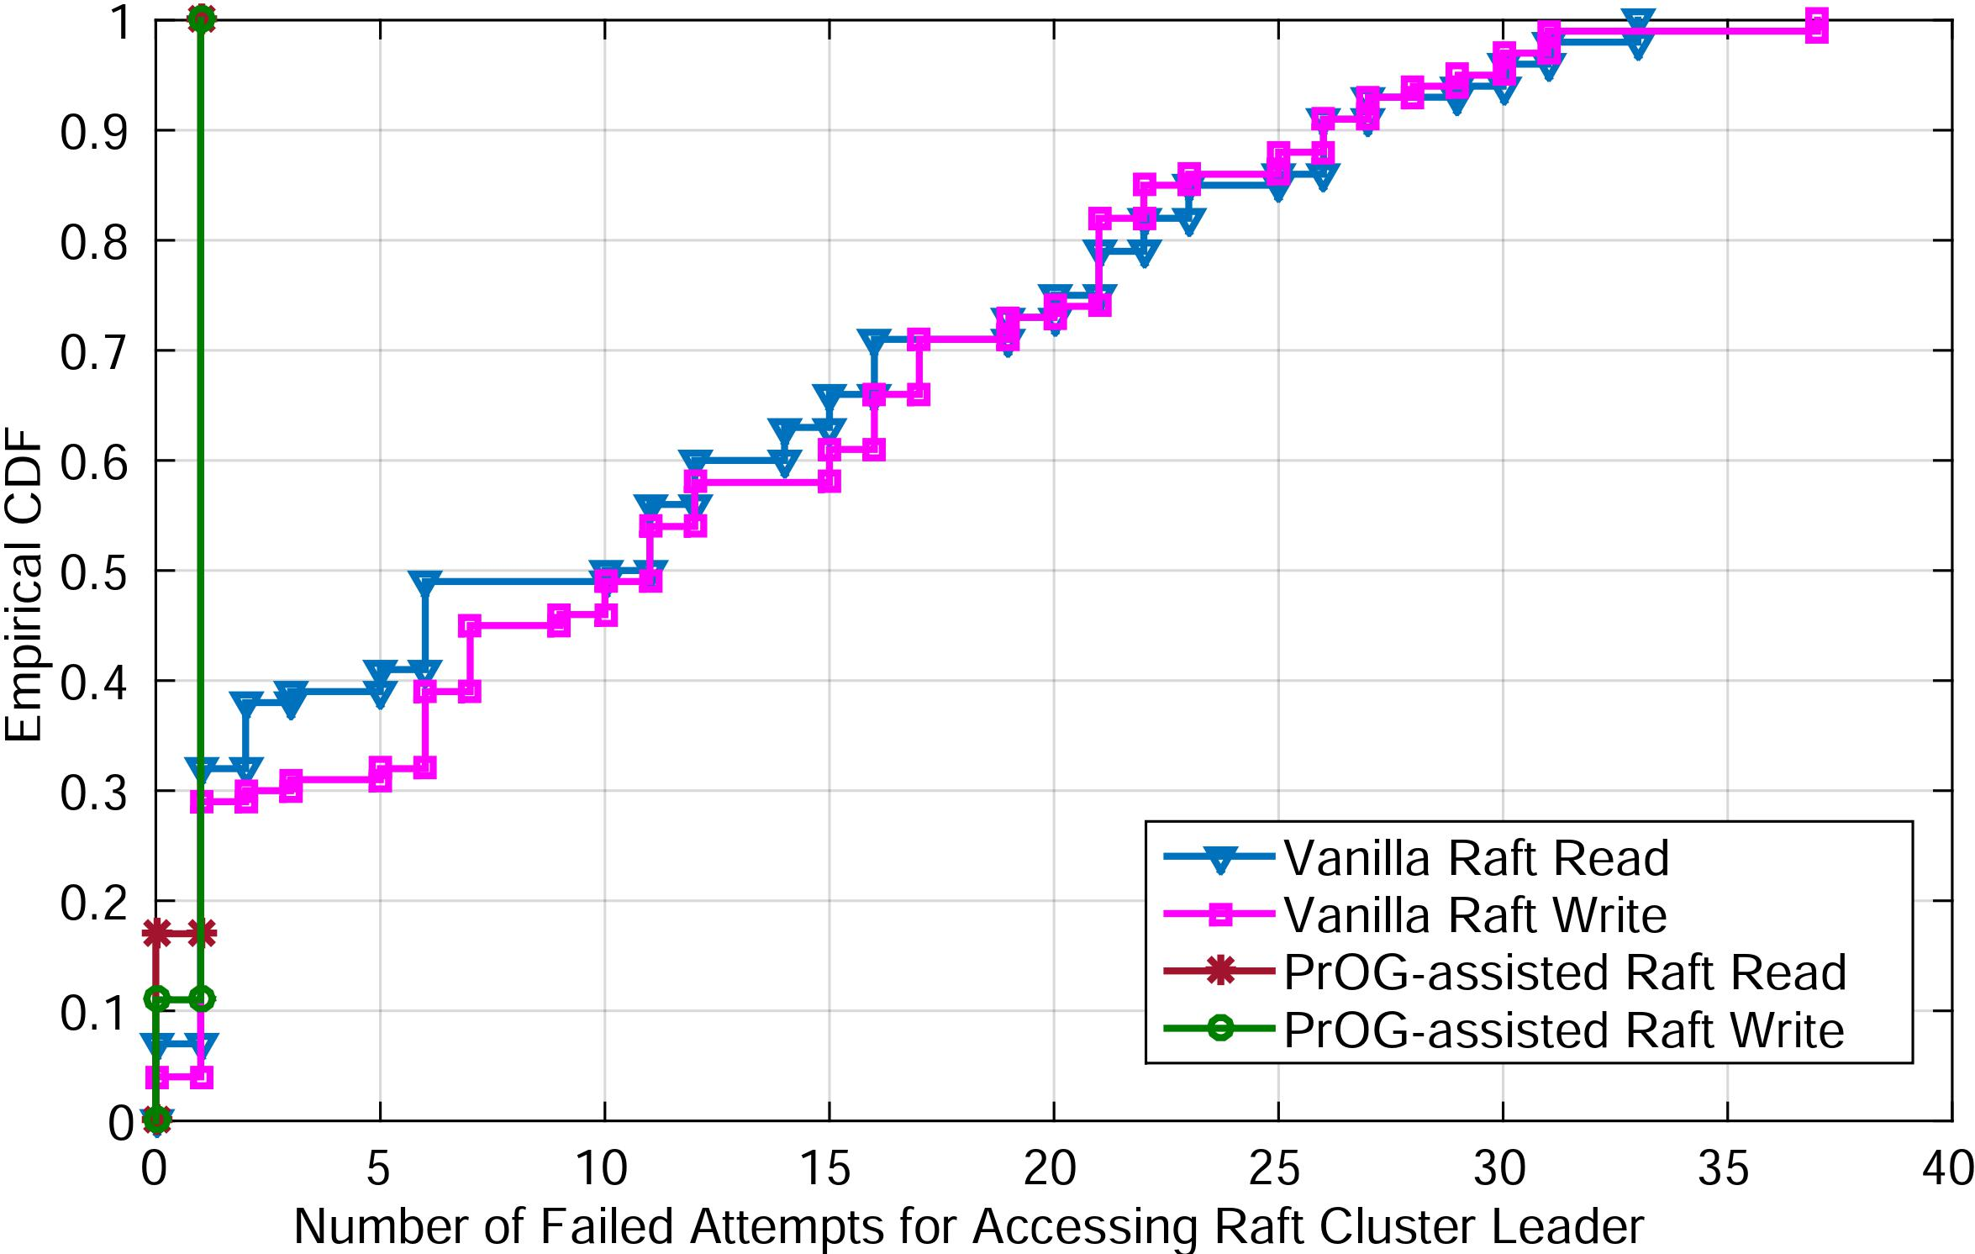
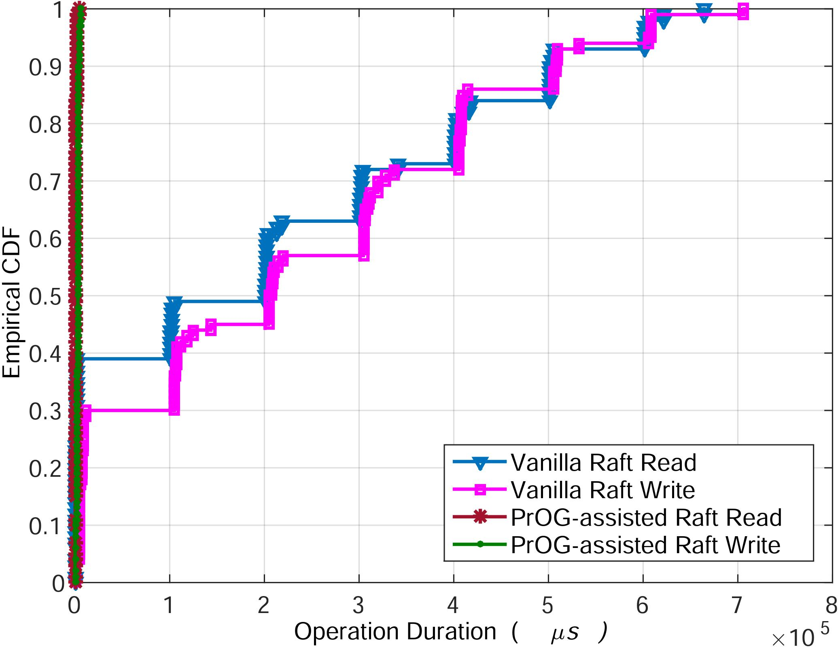
PRELIMINARY RESULTS
Client suffers much more failed attempts for accessing cluster leader in vanilla Raft.
Latency of a request operation increases under failure scenarios

Slide 15
Summary
SDN controller liveness depends on all-to-all message delivery between cluster servers
Raft is used to illustrate the problem induced by interdependency in the design of SDN distributed control plane
Possible solutions are discussed to circumvent interdependency issues.
Preliminary results show the effectiveness of PrOG in improving the availability of leadership in Raft used by critical applications like ONOS.

